Slide 1
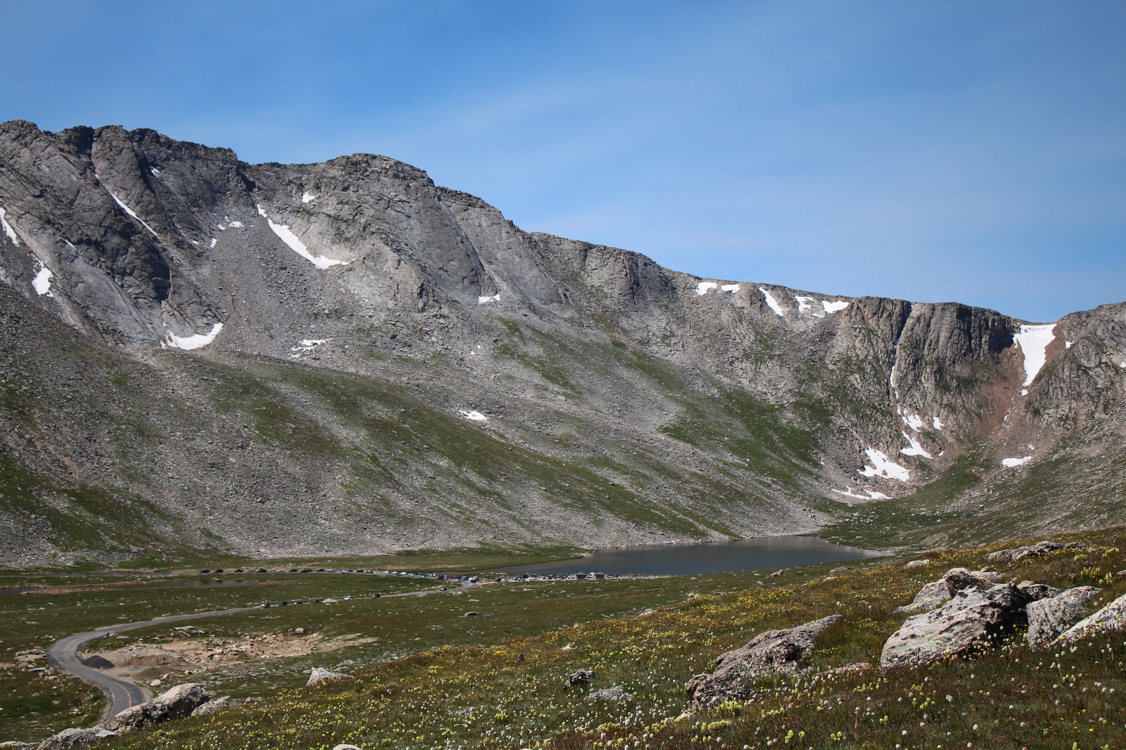
Russell N Clayshulte RNC Consulting LLC Manager Bear Creek Watershed Association Colorado
National Adaptation Forum – Action Today for a Better Tomorrow
Community and Regional Approaches to Climate Resilience for the Water and Wastewater Sector
Mt. Evans Colorado 14,271 feet

Slide 2
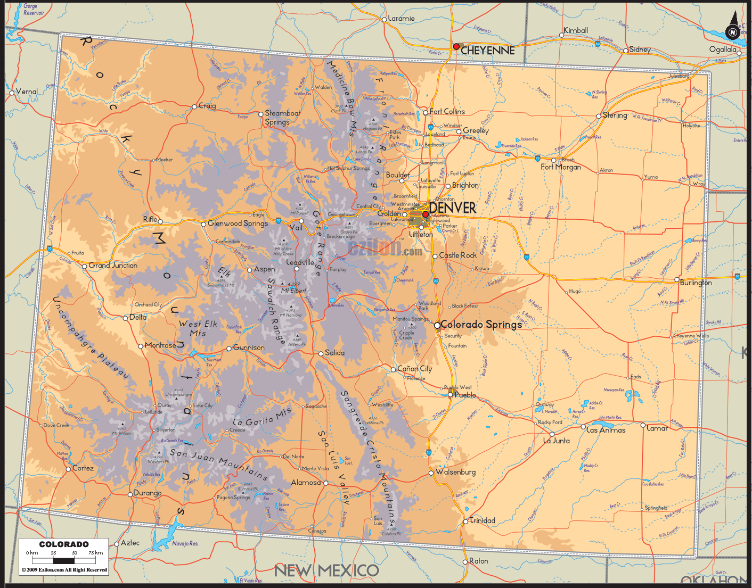
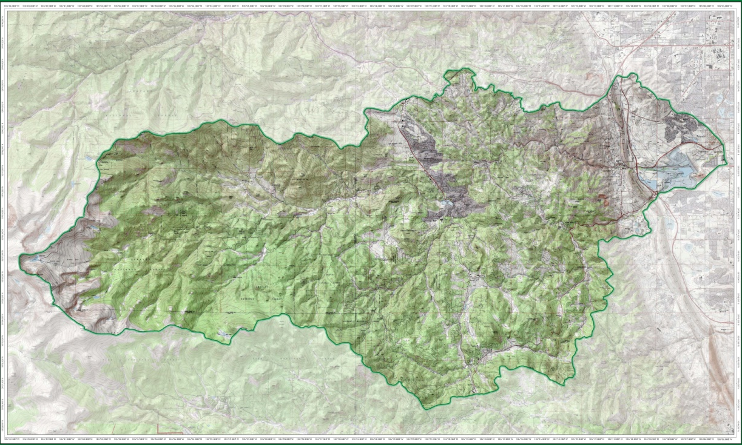
Bear Creek Watershed, just west of Denver, is a specific geographic area listed in the Bear Creek Watershed Colorado State Control Regulation (Regulation #74, 5 CCR 1002-74).
Watershed extends from Mount Evans Wilderness past Town of Morrison (9,500 feet of drop).
Major tributaries - Bear Creek & Turkey Creek.

Slide 3
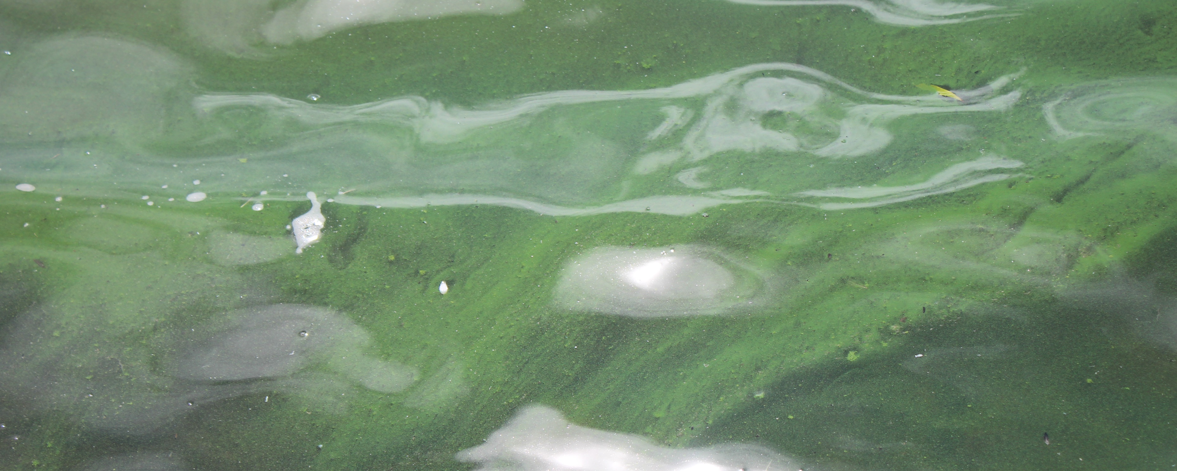
Bear Creek Watershed Association oversees implementation of State Control Regulation
Local water quality management agency
State standards & classified uses of water
Potential degradation of water quality
(3) Counties, (2) local general-purpose governments, (16) special districts (water & wastewater), associate agencies & citizen groups
Manage point sources & track nonpoint source practices & programs
Watershed level
Watershed loadings
Electronic watershed plan www.bearcreekwatershed.org

Slide 4
Peak Spring Runoff over last 30-years has shifted 2-3 weeks earlier
Peak Spring Runoff much quicker
Winter shoulder temperature period for upper cold streams shift 1-month earlier (March)
Drier fall season

Slide 5
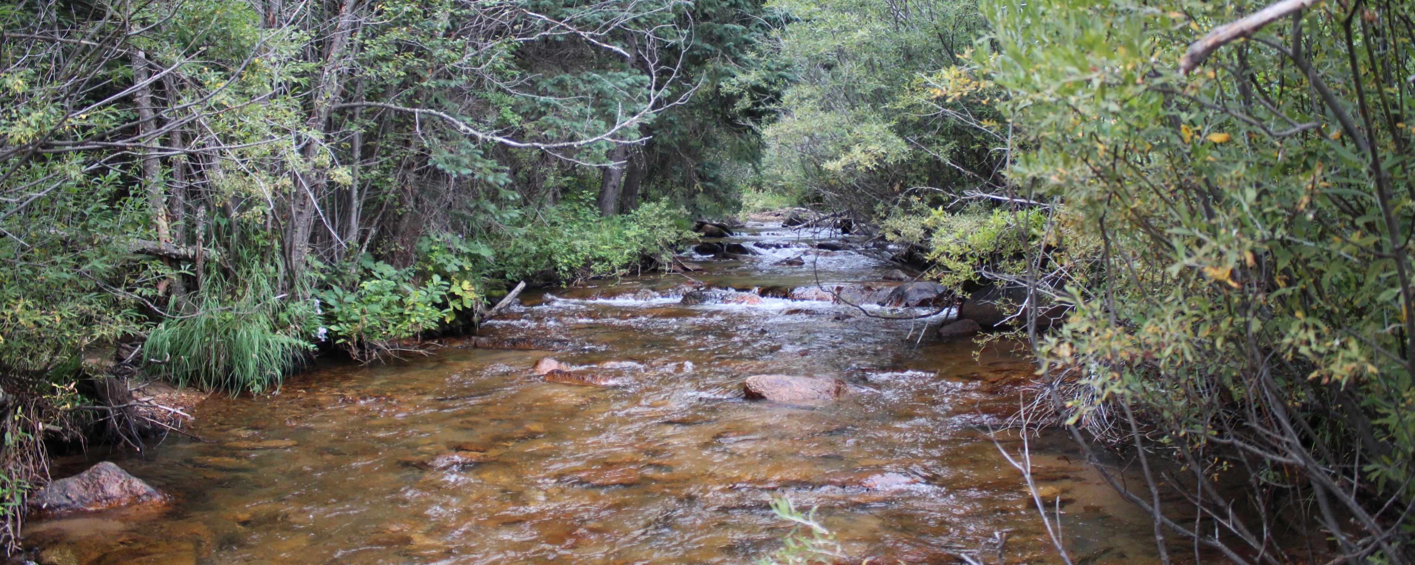
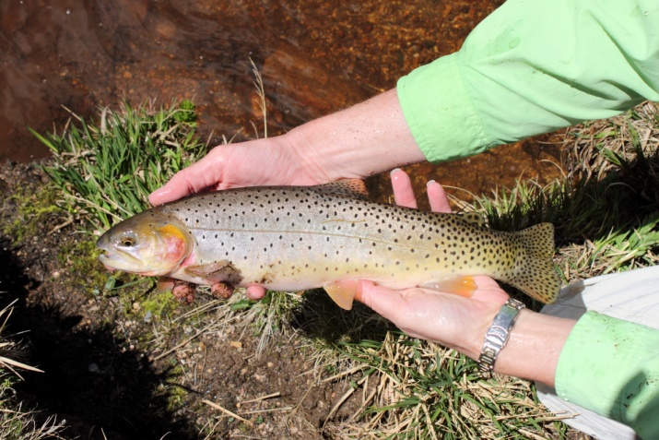
Water Temperature Problem
2002 Colorado 303(d) Listing
Reactive adaptive management program
Have continuous collection of surface quality data 1990-2017
Need defensible data
Experience weather extremes
Extreme drought (300 Yr. Event)
Temperature records
2013 Extreme flood
Collect temperature data
Record water temperatures rises
Site specific stream standards
Expand temperature monitoring >4.8 million data points
Entire watershed
Adopt policies & strategies
Stream health
Fishery surveys
Bug surveys

Slide 6
BCWA adds to the Climate Shield & NorWeST Temperature Data Sets
By 2080 Brook Trout in Upper Bear Creek almost extinct

Slide 7
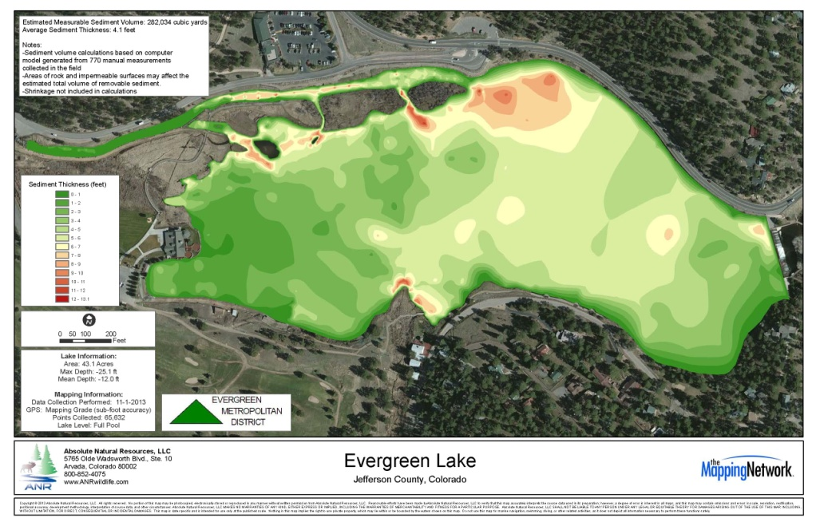
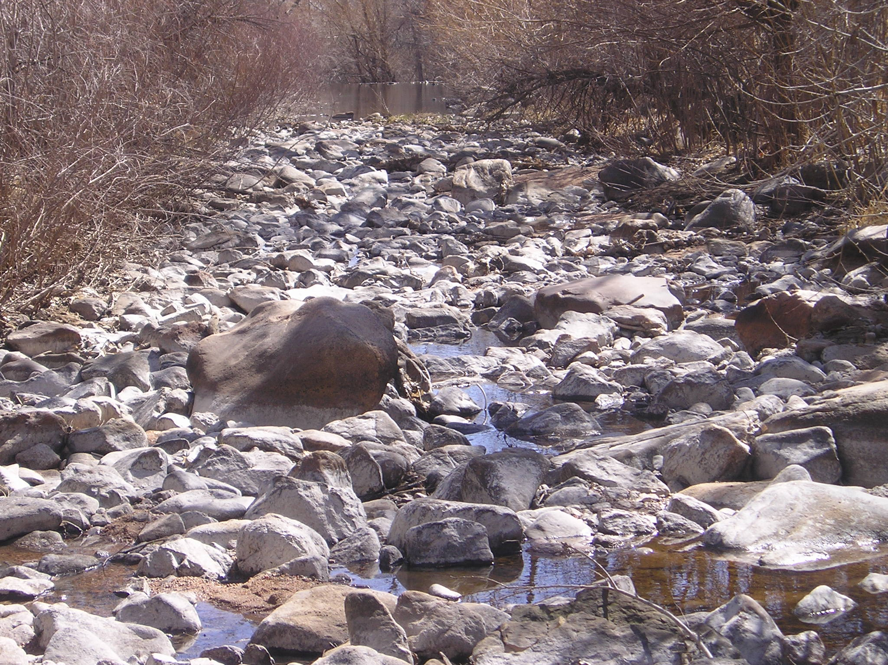
Climate Change Risk Assessment - CREAT Need a long-Range Plan Upper Bear Creek Watershed
Evergreen Metropolitan District provides drinking water & wastewater services to 13,700 customers, Evergreen Lake – water supply
Increasing water quality & quantity issues
Cold-water fisheries at risk (1 to 2°F)
Decreased water supply from drought, water quality issues from wildfires (beetle kill) & subsequent flooding
Regulatory & treatment challenges
Build on existing modeling & monitoring - understand how climate change threats affect utility operations and watershed health

Slide 8
CLIMATE VARIABLE | Baseline scenario | moderate conditions scenario | hotter and drier conditions scenario
Average Annual Temperature | 46.26°F | 5.18°F increase | 6.12°F increase
Average July Temperature | 67.4°F | 5.75°F increase | 5.88°F increase
Average December Temperature | 29.82°F | 4.39°F increase | 5.96°F increase
Hot Days over 90°F | 2.3 days | >10 days | >20 days
Total Annual Precipitation | 19.27 inches | 3.68% increase | 0.88% increase
July Precipitation (rain) | 2.04 inches | 4.69% decrease | 0.93% increase
December Precipitation (rain) | 0.82 inches | 18.04% increase | 5.48% increase
100-Year Storm Event | 2.8 inches 6 hours | 28.59% increase | 28.59% increase

Slide 9
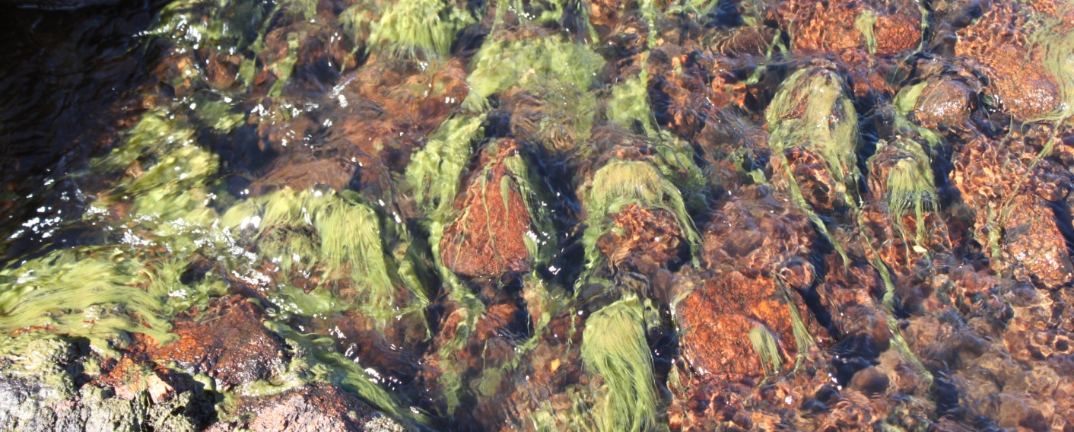
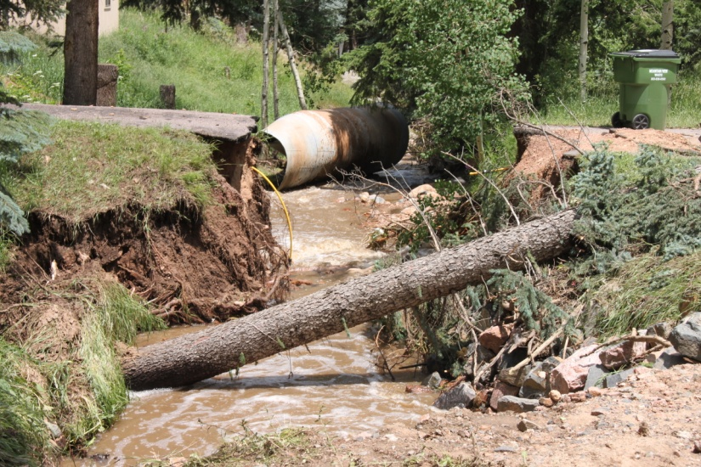
10-year Minimum Proactive Plan – $0.5 to 2.5 million
 | Decision models that incorporate uncertainty
 | Expand BCWA water quality monitoring
 | Promote meadow bioretention facilities
 | Climate awareness for decision makers & watershed members
 | Encourage tree thinning for fire management
 | Develop public communication (Plans)
 | Improve temperature monitoring (air)

Slide 10
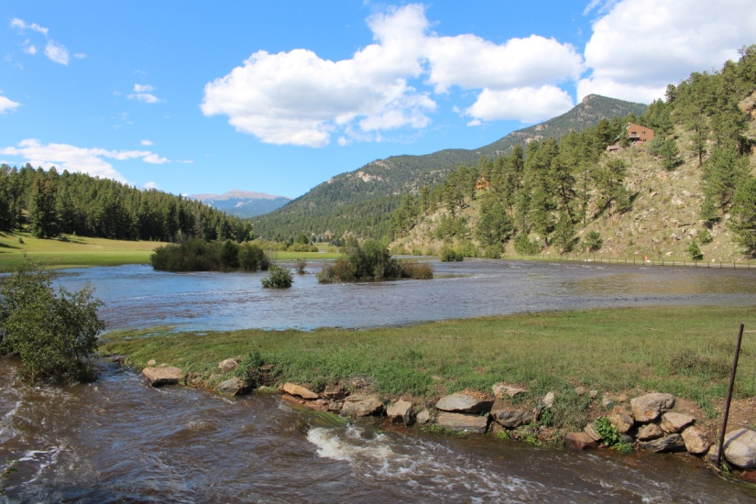
Preferred Plan by 2050 –$ 1.5 -8.5 million
Decision processes that incorporate uncertainty
Expanded BCWA water quality monitoring & modeling
Extensive use of bioretention facilities
Climate training for personnel, decision makers & watershed members
Active fire management
Implement public communication plans
Air & water temperature monitoring/ models
Expand rainwater collection / use – e.g., rain barrels
Active coldwater management of Segment 1A
Storm-related excessive erosion mitigation

Slide 11
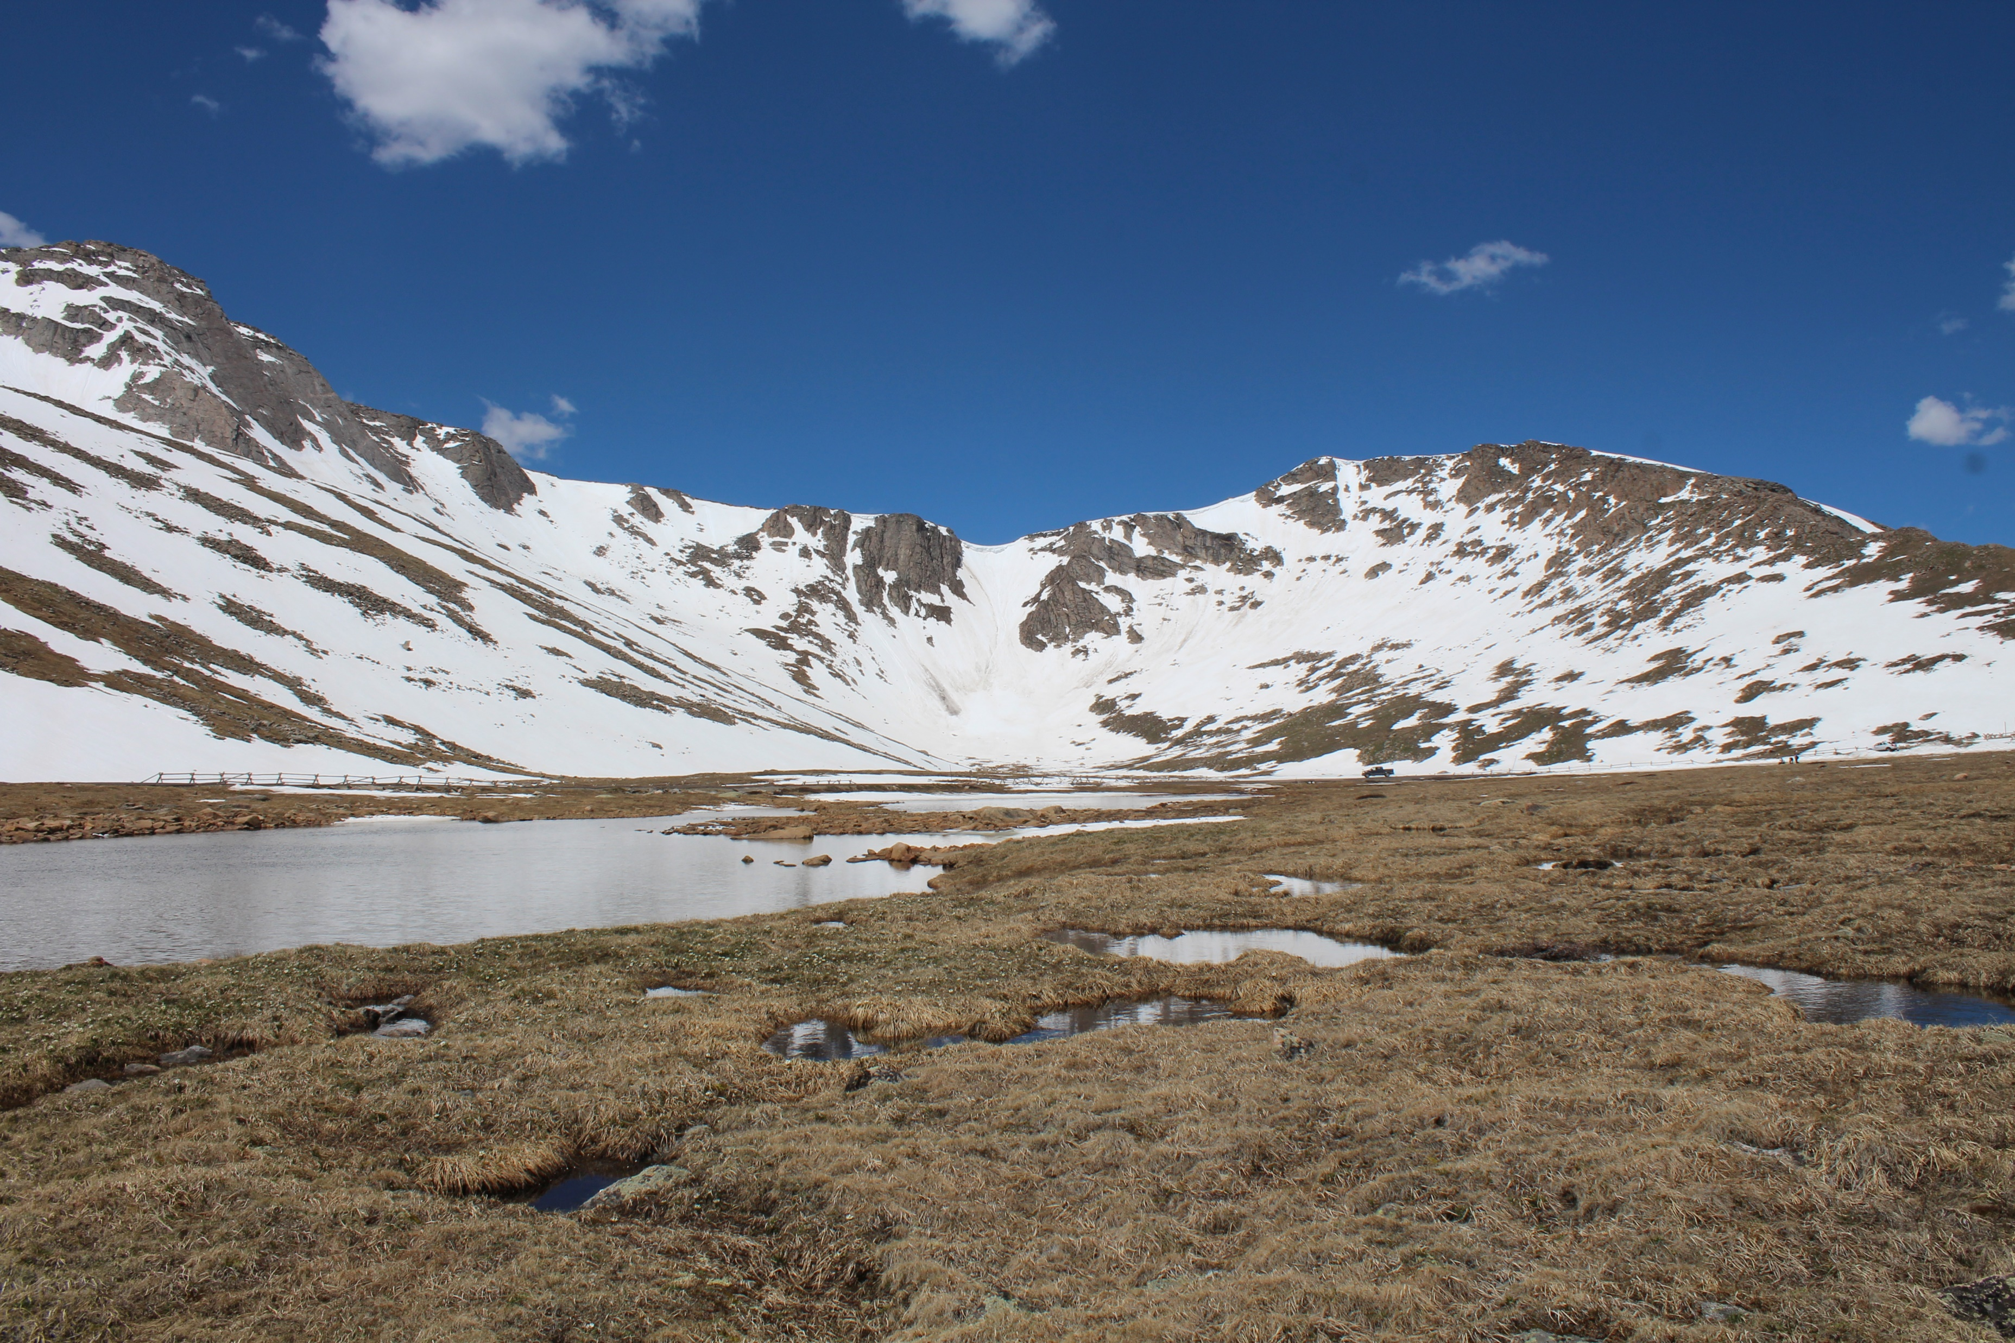
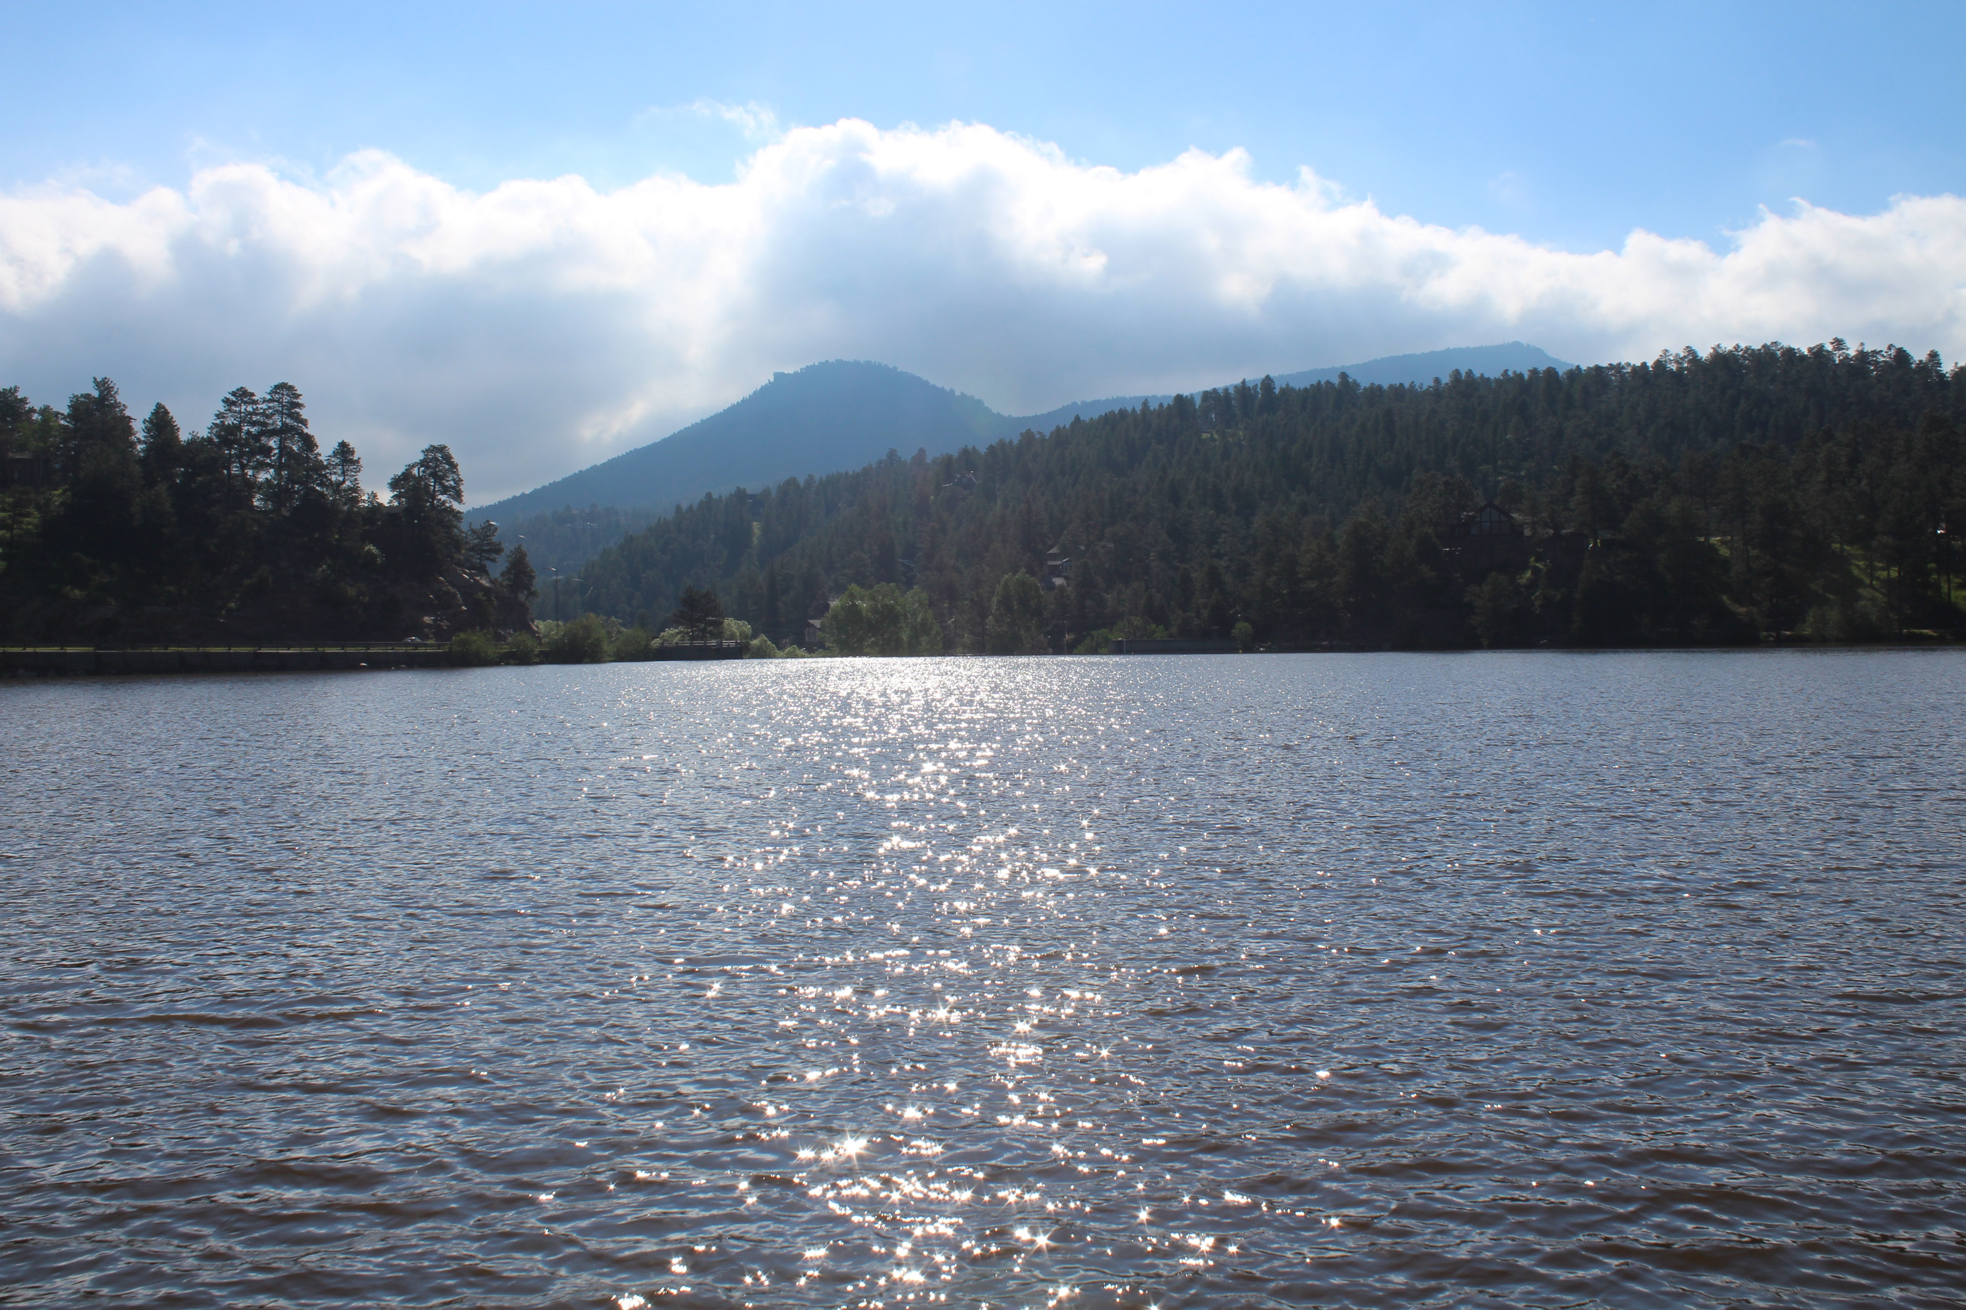
Model Helps Decision Making Under Uncertainty & Politics
Floods: Increased storm frequency with unpredictable high flow events – Lists Issues
Damaged infrastructure or dam safety
Degraded water quality
Drought: More frequent drought, low flow summer conditions – Lists Results
Lower Lake levels can drop water levels below intake infrastructure
Reduce Lake drinking water quality – increase treatment costs
Increasing temperatures more algal growth – decrease quality
Water restrictions
Fire danger and limit lake as a fire supply source
Reduced groundwater levels in alluvial wells – district expansion

Slide 12
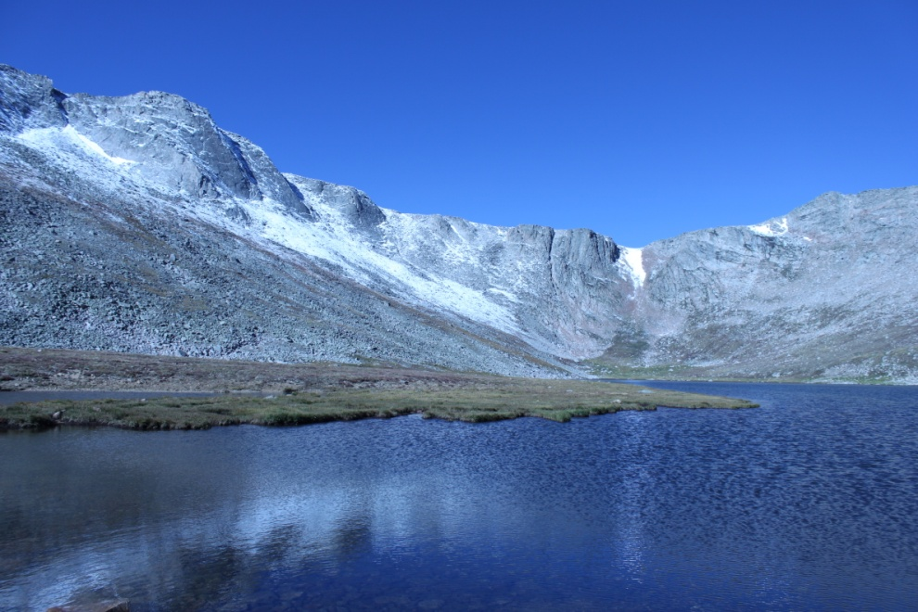
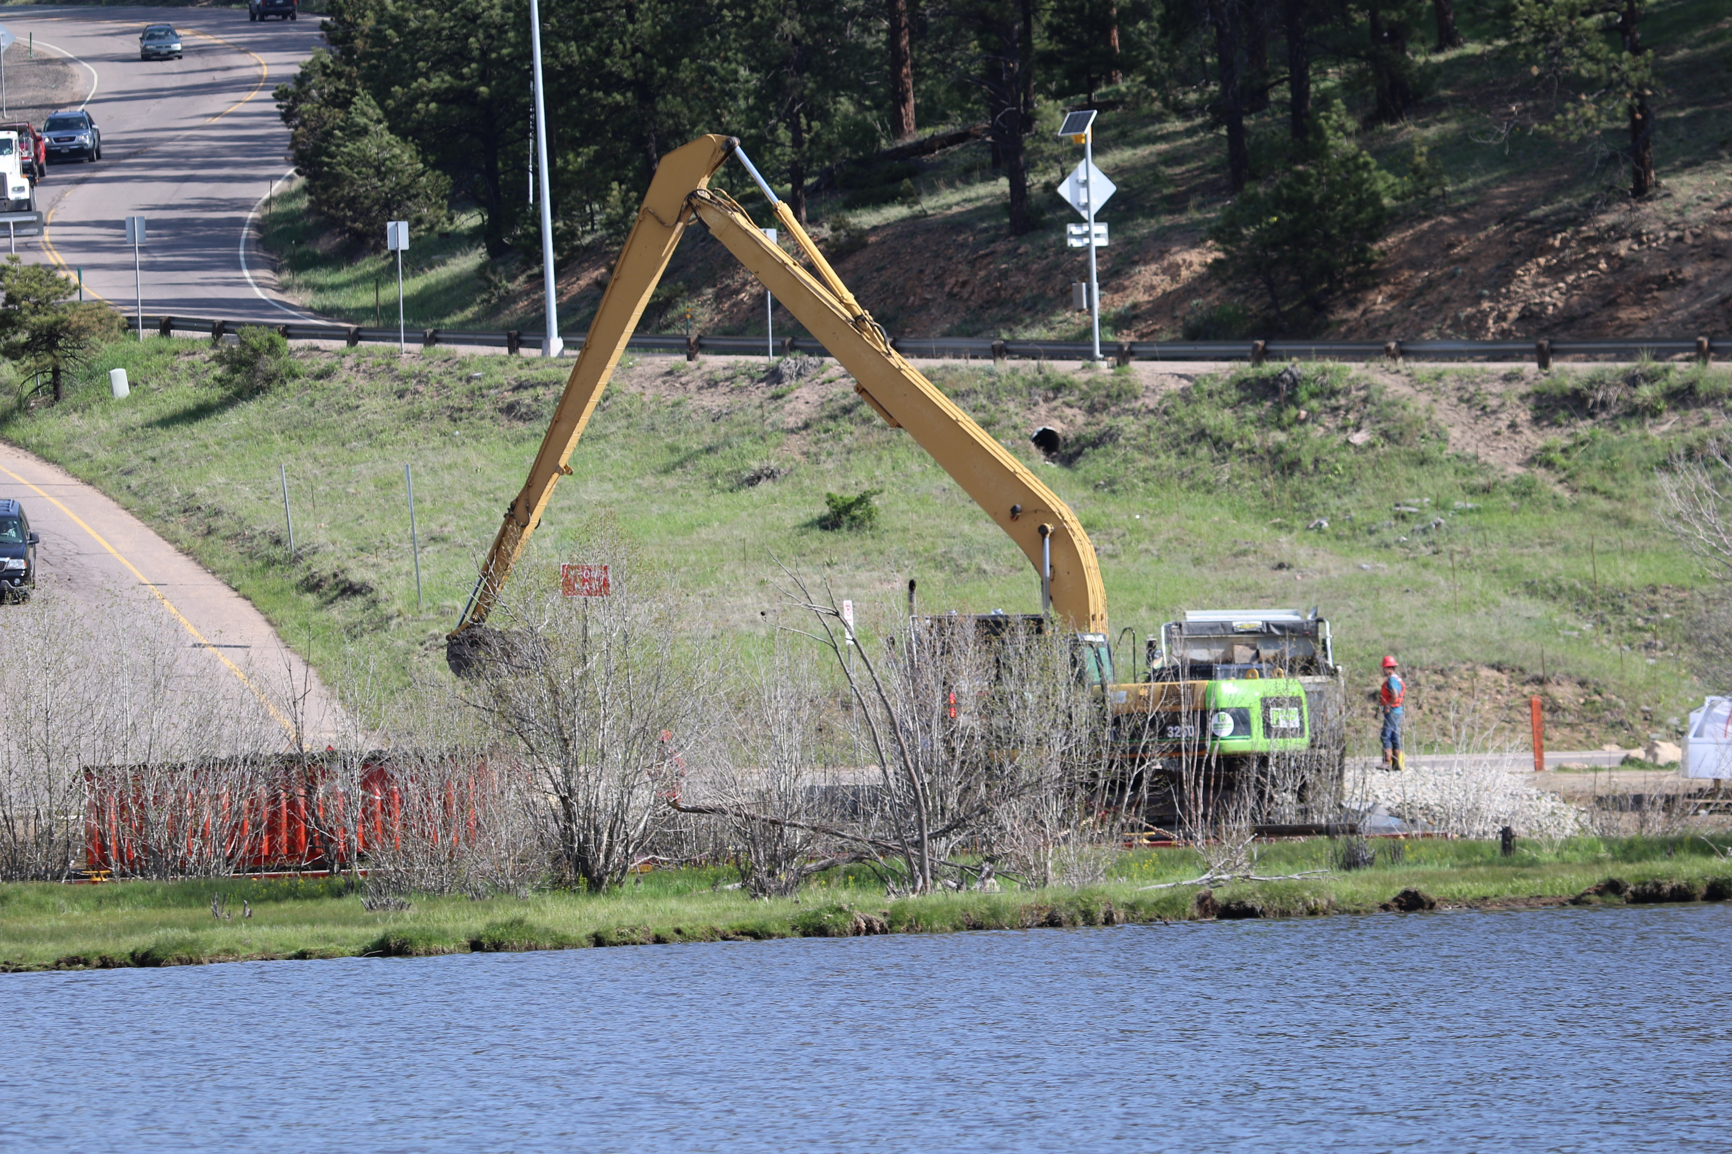
Adaptive Measures
Floods, Water Quality Degradation, Ecosystem Changes, Drought
Evergreen Metro District
Conveyance systems (water & wastewater)
Water source Evergreen Lake
Dam safety
Monitor quality
Increase capacity
Bear Creek Watershed Association
Monitor forest health
Help protect cold water fishery
Regulatory changes
Watershed water quality health
Wastewater effluent limit reductions
Partnerships
Infrastructure in riparian corridor
Alluvial groundwater wells
Watershed/snowpack
Mount Evans Wilderness

Slide 13
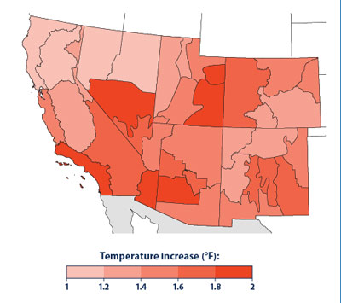
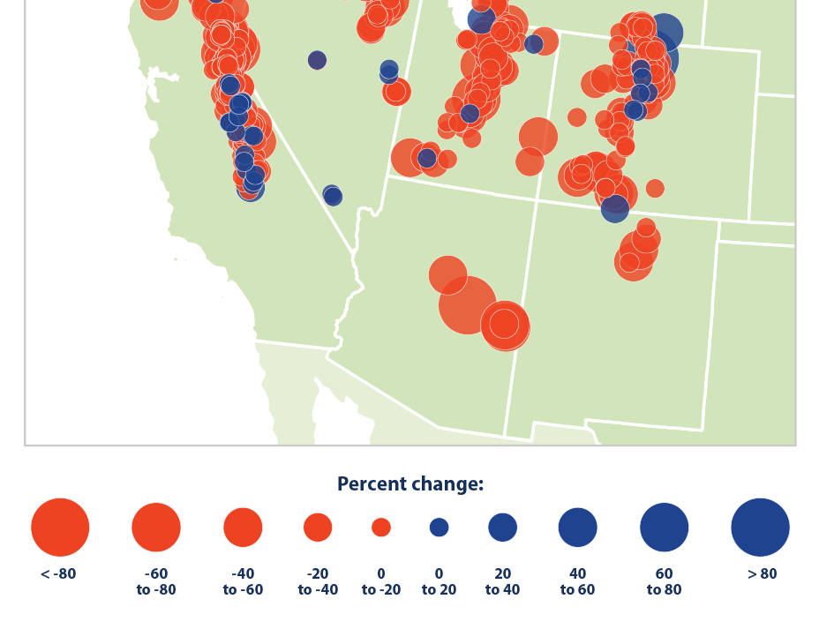
Other Front Range Findings
Joint Front Range Climate Change Vulnerability Study
Front range cities & utilities
Average annual temperature increases 1-6 ͦ F by 2040; 2-10 ͦF by 2070
Moisture -18% to + 28% by 2040
Change in runoff timing; more rain less snowpack
Spatial variability and uncertainty
Denver Climate Adaptation Plan
Statewide temperature increases
Earlier mountain snowpack runoff resulting in lower summer stream flows (South Platte)
More extreme weather events – floods & drought

Slide 14
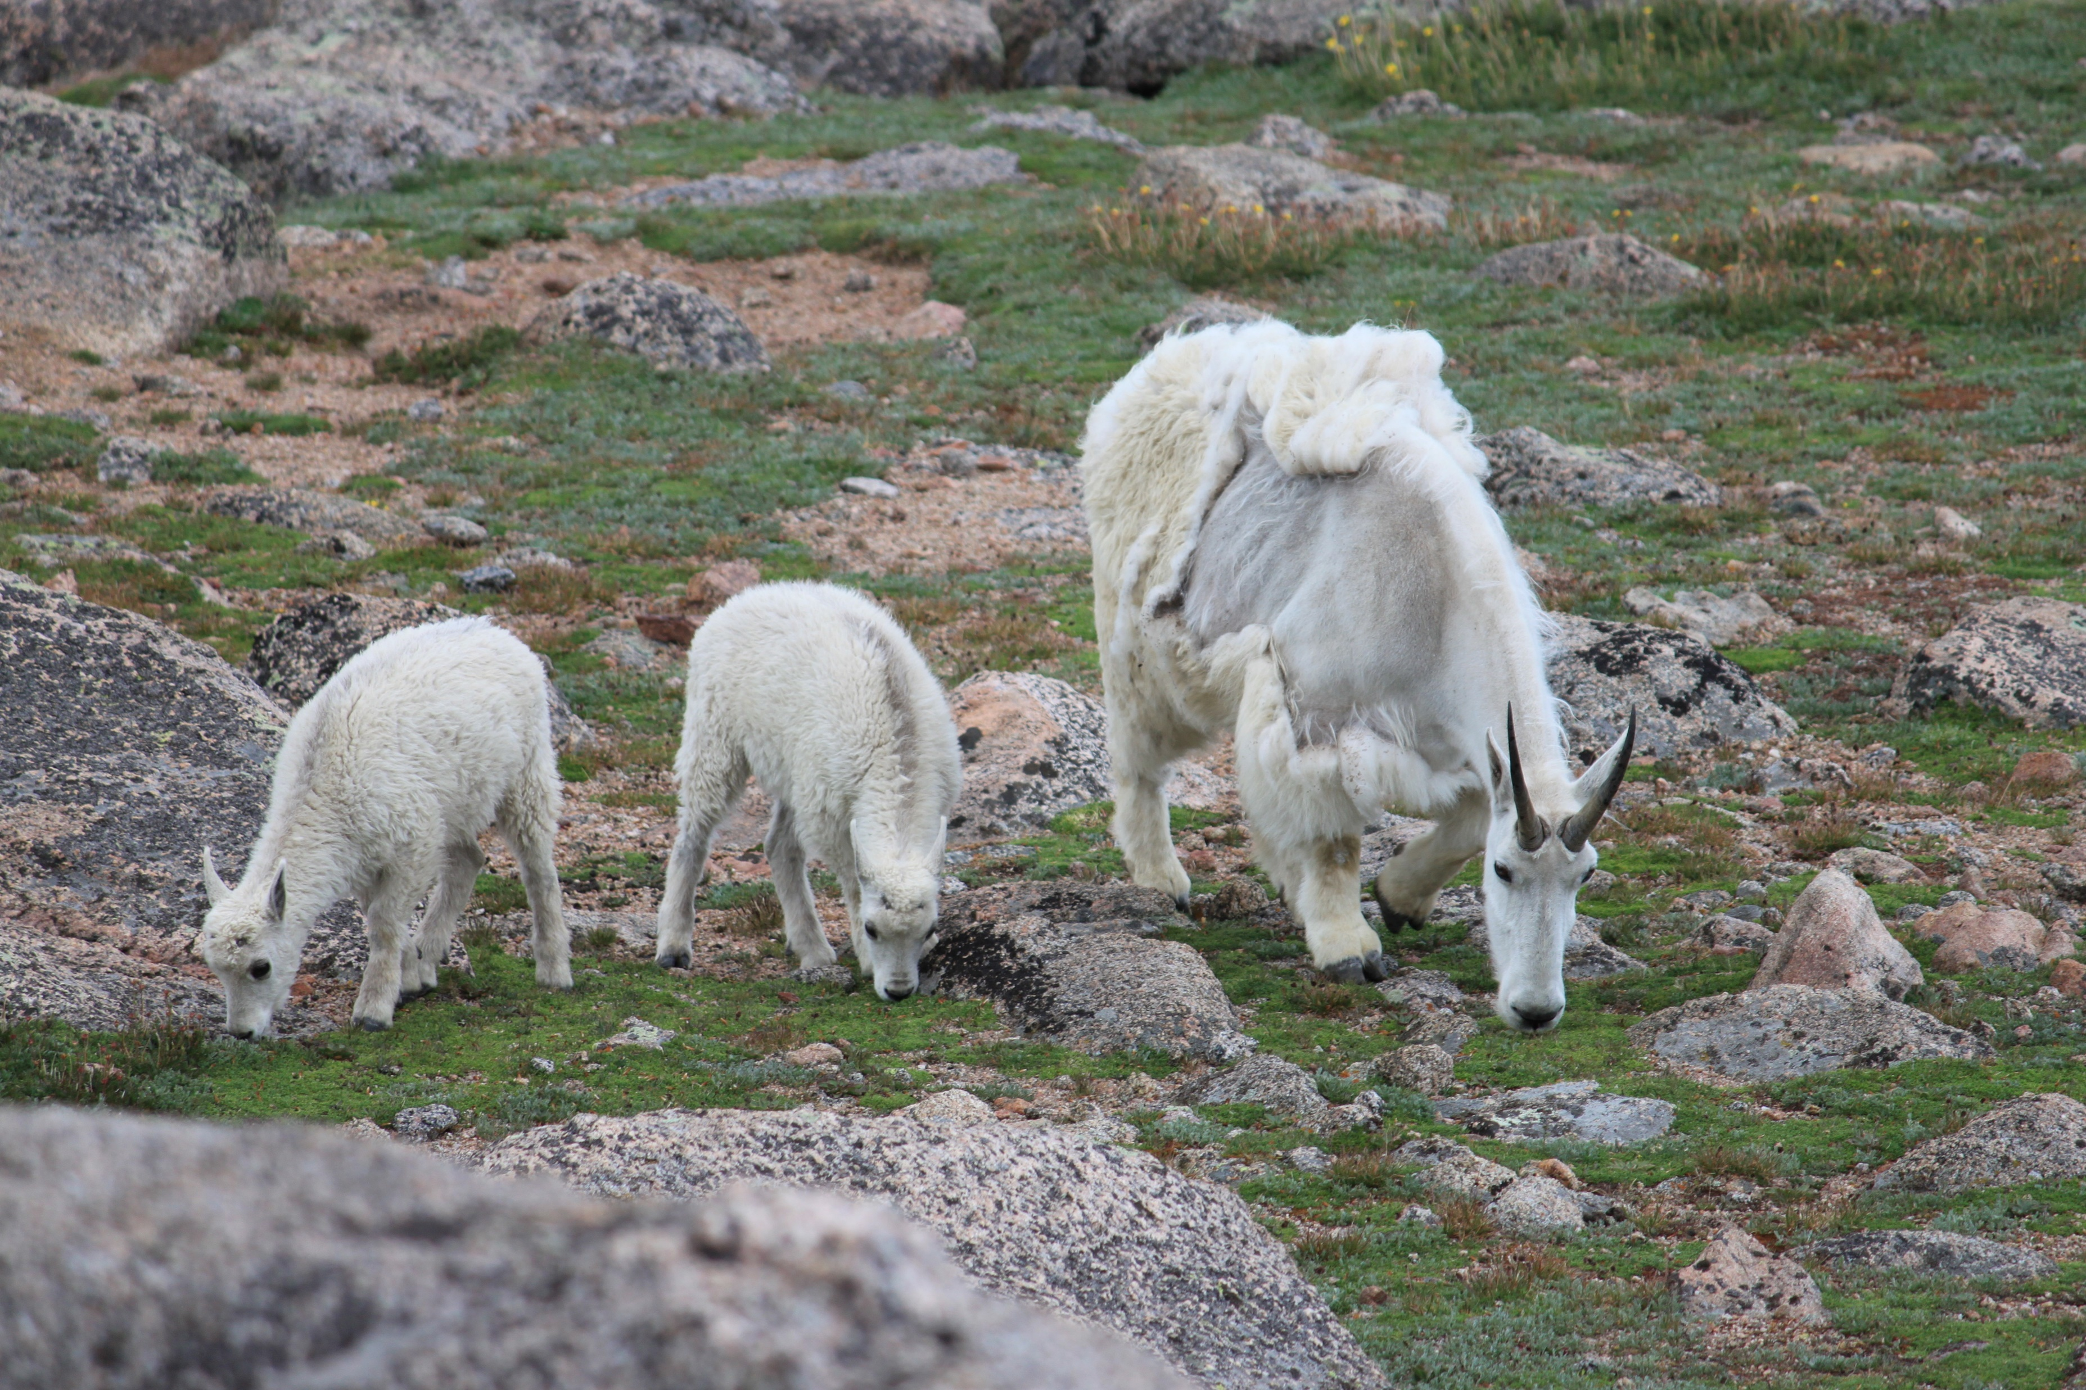
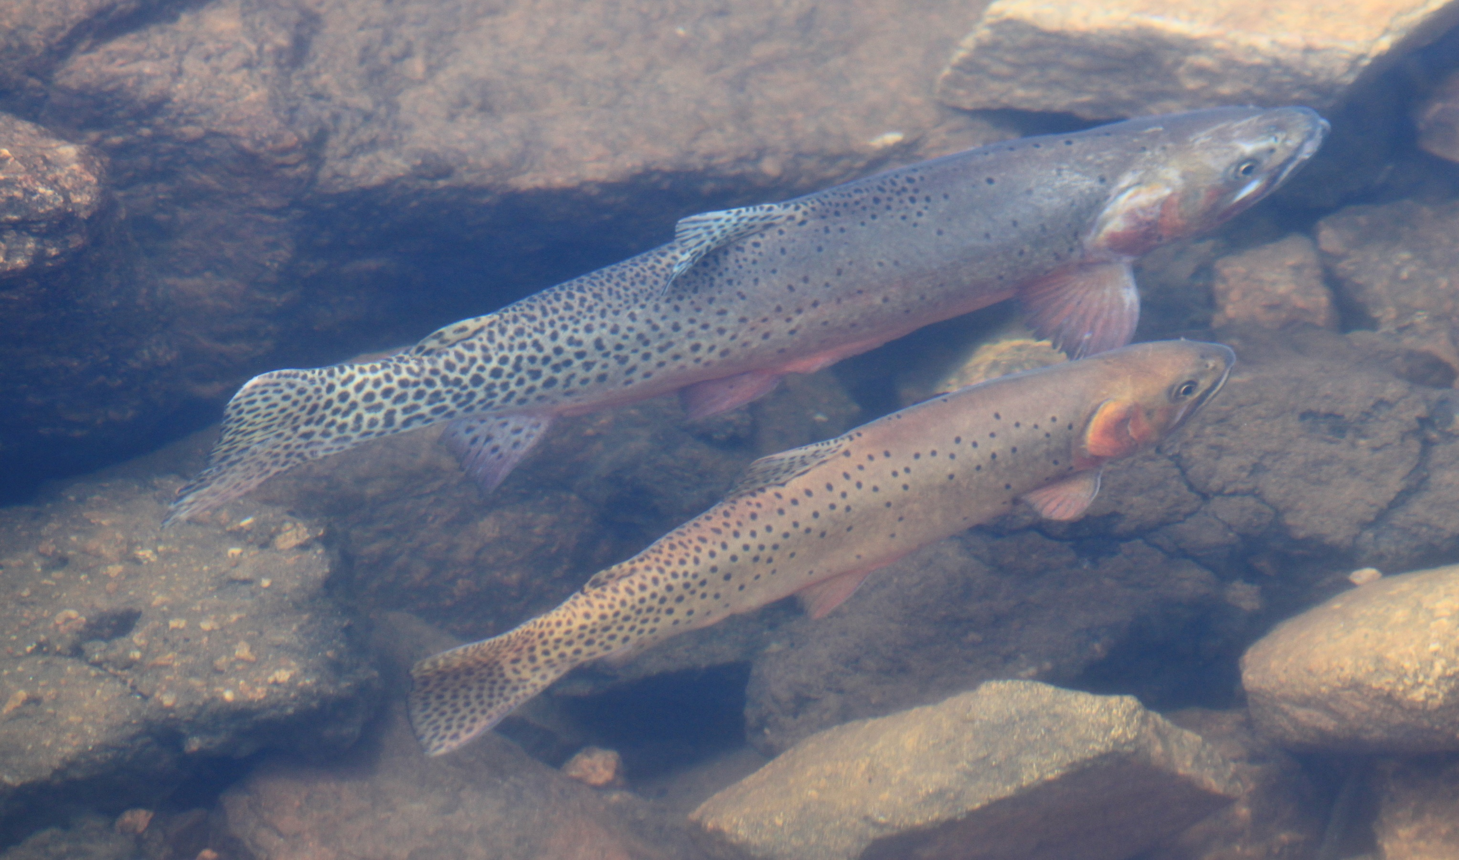
Understanding climate behavior is based on data, lots of measurements & observations
If you don’t like the numbers, then just hide them?

