Slide 1

The Bear Creek Watershed Association protects & restores water & environmental quality within the Bear Creek Watershed from the effects of land use.

Slide 2
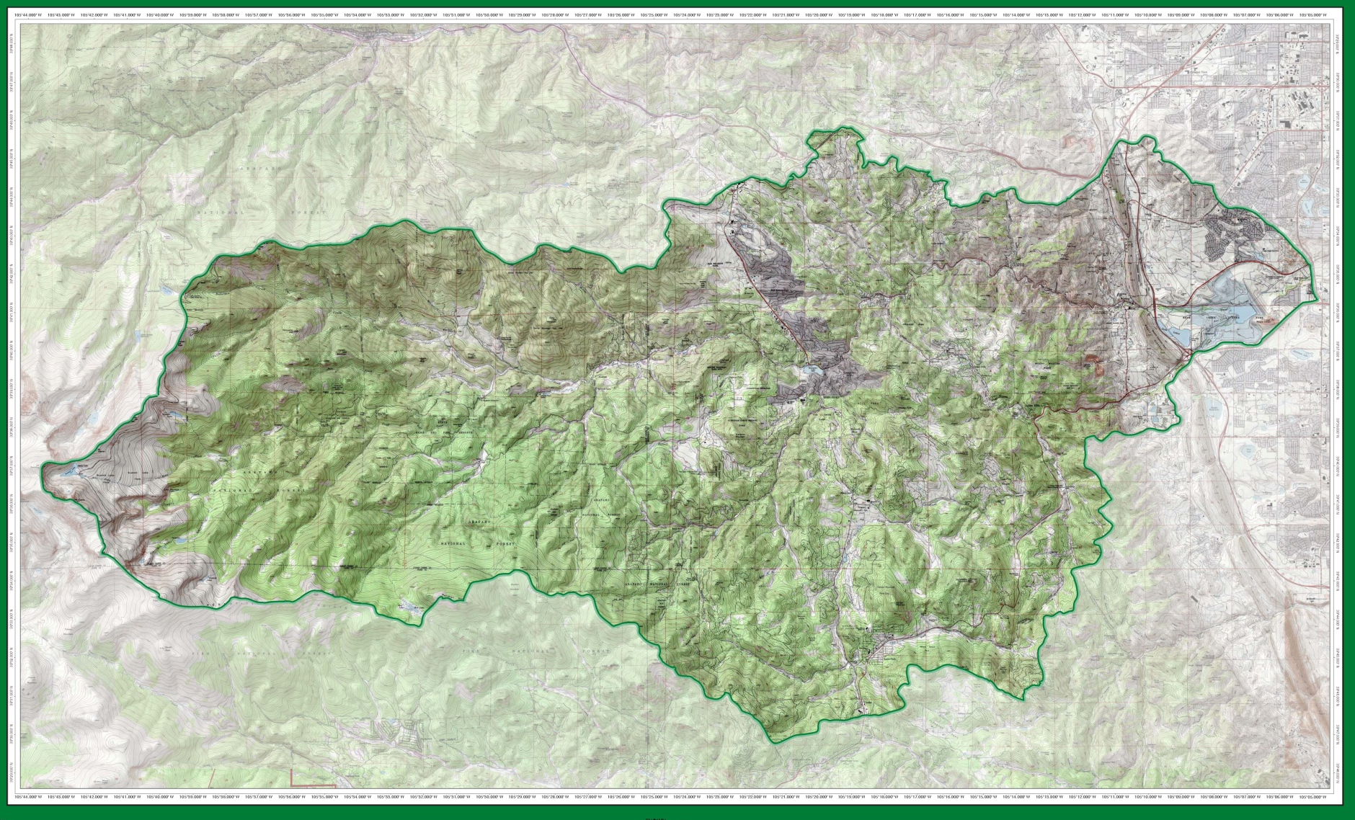
Operational Bear Creek Watershed 2017

Slide 3
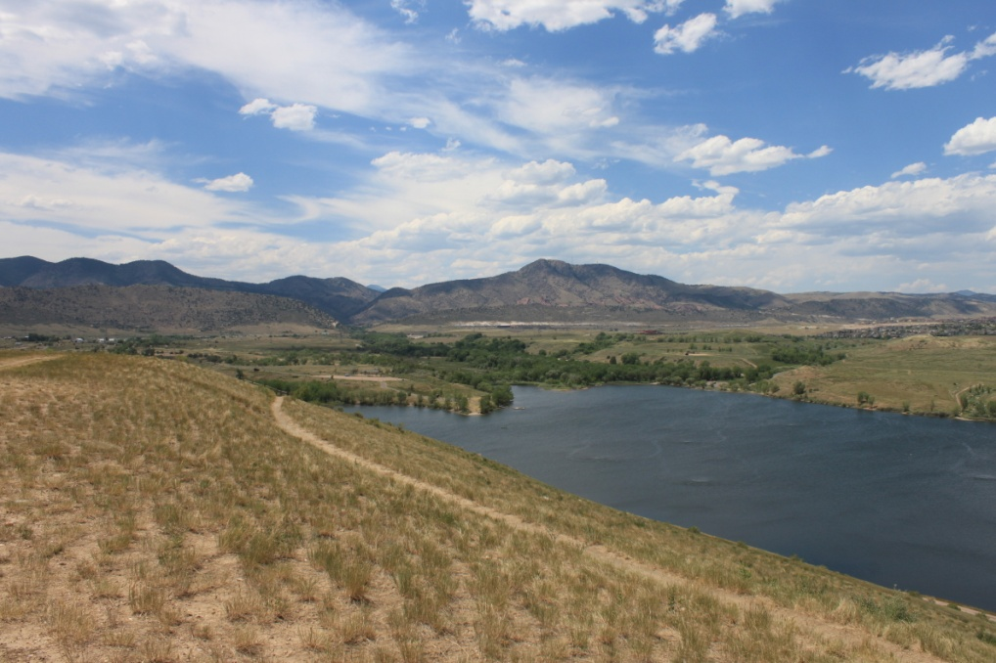
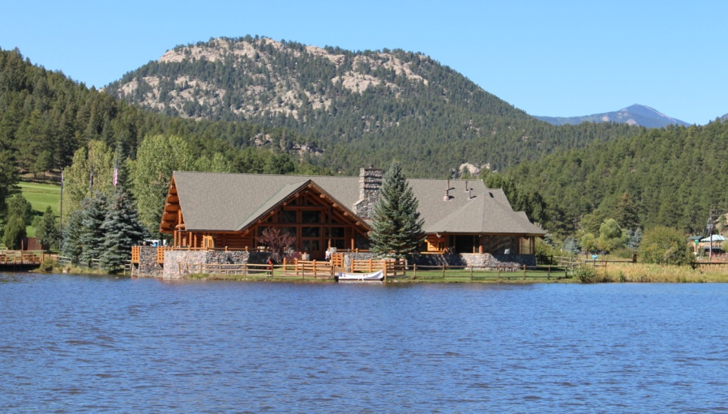
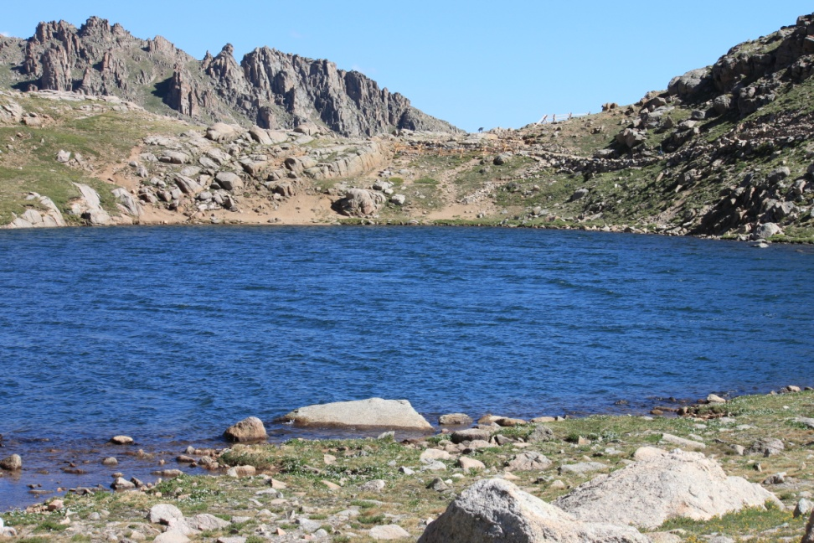
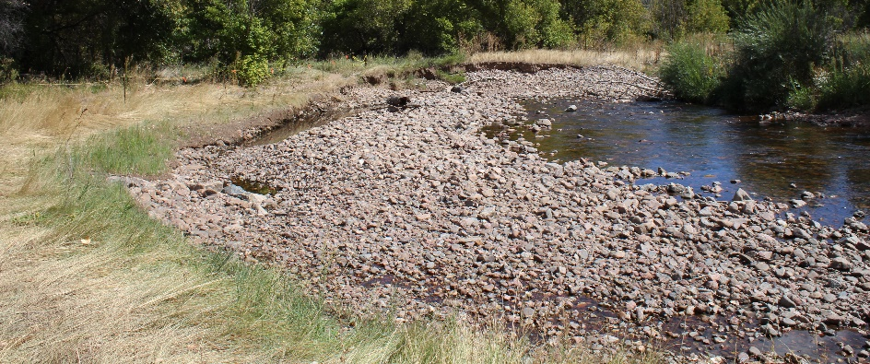
100 Stream Monitoring Sites
Bear Creek Reservoir
  Inflow Turkey Creek
  Inflow Bear Creek
  Outflow Site 45
  Site 90 input Barr/Milton
Evergreen Lake
Summit Lake (Mt Evans)
Other WQ Features

Slide 4
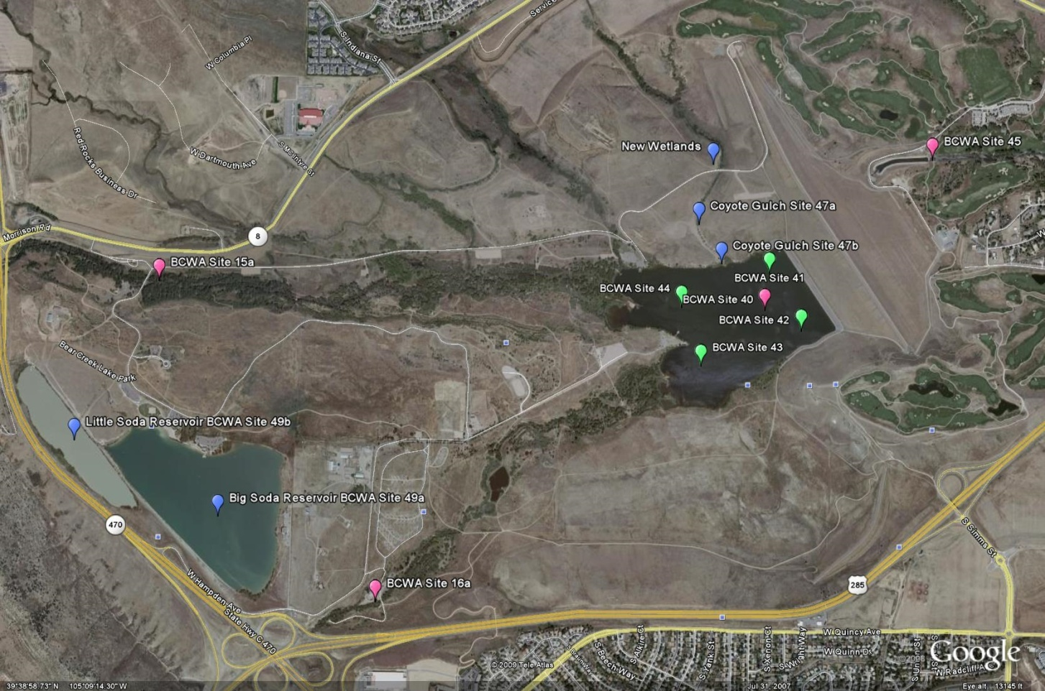

Slide 5
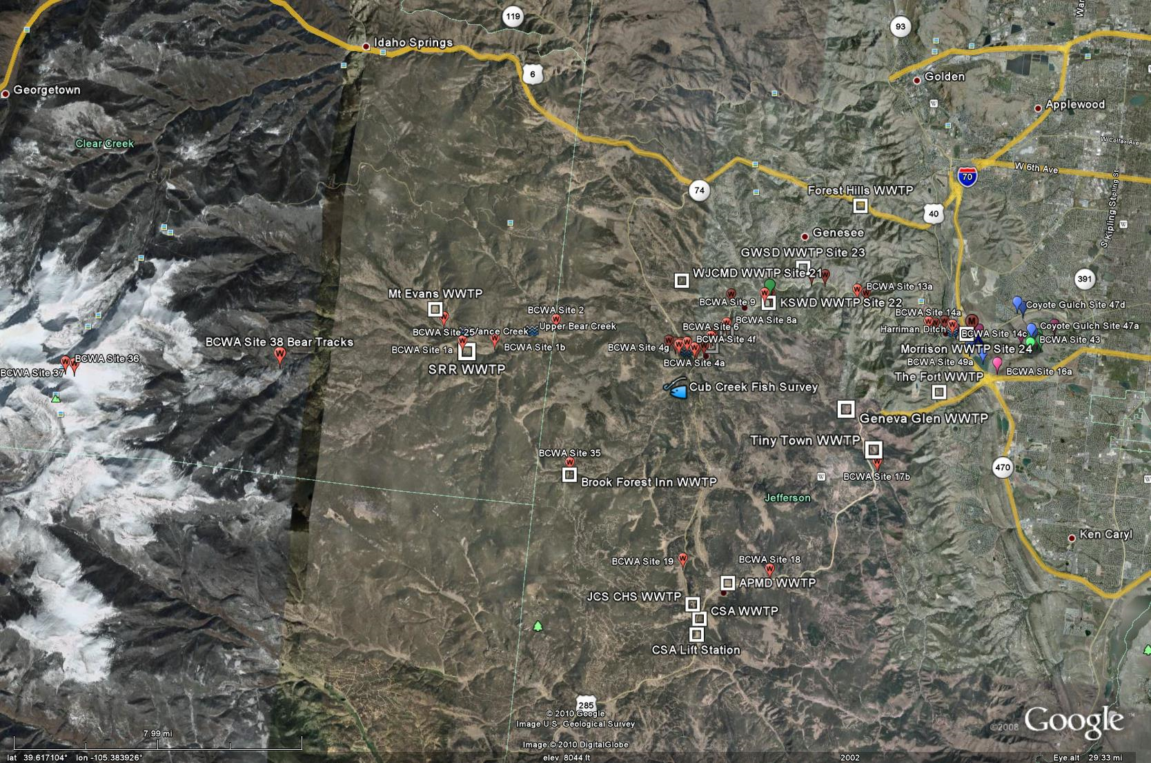
100 Monitoring Sites

Slide 6
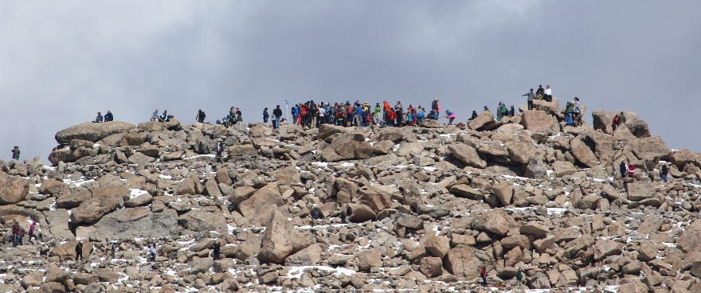
2017 Estimates Recreation Use BCW
Recreational Users Bear Creek Park > 600,000
People Traveling to Mt. Evans > 185,000
Wilderness Access > 25,000
Users Denver Mountain Parks > 225,000
Users Evergreen Lake > 300,000
Jefferson County Open Space > 80,000
Attendees & Visitors Red Rocks/Morrison >1.3 million
Bear Creek Park Swim Beach Use > 750 per weekend
Fishing > 65,000 people per year
BCWA Fact Sheet 35 Recreational Uses in BCW
BCW Total Species
Common Sport Fish | Other Reported Fish
16 | 14

Slide 7
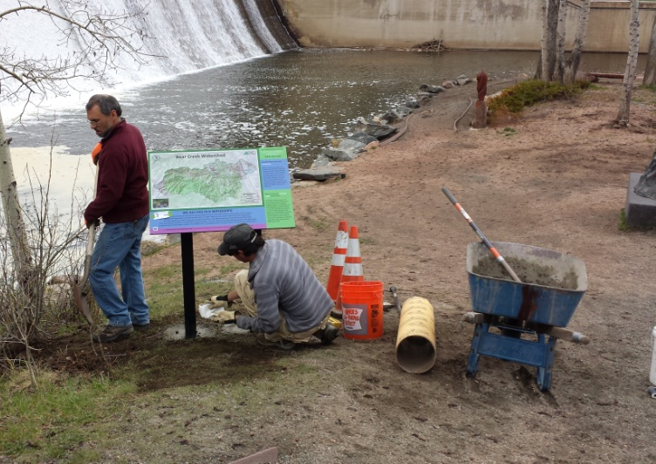
BCWA 2017 Watershed Plan
Online Decision Support Program
Electronic Online Watershed Plan
  36 Policies
  59 Fact Sheets
  22 Data Masters
  34 Informational Maps
  26-yrs of Rulemaking & Standards
  31 Program Documents
  >100 linked reports & documents
  18 Wastewater Management Summaries
  + Other Informational, Methods, Program Guidance, Technical Series, Special Studies, Annual Monitoring Plans
Photo Library
Quarterly Newsletter (>350)
NPS education
Membership special programs

Slide 9
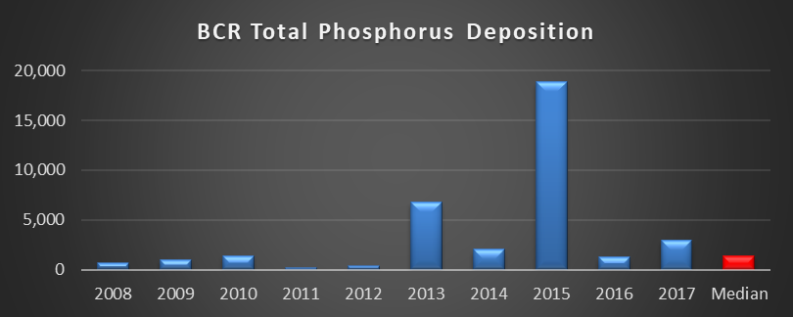
2017 Annual Report
WQCC Summary
  Status of Water Quality (Normal Year)
  Status of WQ Goals & Standards (Temperature)
  Phosphorus Trading Program (3 trade policies)
Bear Creek Watershed Association Program

Slide 10
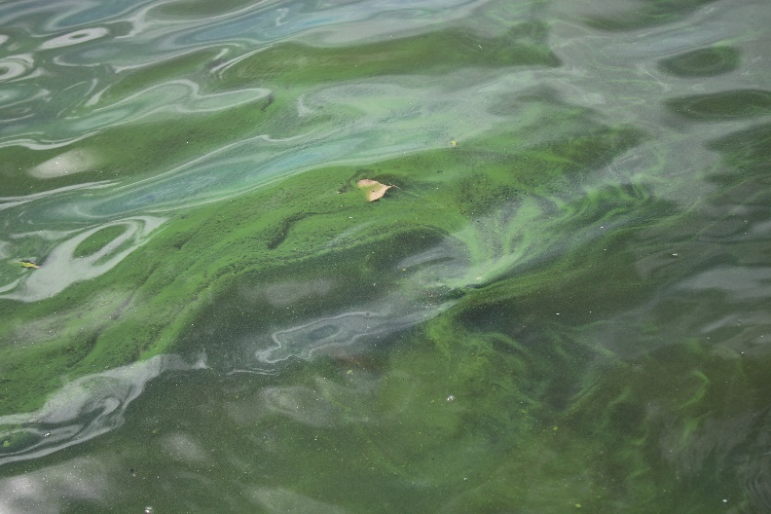
Average seasonal total phosphorus of 61.8 µg/L in BCR exceeds the 22.2 µg/L goal-standard
Average seasonal chlorophyll-a of 22.5 µg/L was over the 12.2 µg/L standard
Trophic status of the reservoir remains at the Eutrophic-Hypertrophic boundary based on Carlson and Walker indices
Seasonal average reservoir temperature (-1/2-2m) = 20.0ºC with no exceedances of the WAT or DM
Lake aeration maintained dissolved oxygen levels (-1/2-2m) at or above 6.0 mg/L throughout most of the growing season
Late season blue-green algal blooms
Recreational fishing remained active

Slide 11
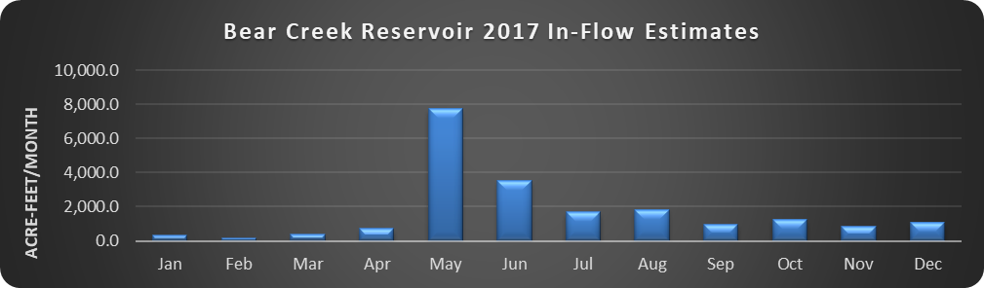
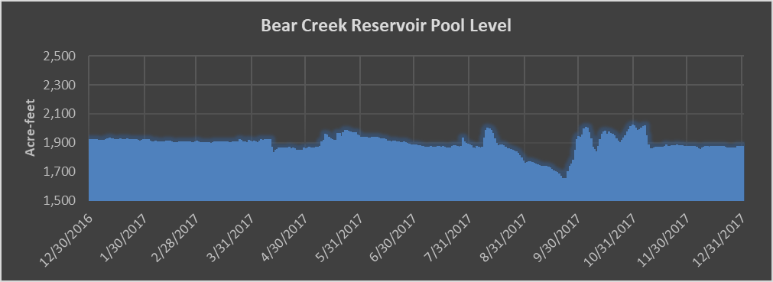

Slide 12
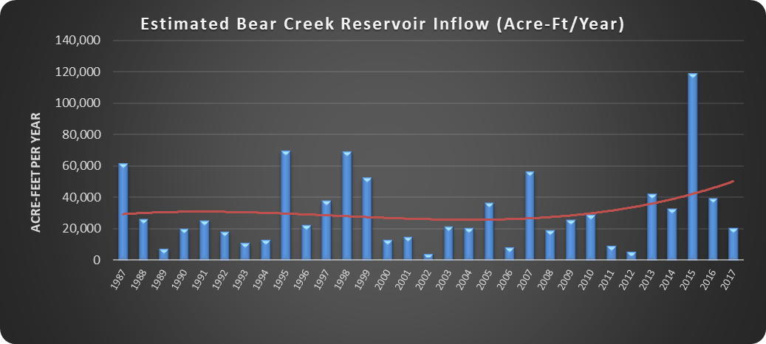
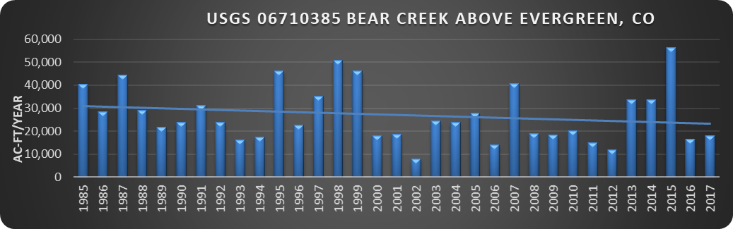

Slide 13
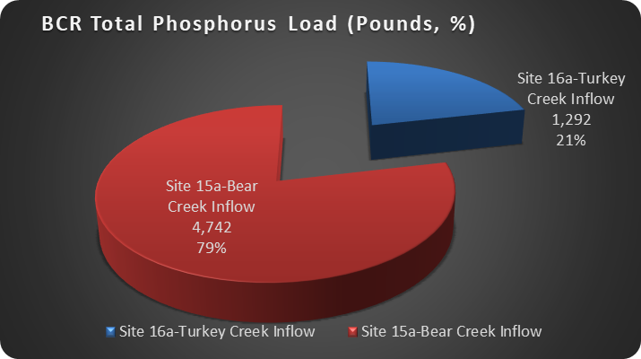

Slide 14
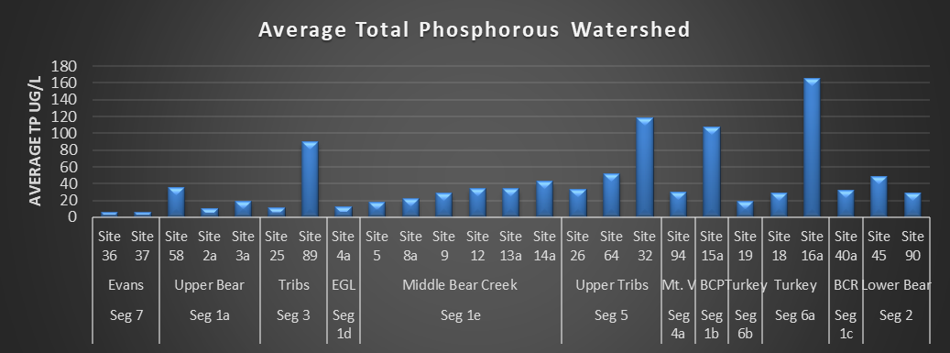

Slide 15
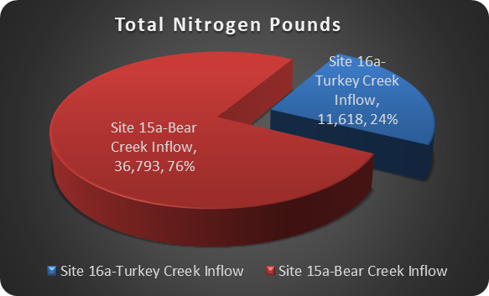

Slide 16
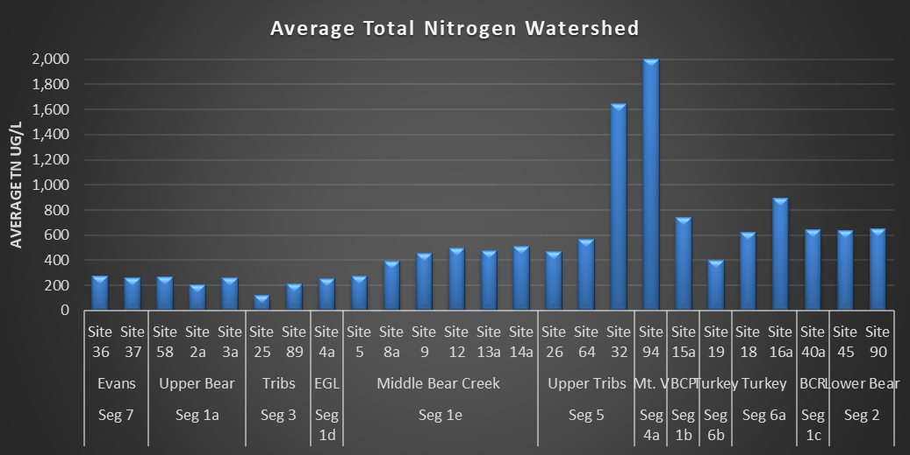

Slide 17
 | 2017 Total Phosphorus Loading (Pounds)
 | Total TP Load | PS | %PS | NPS | %NPS
Turkey Creek Drainage | 1,292 | 84 | 1.4% | 1,208 | 93%
Bear Creek Drainage | 4,742 | 1,007 | 16.7% | 3,734 | 79%
Discharged into Reservoir | 6,034 | 1,092 | 18.1% | 4,942 | 82%
Site 45 Outflow BCR | 3,051
BCR Total Phosphorus Deposition | 2,983
Site 90 - Lower Bear Creek | 2,081

Slide 18
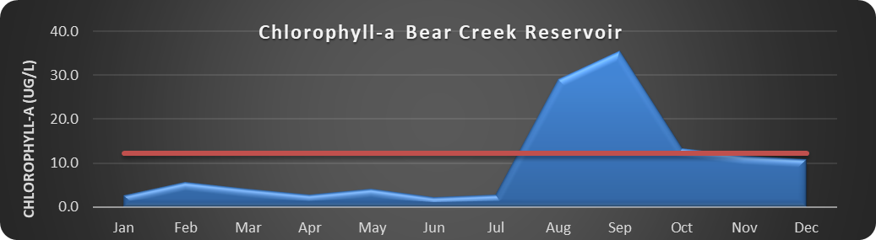
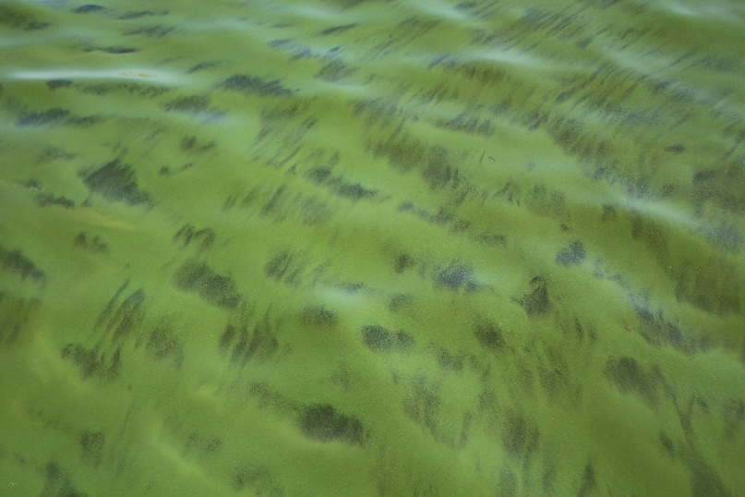
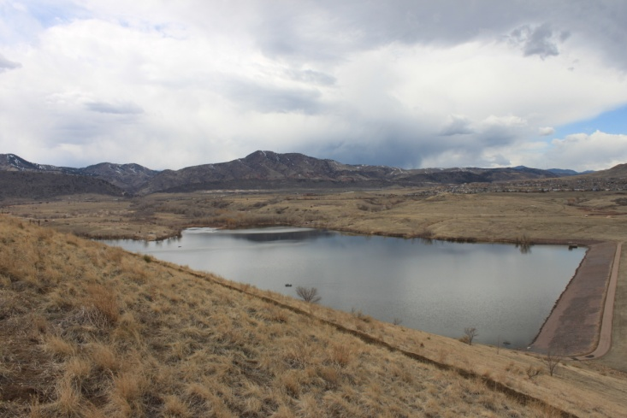

Slide 19
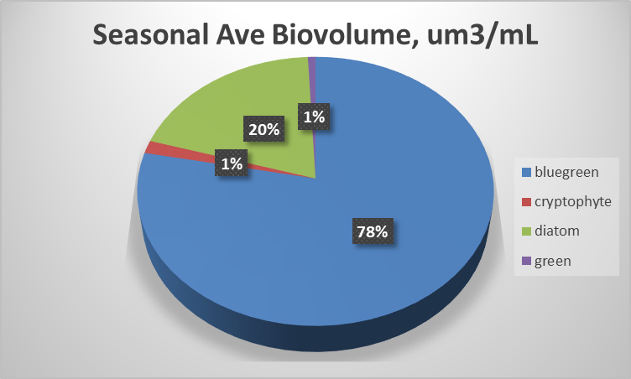

Slide 20
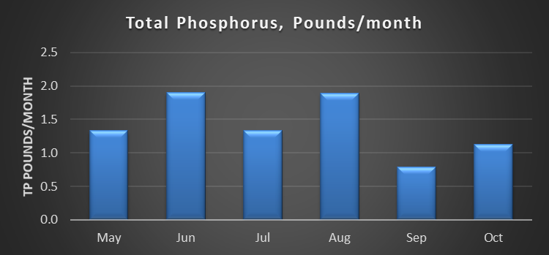
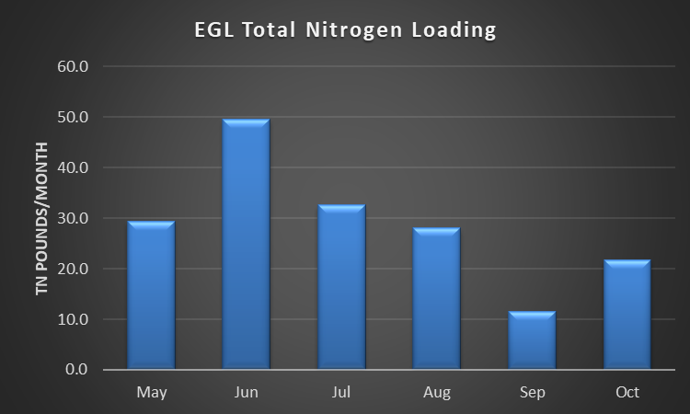
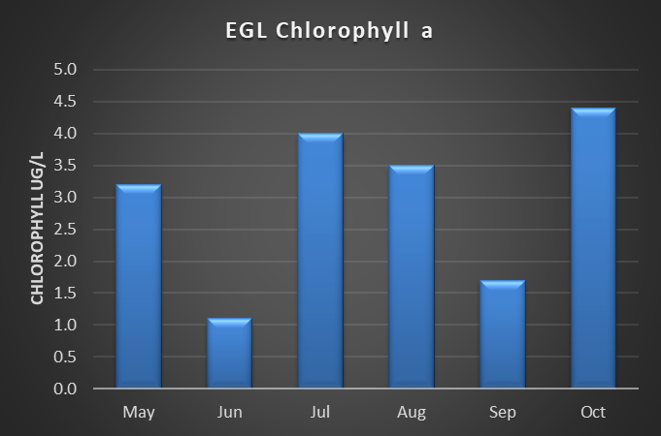
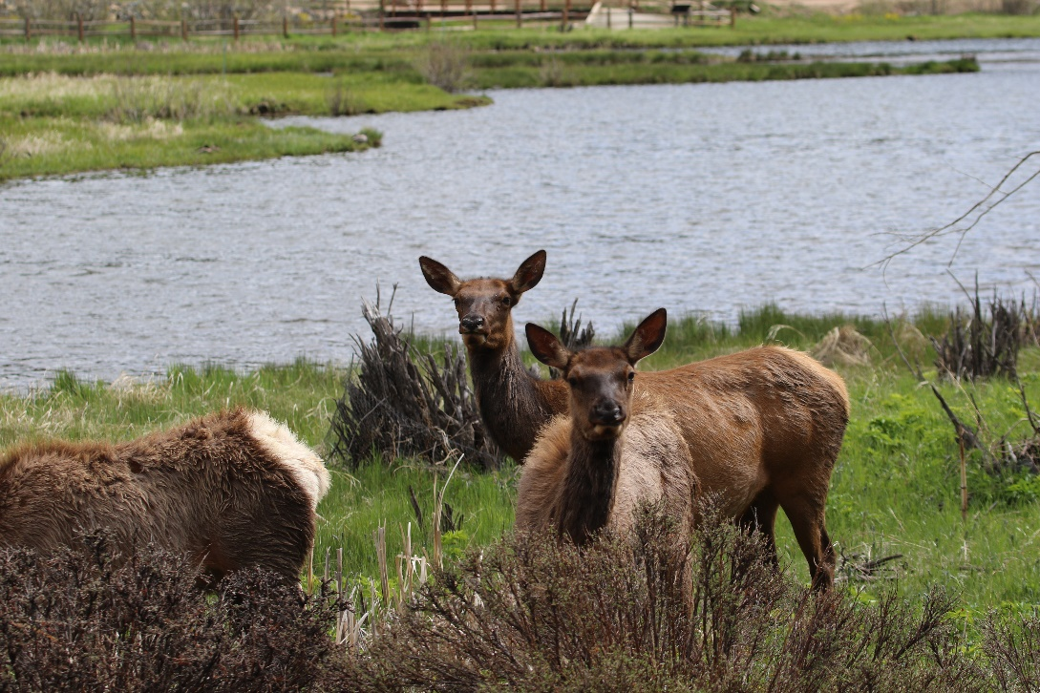

Slide 21
Bear Creek Watershed Wastewater Treatment Plants by Drainage Basin | WQCC Adopted Phosphorus WLA Pounds/ year | 2017 Discharged Phosphorus Pounds/year | % Allocation Used by WWTF
Bear Creek Drainage
Jefferson County Schools – Mt. Evans Outdoor Lab | 20 | 4.76 | 24%
Brook Forest Inn¹ | 5 | 22 | 440%
Evergreen Metropolitan District | 1,500 | 250.73 | 17%
West Jefferson County Metro District | 1,500 | 268.33 | 18%
Kittredge Sanitation and Water District | 240 | 47.39 | 20%
Genesee Water and Sanitation District | 1,015 | 318.67 | 31%
Forest Hills Metropolitan District | 80 | 21.35 | 27%
Town of Morrison | 600 | 74.19 | 12%
Bear Creek Total | 4,960 | 1,007.42 | 20%
Turkey Creek Drainage
Conifer Metropolitan District | 40 | 3.7 | 9%
Conifer Sanitation Association | 40 | 0.95 | 2%
Aspen Park Metropolitan District | 40 | 6.9 | 17%
Jefferson County Schools - Conifer High School | 110 | 3.9 | 4%
Geneva Glen² | 5 | 19.96 | 399%
Bear Creek Development Corp. - Tiny Town³ | 5 | Hauling Columbia
Turkey Creek Total | 240 | 35.41 | 15%
Total Operational Facilities Lbs./year | 5,200 | 1,042.83 | 20%
Reserve Pool⁴ | 55 | 0 | 0%
Total Phosphorus Wasteload lbs./year | 5,255
1-Brook Forest Inn - Compliance Advisory, Reported Effluent Violation Notice of Significant Non-Compliance by WQCD. Exceeded phosphorus concentration limits and pounds as reported by WQCD. No compliance action by WQCD enforcement section.
2-Geneva Glen - Compliance Agreement. Exceeded phosphorus concentration limits and pounds as reported to WQCD. New LAMP in progress. No compliance action by WQCD enforcement section.
3-Records from Columbia Sanitary show they hauled 131,400 gallons in the 2017 operation season
4- The reserve pool in the Control Regulation is 2 pounds of total phosphorus, the 55 pounds listed by the BCWA includes pounds from closed treatment facilities (Singing River Ranch (30), The Fort Restaurant (18), Bear Creek Cabins (5))

Slide 22
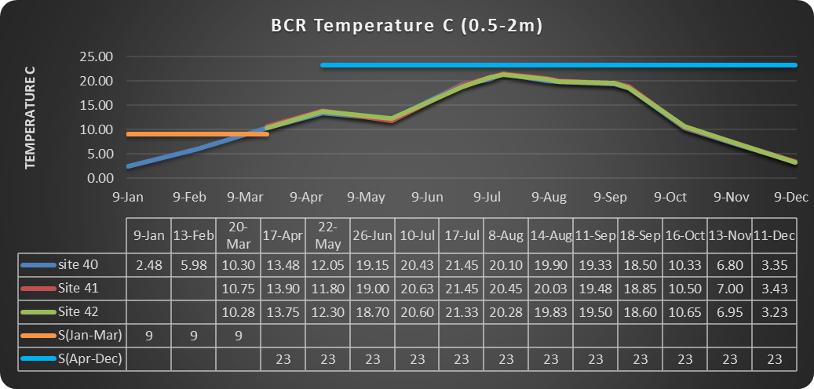

Slide 23
Segment | Cold-season |  | Warm Season
Segment 3 | 9 ºC WAT | 13 ºC DM | 17 ºC WAT | 21.2 ºC DM
# Exceedances | 0 | 15 | 0 | 0
% Compliance | 100% | 94% | 100% | 100%
Segment 1a | 9 ºC WAT | 13 ºC DM | 17 ºC WAT | 21.2 ºC DM
# Exceedances | 3 | 10 | 0 | 0
% Compliance | 94% | 97% | 100% | 100%
Segment 1d | 9 ºC WAT | 13 ºC DM | 17 ºC WAT | 21.2 ºC DM
# Exceedances |  |  | 0 | 0
% Compliance |  |  | 100% | 100%
Segment 1e | 9 ºC WAT | 13 ºC DM | 17 ºC WAT | 21.2 ºC DM
# Exceedances | 0 | 0 | 0 | 0
% Compliance | 100% | 100% | 100% | 100%
Segment 1b | 9 ºC WAT | 13 ºC DM | 17 ºC WAT | 21.2 ºC DM
# Exceedances | 0 | 1 | 0 | 0
% Compliance | 100% | 99% | 100% | 100%
Segment 5 | 9 ºC WAT | 13 ºC DM | 17 ºC WAT | 21.2 ºC DM
# Exceedances | 0 | 0 | 0 | 0
% Compliance | 100% | 100% | 100% | 100%
Segment 6a | 9 ºC WAT | 13 ºC DM | 17 ºC WAT | 21.2 ºC DM
# Exceedances | 0 | 1 | 0 | 0
% Compliance | 100% | 99% | 100% | 100%
Segment 6b | 9 ºC WAT | 13 ºC DM | 17 ºC WAT | 21.2 ºC DM
# Exceedances | 0 | 0
% Compliance | 100% | 100%
Segment 2 | 13.7°C WAT | 14.3°C DM | 27.5°C WAT | 28.6°C DM
# Exceedances | 0 | 0 | 0 | 1
% Compliance | 100% | 100% | 100% | 100%
Segment 1c | 9°C WAT | 13°C DM | 23.3°C WAT | 23.8°C DM
# Exceedances | 2 | 0 | 0 | 0
% Compliance | 0% | 100% | 100% | 100%

Slide 24
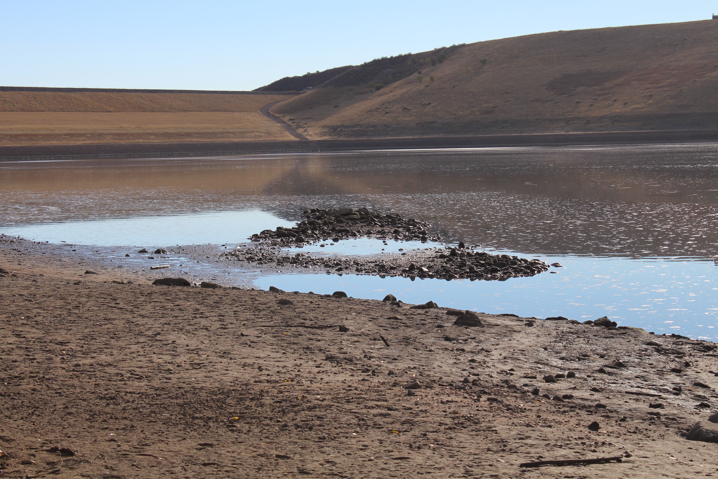
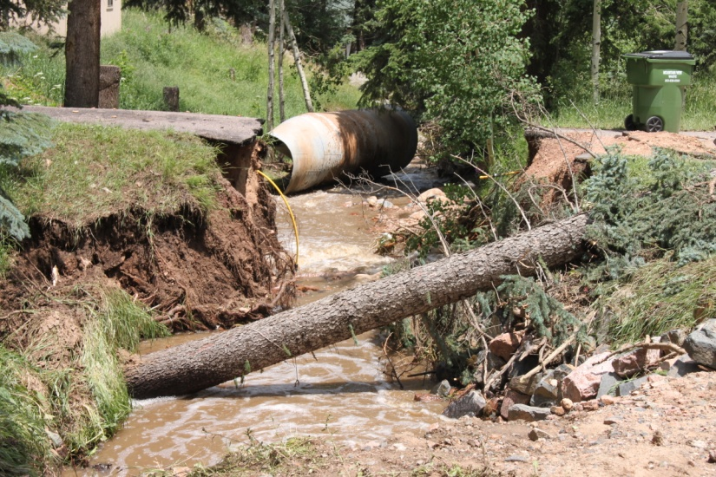
Adaptive Management Program
Nonpoint source loading & tracking
Coyote Gulch - Trading
Septic Systems – Kerr & Cub
Tracking management practices
Zoning and planning reviews for BMPs
Local presentations, education programs
Flood restoration practices
Assist land-owners
Assist invasive species programs
Green Infrastructure projects
Wildfire assessment
Source water protection
Tributary loading studies
Erosion Control Reviews
Online adaptive management
Climate Modeling

Slide 25
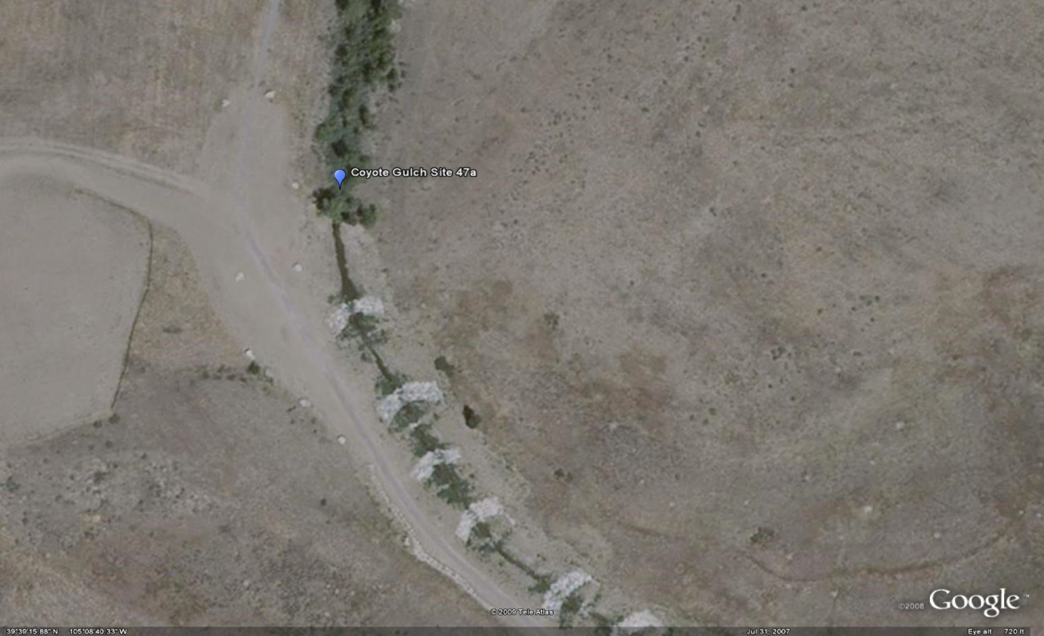
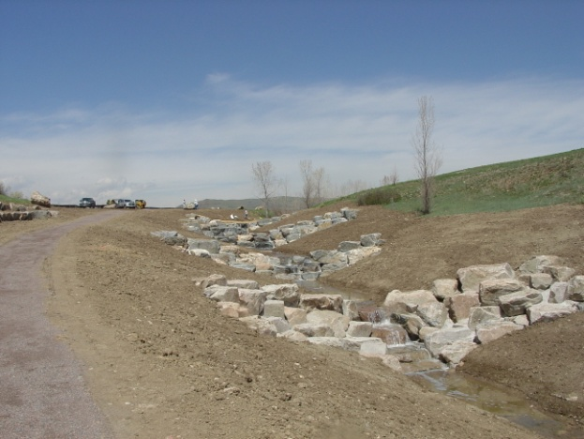
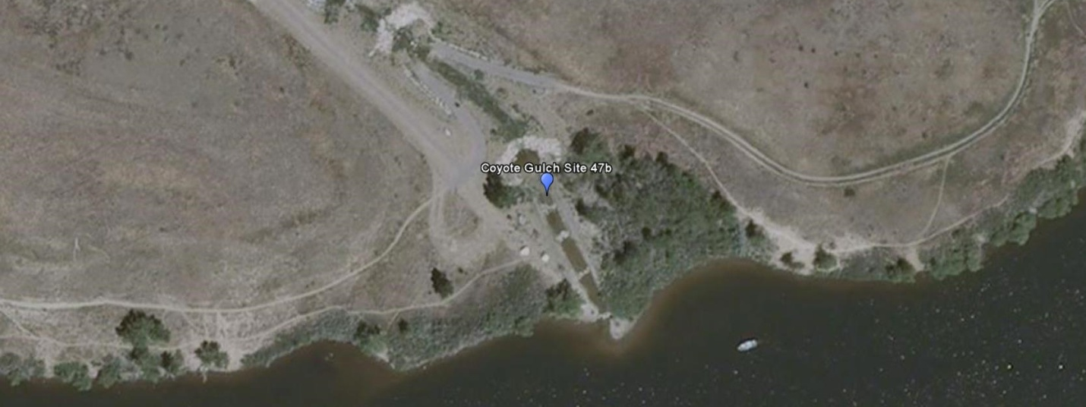
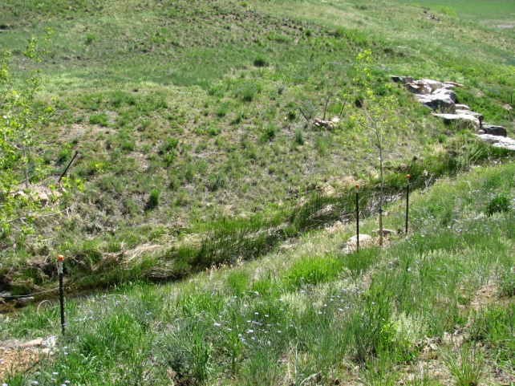
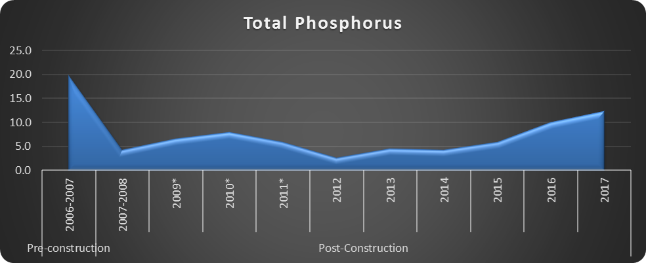
Coyote Gulch
2006-2017
Trade Pounds = 80.4

Slide 26
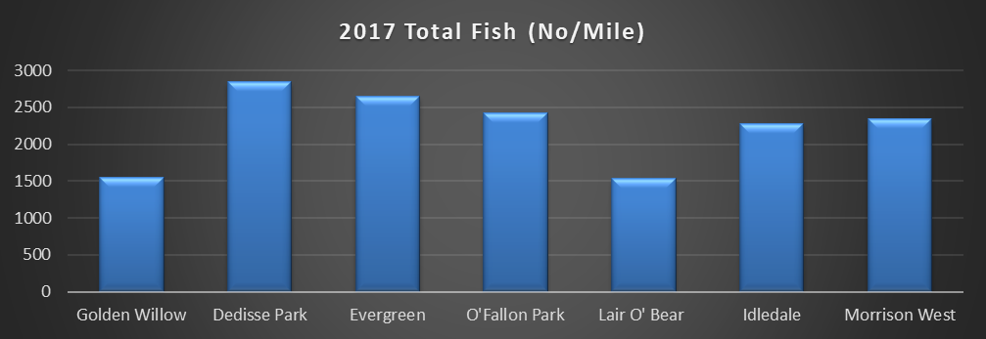

Slide 27
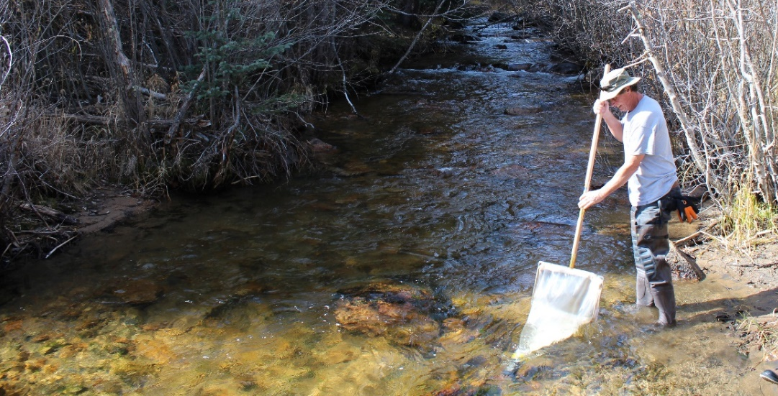
WQCD Station ID | BCWA Station ID | Location | Biotype | MMI
 |  |  |  | 2009 | 2010 | 2011 | 2012 | 2014 | 2015 | 2016 | 2017
5756a | 15a | BCLP @ bridge | Transition |  |  |  |  | 66.4 | 59.1 | 67.0 | 56.4
122 | 14a | Morrison @ Gage | Transition | 69.8 | 80.5 | 74.5 | 72.9 | 48.8 | 73.5 | 72.0 | 63.9
122C | 13a | Idledale | Transition | 62.1 | 69.8 | 57.1 | 68.0 | 59.3 | 59.2 | 50.0 | 62.2
122a | 12 | Lair O’ Bear | Transition | 58.5 | 62.2 | 56.4 | 51.3 | 49.5 | 72.2 | 46.0 | 62.9
122b | 9 | O’ Fallon | Transition | 53.6 | 57.7 | 45.5 | 49.9 | 44.8 | 59.1 | 57.0 | 60.1
5762 | 8b | BCC @ Bridge | Transition | 55.6 | 39.1 | 51.1 | 44.3 | 49.6 | 62.3 | 59.0 | 57.4
5763 | 5 | Little Bear | Transition | 52.3 | 56.6 | 42.9 | 40.0 | 56.2 | 68.9 | 75.0 | 38.4
5764 | 3a | Keys @ bridge | Mountain | 38.6 | 36.9 | 45.3 | 46.9 | 43.9 | 63.6 | 37.0 | 57.9
5768d | 2a | Golden Willow | Mountain |  |  |  | 71.9 | 60.8 | 56.6 | 65.0 | 58.1
5768c | 58 | Mt Evans Wilderness | Mountain |  |  | 55.5 | 72.5 | 67.0 | 53.8 | 67.0 | 75.6
BCWA90 | 90 | Wadsworth | Transition |  |  |  |  |  |  | 55.0 | 39.9

Slide 28
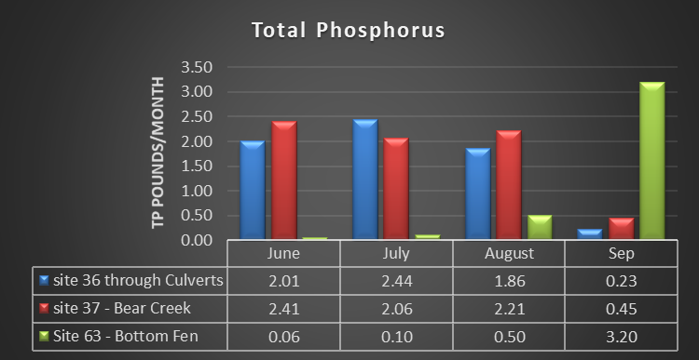
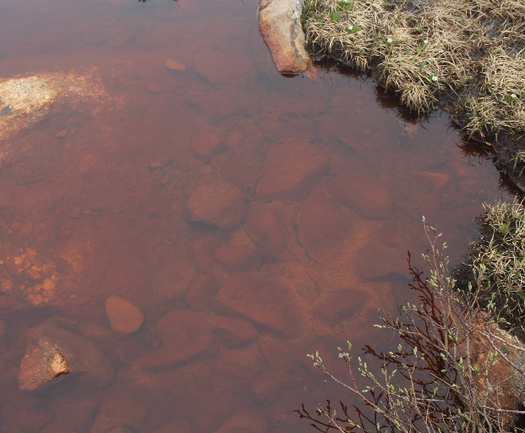
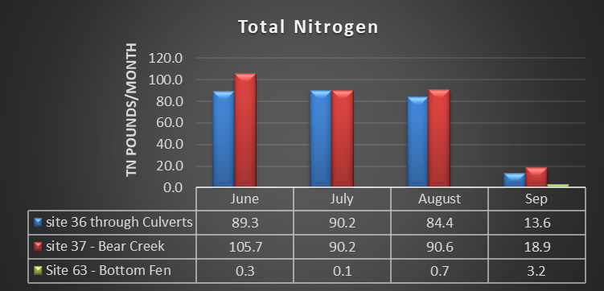

Slide 29
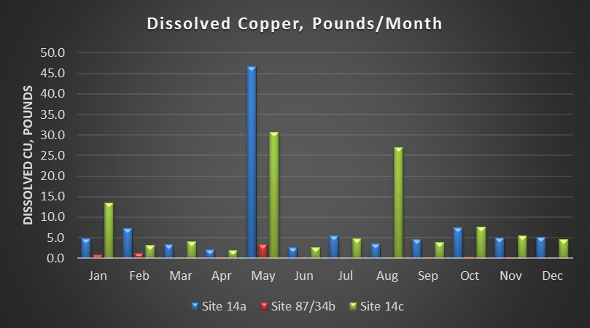

Slide 30
BCWA spent 2.2 million on regulation directed programs
1.3 million on data & monitoring efforts
28-years of data & studies to support good science
>2 million on water quality improvement projects
Discharger members have spent >21 million dollars on WWTFs
BCWA has 78.5 years worth of voluntary efforts
WQCD enforcement staff stated the monitoring provisions of Regulation #74 are not enforceable.
WQCD enforcement staff stated the nonpoint source provisions of Regulation #74 are not enforceable.

Slide 31
