Slide 1

The Bear Creek Watershed Association protects & restores water & environmental quality within the Bear Creek Watershed from the effects of land use.

Slide 2
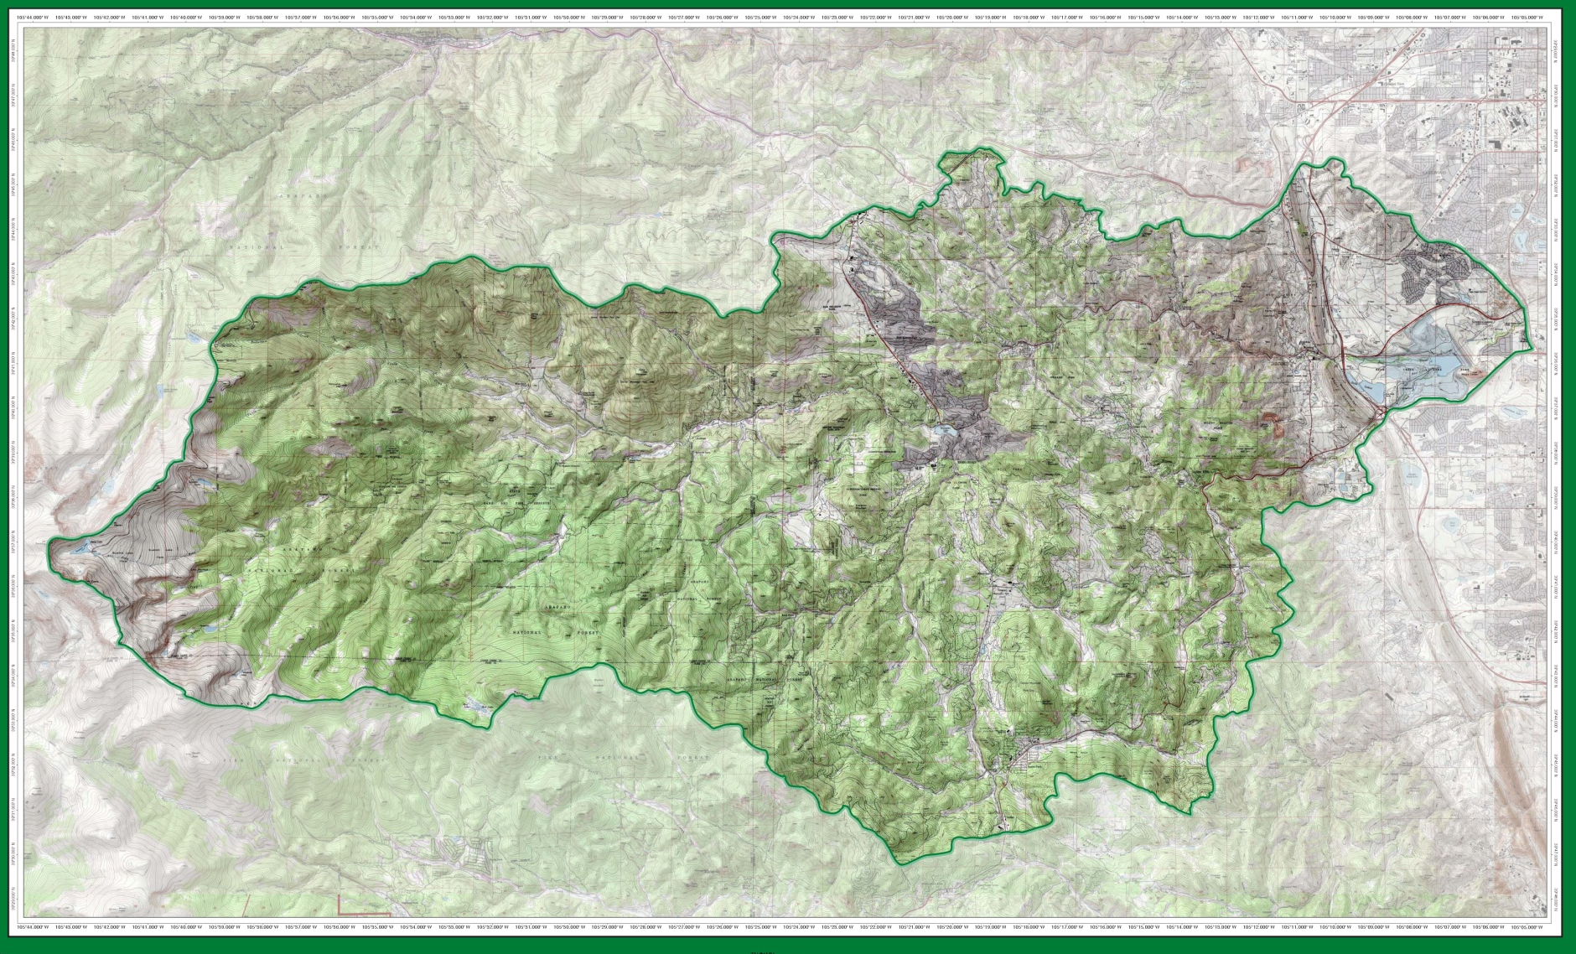
Operational Bear Creek Watershed 2019

Slide 3
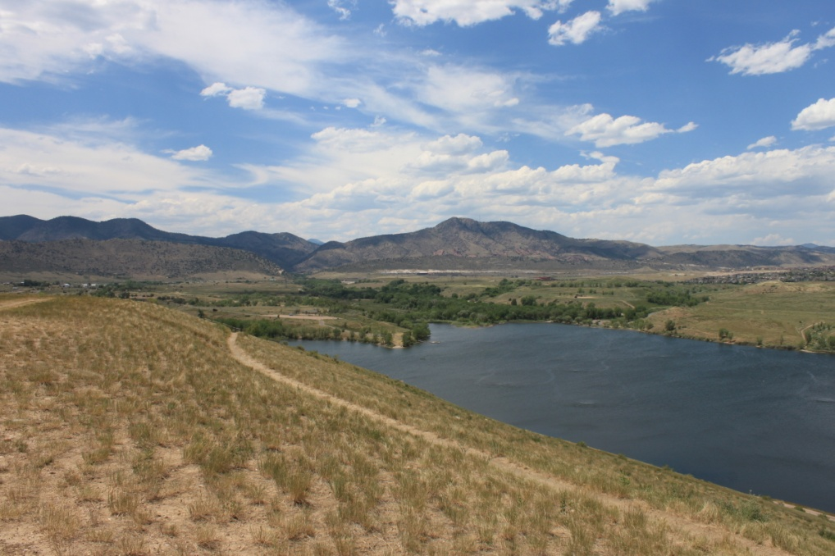
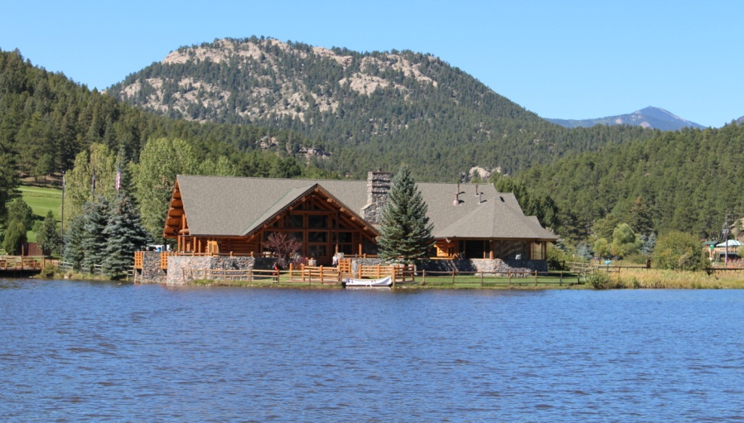
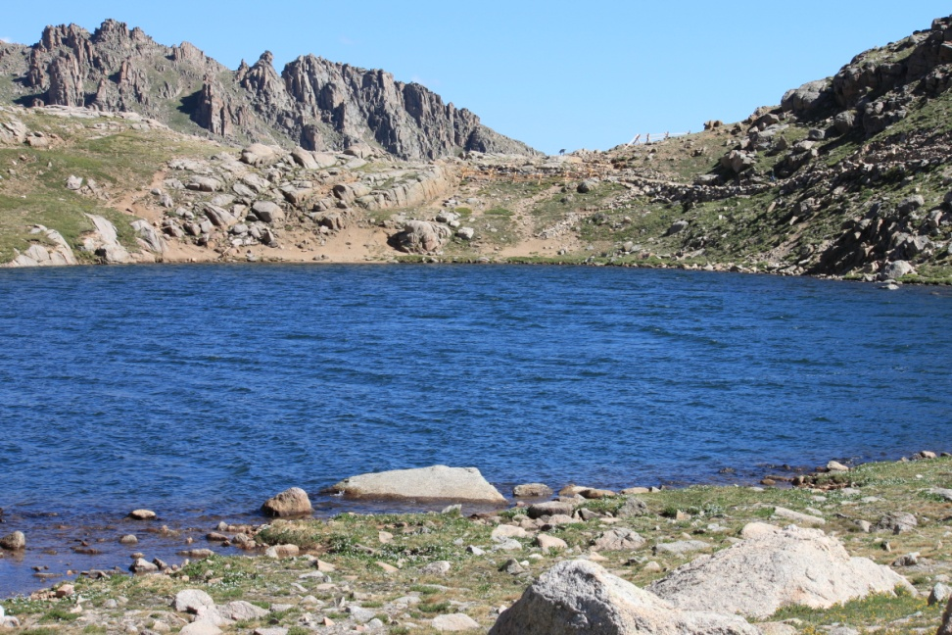
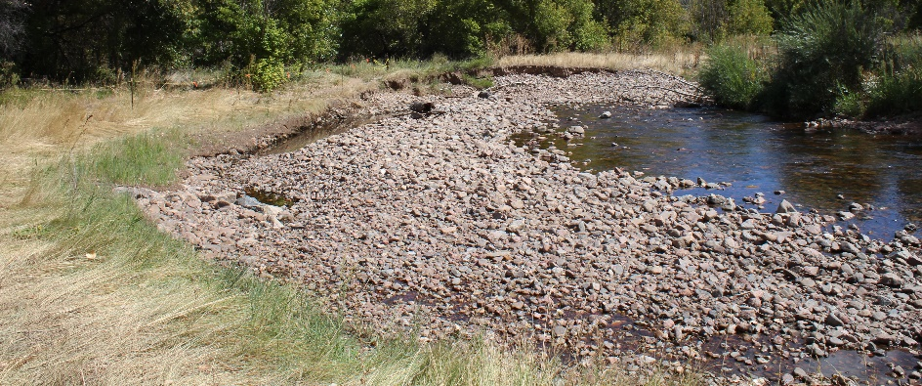
105 Stream Monitoring Sites
Bear Creek Reservoir
  Inflow Turkey Creek
  Inflow Bear Creek
  Outflow Site 45
  Site 90 input Barr/Milton
Evergreen Lake
Summit Lake (Mt Evans)
Other WQ Features

Slide 4
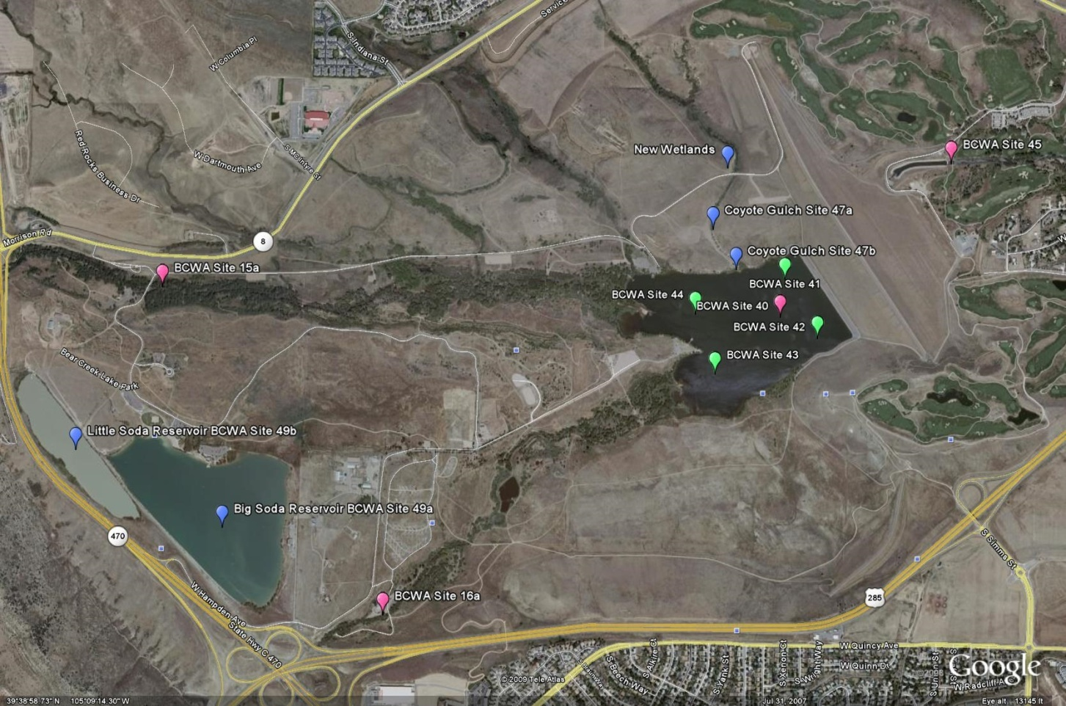

Slide 5
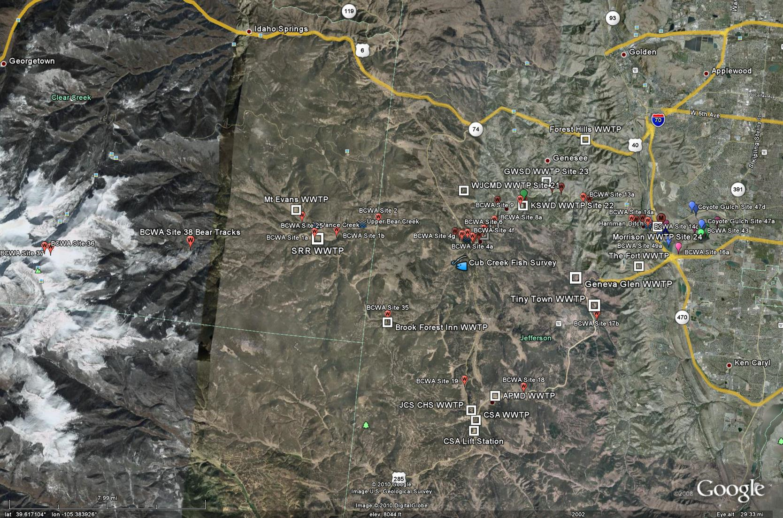
105 Monitoring Sites

Slide 6
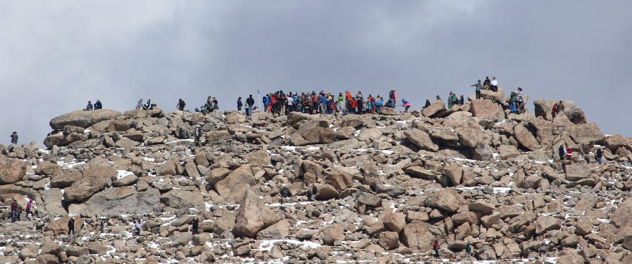
2018 Estimates Recreation Use BCW
Recreational Users Bear Creek Park > 675,000
People Traveling to Mt. Evans > 188,000
Wilderness Access > 25,000
Users Denver Mountain Parks > 250,000
Users Evergreen Lake > 300,000
Jefferson County Open Space > 80,000
Attendees & Visitors Red Rocks/Morrison >1.3 million
Bear Creek Park Swim Beach Use > 750 per weekend
Fishing > 65,000 people per year
BCWA Fact Sheet 35 Recreational Uses in BCW
BCW Total Species
Common Sport Fish | Other Reported Fish
16 | 14

Slide 7
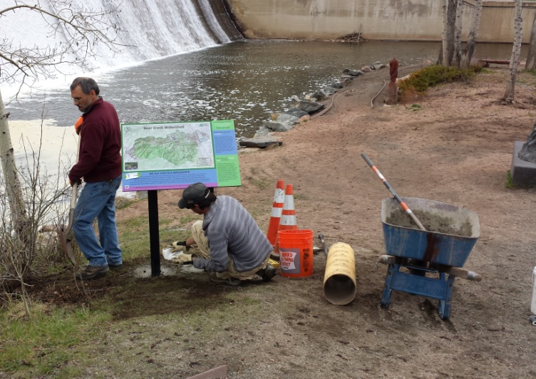
BCWA 2018 Watershed Plan
Online Decision Support Program
Electronic Online Watershed Plan
  37 Policies
  64 Fact Sheets
  25 Data Masters
  34 Informational Maps
  27-yrs of Rulemaking & Standards
  36 Program Documents
  >100 linked reports & documents
  18 Wastewater Management Summaries
  + Other Informational, Methods, Program Guidance, Technical Series, Special Studies, Annual Monitoring Plans
Photo Library
Quarterly Newsletter (>350)
NPS education
Membership special programs

Slide 8
Members & Participants | Wastewater Discharger | 2018 Participation
Counties
Jefferson County |  | Active
Clear Creek County |  | Active
City and Towns
City of Lakewood |  | Active
Town of Morrison | Yes | Active
Water & Sanitation Districts
Aspen Park Metropolitan District | Yes | Active
Conifer Sanitation Association | Yes | Dues Paid, Not Active
Evergreen Metropolitan District | Yes | Active
Forrest Hills Metropolitan District | Yes | Active
Genesee Water & Sanitation District | Yes | Active
Geneva Glen | Yes | Dues Paid, Not Active
Jefferson County School District | Yes | Active
Kittredge Water & Sanitation District | Yes | Active
Tiny Town Foundation, Inc. | Yes | Not Paid, Not Active
West Jefferson County Metropolitan District | Yes | Active
Other Member
Denver Water Department |  | Active
Denver Heath |  | Attended
Participant Agencies
U.S. Army Corps of Engineers |  | Attended
Jefferson Conservation District |  | Active
WQCD |  | Attended
ETU |  | Active

Slide 9
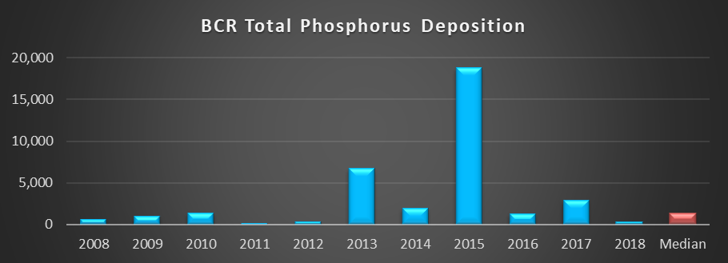
2018 Annual Report
WQCC Summary
  Status of Water Quality (Normal Year)
  Status of WQ Goals & Standards (Temperature)
  Phosphorus Trading Program (3 trade policies)
Bear Creek Watershed Association Program

Slide 10
Average seasonal total phosphorus of 61.8 µg/L in BCR exceeds the 22.2 µg/L goal-standard
Average seasonal chlorophyll-a of 16.4 µg/L was over the 12.2 µg/L standard
Trophic status of the reservoir remains at the Eutrophic-Hypertrophic boundary based on Carlson and Walker indices
Seasonal average reservoir temperature (-1/2-2m) = 21.4ºC with exceedances of the WAT (32) and DM (86)
Lake aeration maintained dissolved oxygen levels (-1/2-2m) at or above 6.0 mg/L throughout most of the growing season
Late season blue-green algal blooms
Recreational fishing remained active

Slide 11
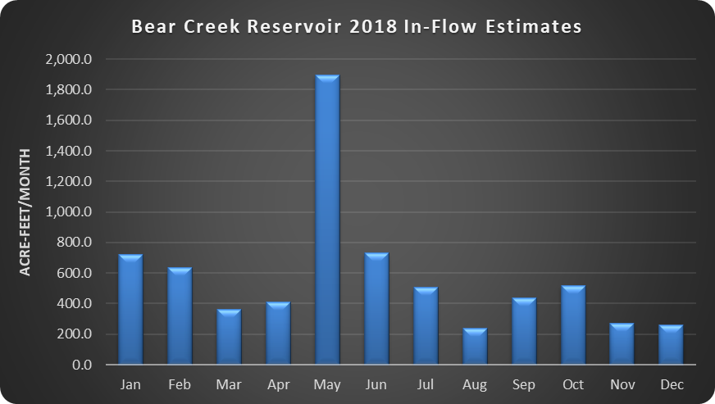
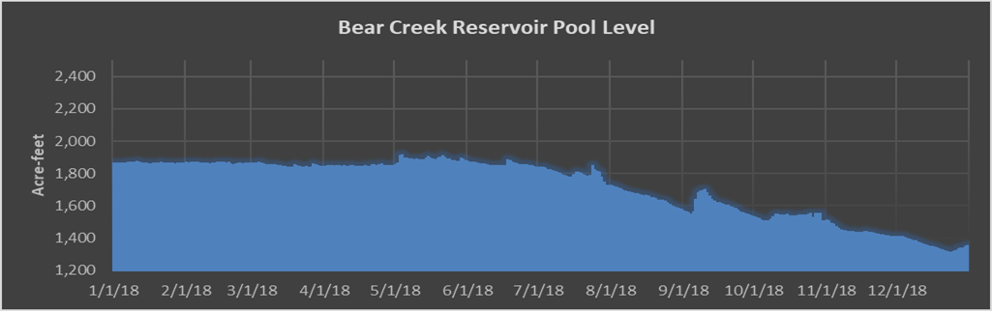

Slide 12
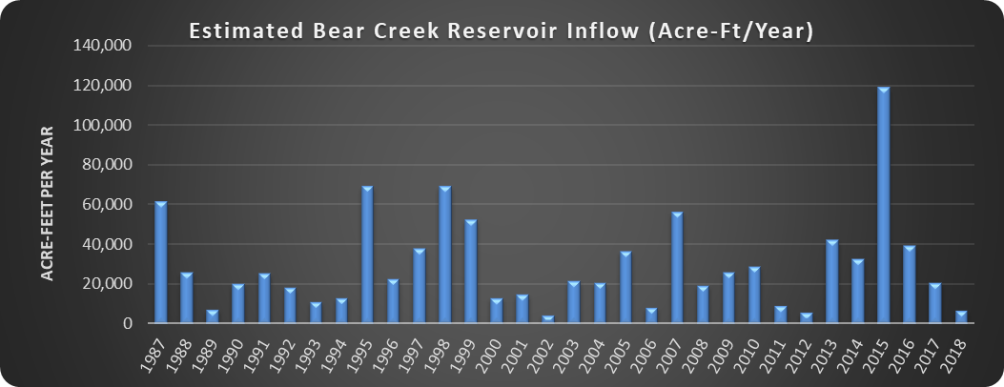
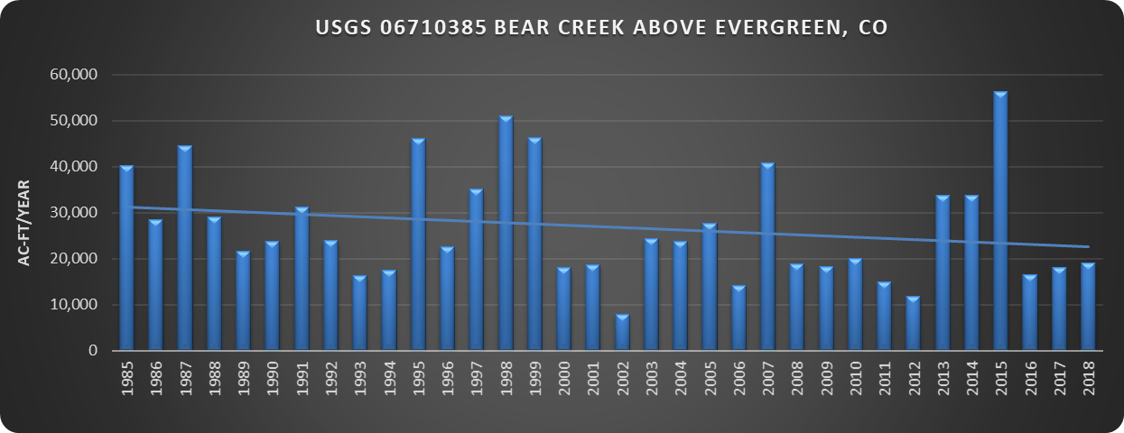

Slide 13
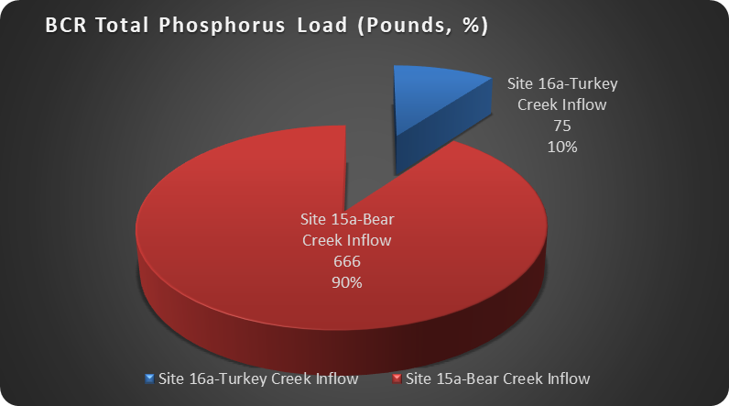

Slide 17
 | 2018 Total Phosphorus Loading (Pounds)
 | Total TP Load | PS | %PS | NPS | %NPS
Turkey Creek Drainage | 75 | 39 | 52.2% | 36 | 48%
Bear Creek Drainage | 666 | 951 | 142.7% | -285 | -43%
Discharged into Reservoir | 741 | 990 | 133.6% | -249 | -34%
Site 45 Outflow BCR | 409
BCR Total Phosphorus Deposition | 332
Site 90 - Lower Bear Creek | 747
NPS load increase between 45 and 90 | 45% | 338

Slide 18
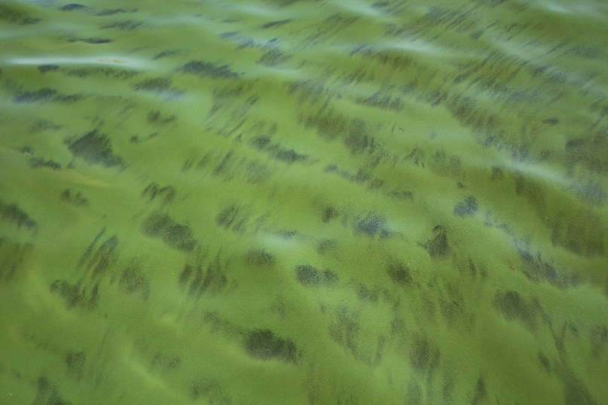
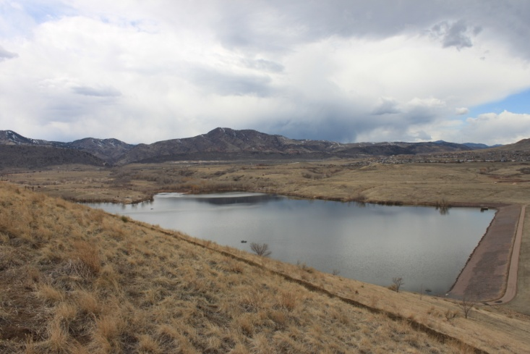

Slide 19
Functional Group | Species | Seasonal Ave Density #/ml | Seasonal Ave Biovolume, um3/mL
Bluegreen | 5 | 315 | 181,402
chrysophyte | 5 | 463 | 143,145
Diatom | 39 | 59 | 56,418
Green | 6 | 70 | 18,721

Slide 20
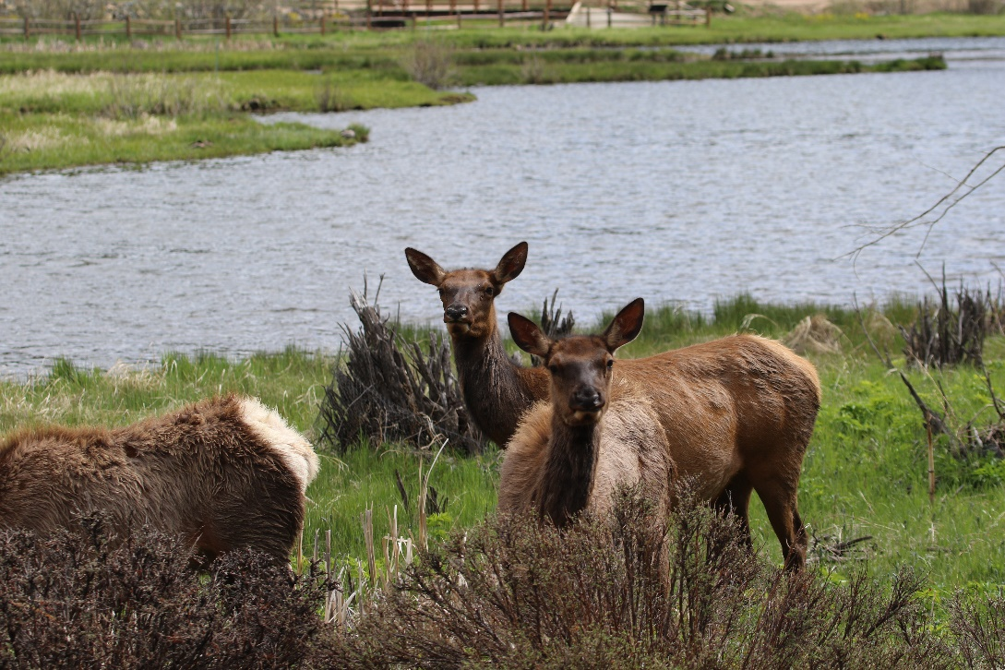

Slide 21
Bear Creek Watershed Wastewater Treatment Plants by Drainage Basin | WQCC Adopted Phosphorus WLA Pounds/ year | 2018 Discharged Phosphorus Pounds/year | % Allocation Used by WWTF
Bear Creek Drainage
Jefferson County Schools – Mt. Evans Outdoor Lab | 20 | 2.68 | 13%
Brook Forest Inn¹ | 5 | 0 | 0%
Evergreen Metropolitan District | 1,500 | 297.46 | 20%
West Jefferson County Metro District | 1,500 | 313.18 | 21%
Kittredge Sanitation and Water District | 240 | 40.27 | 17%
Genesee Water and Sanitation District | 1,015 | 226.32 | 22%
Forest Hills Metropolitan District | 80 | 28.57 | 36%
Town of Morrison | 600 | 42.35 | 7%
Bear Creek Total | 4,960 | 950.83 | 19%
Turkey Creek Drainage
Conifer Metropolitan District | 40 | 0.73 | 2%
Conifer Sanitation Association | 40 | 1.85 | 5%
Aspen Park Metropolitan District | 40 | 3.5 | 9%
Jefferson County Schools - Conifer High School | 110 | 1.9 | 2%
Geneva Glen² | 5 | 31.16 | 623%
Bear Creek Development Corp. - Tiny Town³ | 5 | Hauling Columbia
Turkey Creek Total | 240 | 39.14 | 16%
Total Operational Facilities Lbs./year | 5,200 | 989.97 | 19%
Reserve Pool⁴ | 55 | 0 | 0%
Total Phosphorus Wasteload lbs./year | 5,255
1-Brook Forest Inn - Under Compliance Advisory, Still permitted with no reported flow
2-Geneva Glen - Under Compliance Agreement. Concentration and poundage exceedances from May to October 2018
3-Records from Columbia Sanitary show they hauled 64,700 gallons in the 2018 operation season to South Platte Renewal Partners formally known as Englewood/Littleton WWTP. No Phosphorus Data Taken.
4- The reserve pool in the Control Regulation is 2 pounds of total phosphorus, the 55 pounds listed by the BCWA includes pounds from closed treatment facilities (Singing River Ranch (30), The Fort Restaurant (18), Bear Creek Cabins (5))

Slide 23
Segment | Cold-season |  | Warm Season
Segment 3 | 9°C WAT | 13°C DM | 17°C WAT | 21.2°C DM
# Exceedances | 4 | 24 | 0 | 5
% Compliance | 82% | 79% | 100% | 96%
Segment 1a | 9°C WAT | 13°C DM | 17°C WAT | 21.2°C DM
# Exceedances | 9 | 64 | 2 | 18
% Compliance | 76% | 76% | 95% | 94%
Segment 1d | 9°C WAT | 13°C DM | 18.2°C WAT | 23.8°C DM
# Exceedances |  |  | 32 | 0
% Compliance |  |  | 50% | 100%
Segment 1e | 9°C WAT | 13°C DM | 19.3°C WAT | 23.8°C DM
# Exceedances | 0 | 0 | 11 | 31
% Compliance | 100% | 100% | 93% | 97%
Segment 1b | 9°C WAT | 13°C DM | 19.3°C WAT | 23.8°C DM
# Exceedances | 0 | 0 | 0 | 0
% Compliance | 100% | 100% | 100% | 100%
Segment 5 | 9°C WAT | 13°C DM | 18.2°C WAT | 23.8°C DM
# Exceedances | 0 | 0 | 0 | 0
% Compliance | 100% | 100% | 100% | 100%
Segment 6a | 9°C WAT | 13°C DM | 18.2°C WAT | 23.8°C DM
# Exceedances | 0 | 0 | 7 | 0
% Compliance | 100% | 100% | 88% | 100%
Segment 6b | 9°C WAT | 13°C DM | 17°C WAT | 21.2°C DM
# Exceedances | 1 | 8 | 0 | 0
% Compliance | 95% | 94% | 100% | 100%
Segment 2 | 13.7°C WAT | 14.3°C DM | 27.5°C WAT | 28.6°C DM
# Exceedances | 0 | 0 | 0 | 0
% Compliance | 100% | 100% | 100% | 100%
Segment 1c | 9°C WAT | 13°C DM | 23.3°C WAT | 23.8°C DM
# Exceedances | 0 | 0 | 13 | 86
% Compliance | 100% | 100% | 92% | 92%

Slide 24
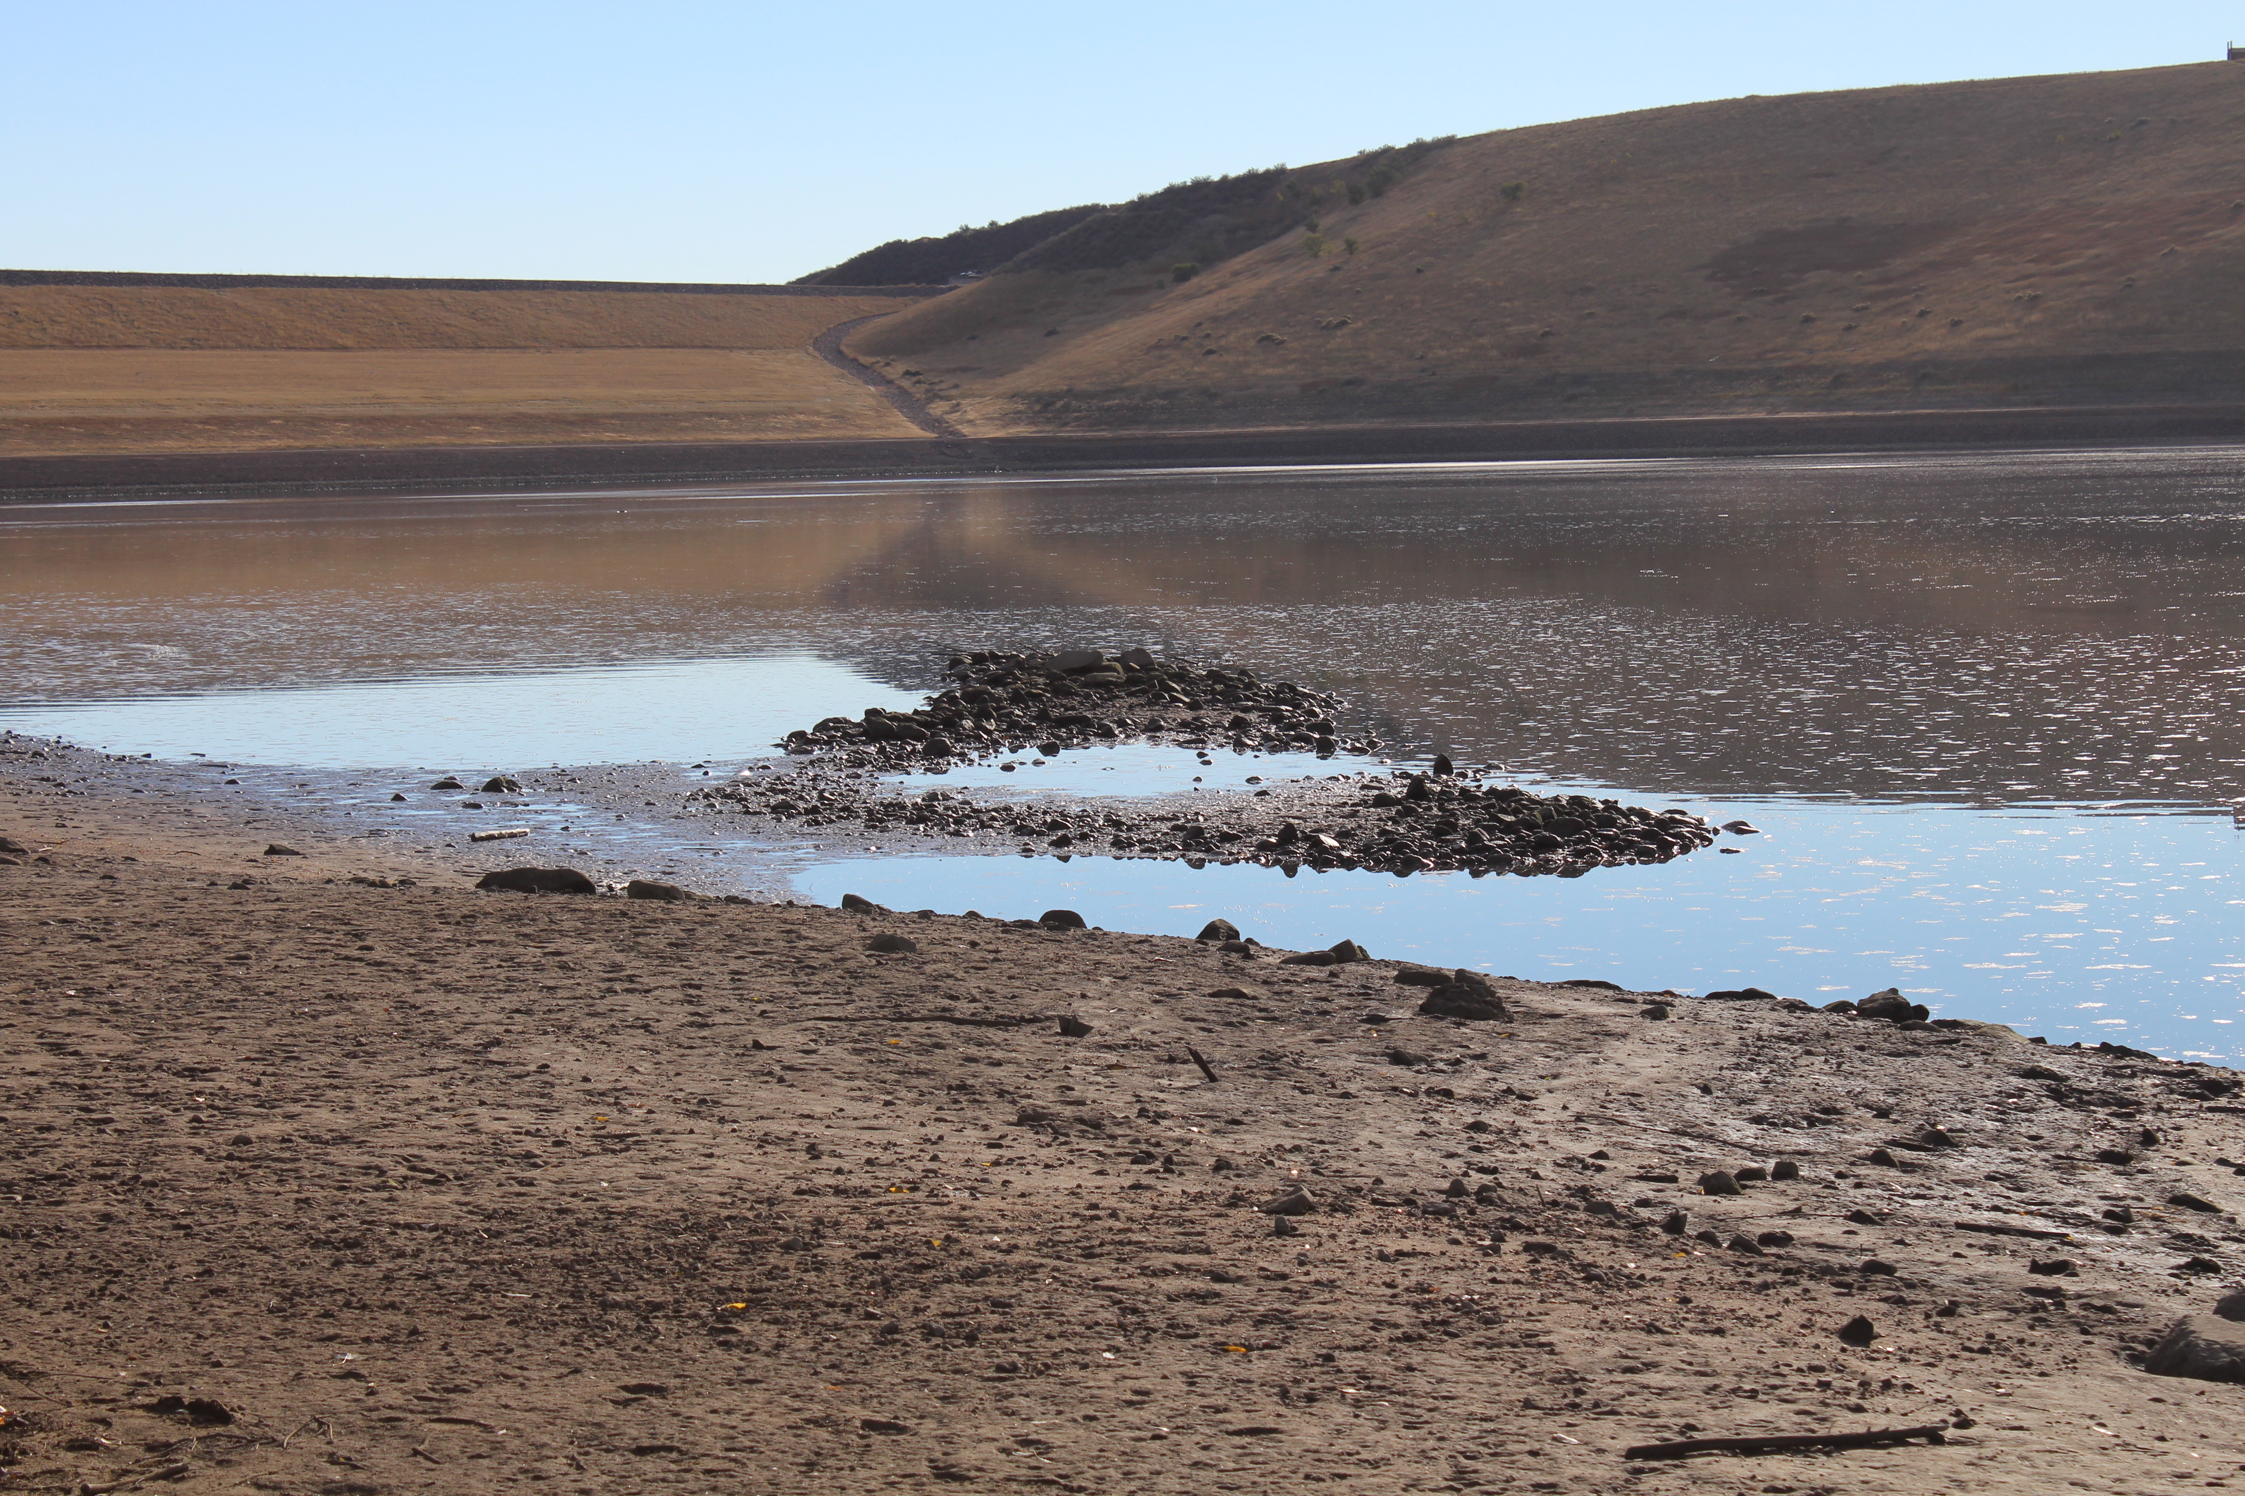
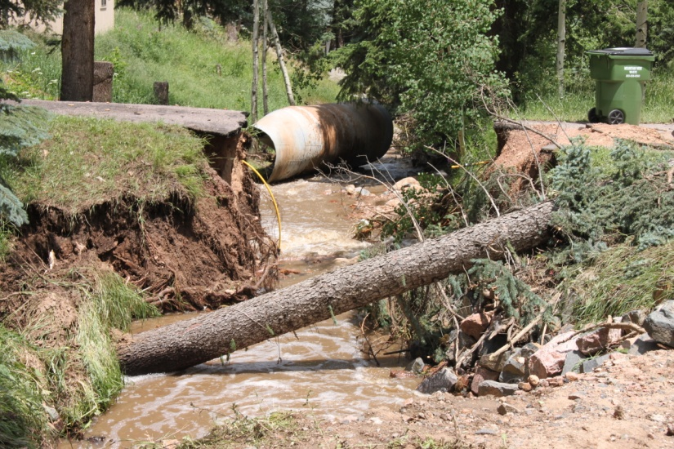
Adaptive Management Program
Nonpoint Source Loading & Tracking
Coyote Gulch - Trading
Septic Systems – Kerr & Cub
Tracking Management Practices
Zoning And Planning Reviews For BMPs
Local Presentations, Education Programs
Flood Restoration Practices
Assist Land-owners
Assist Invasive Species Programs
Green Infrastructure Projects
Wildfire Assessment
Source Water Protection
Tributary Loading Studies
Erosion Control Reviews
Online Adaptive Management
Climate Modeling

Slide 25
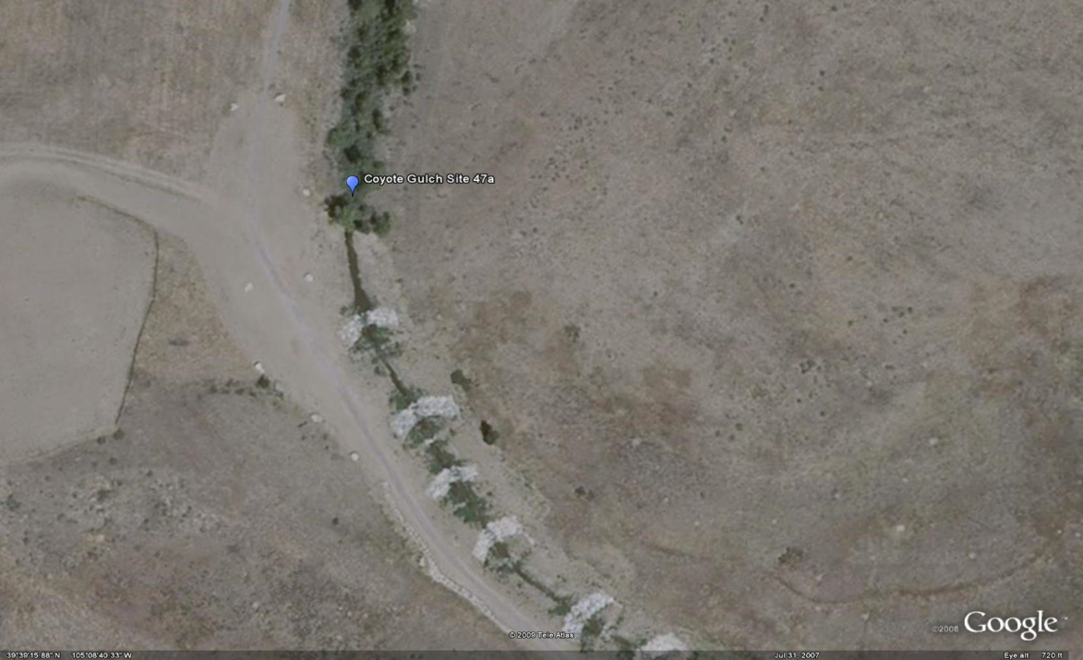
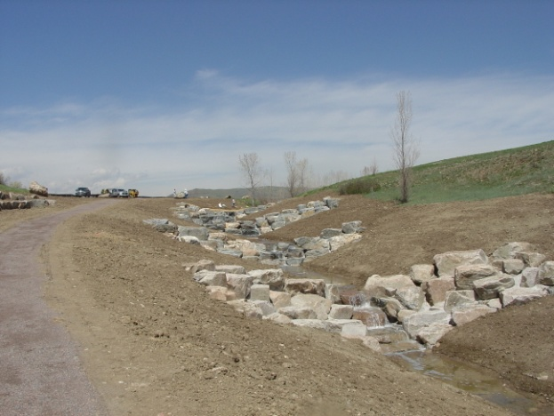
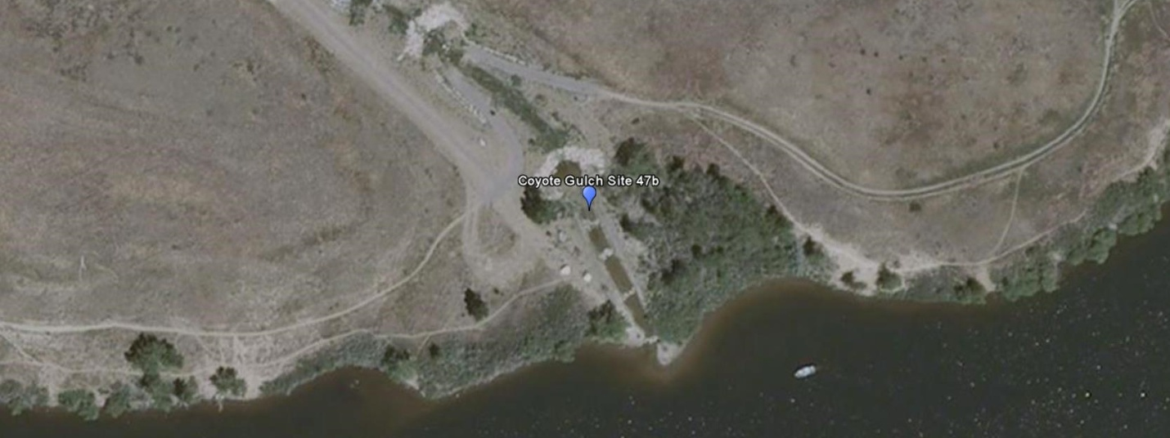
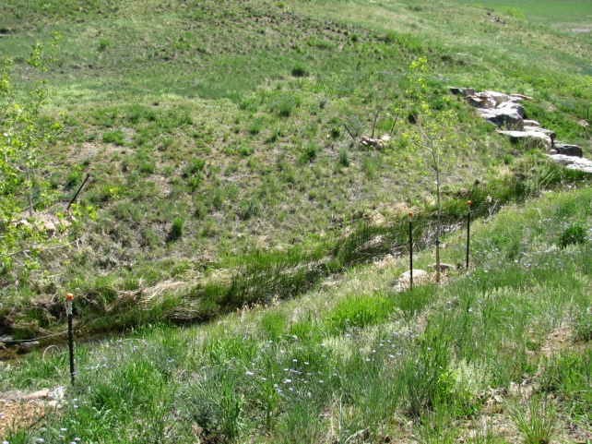
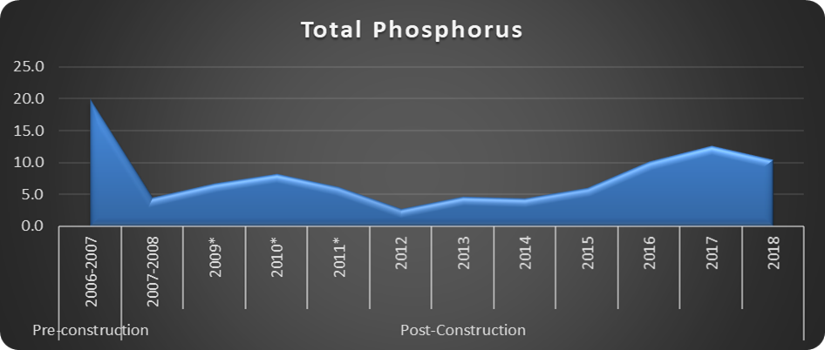
Coyote Gulch
2006-2018
Trade Pounds = 78.3

Slide 26
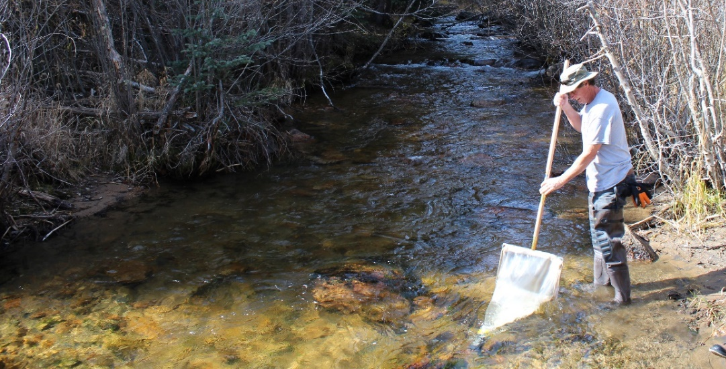

Slide 27
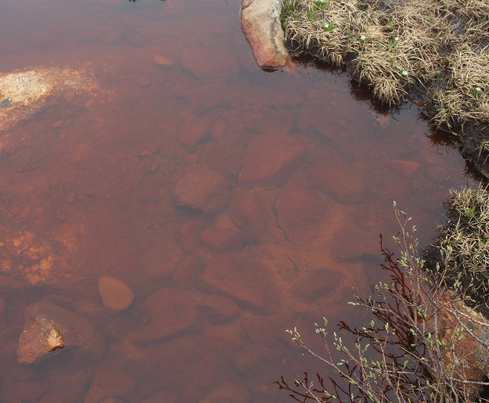

Slide 29
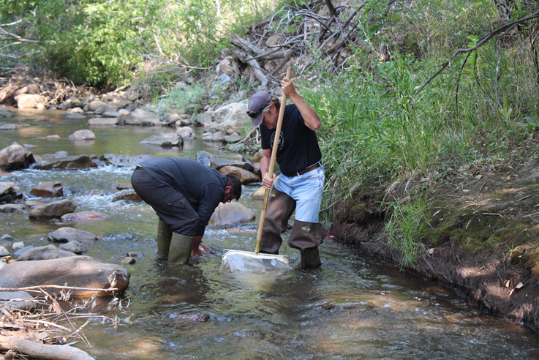
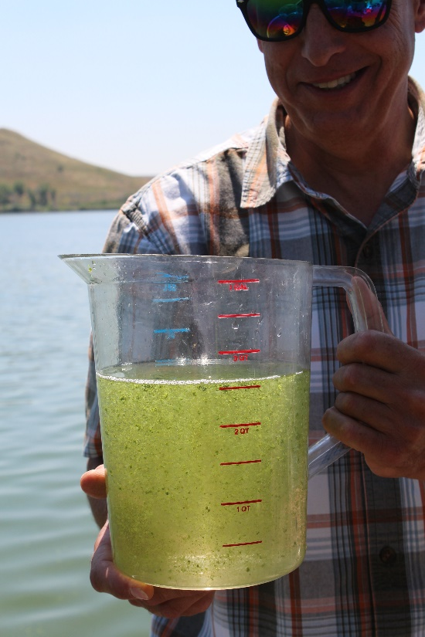
BCWA spent $2.2 million on regulation directed programs
$1.35 million on data & monitoring efforts
29-years of data & studies to support good science
>$2 million on water quality improvement projects
Discharger members have spent >$21 million on WWTFs
BCWA has 79.5 years worth of voluntary efforts

Slide 30
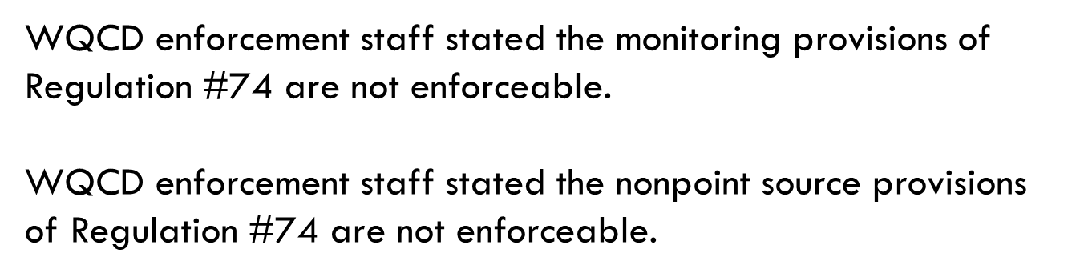

Slide 31
