Slide 1

The Bear Creek Watershed Association protects & restores water & environmental quality within the Bear Creek Watershed from the effects of land use.

Slide 2
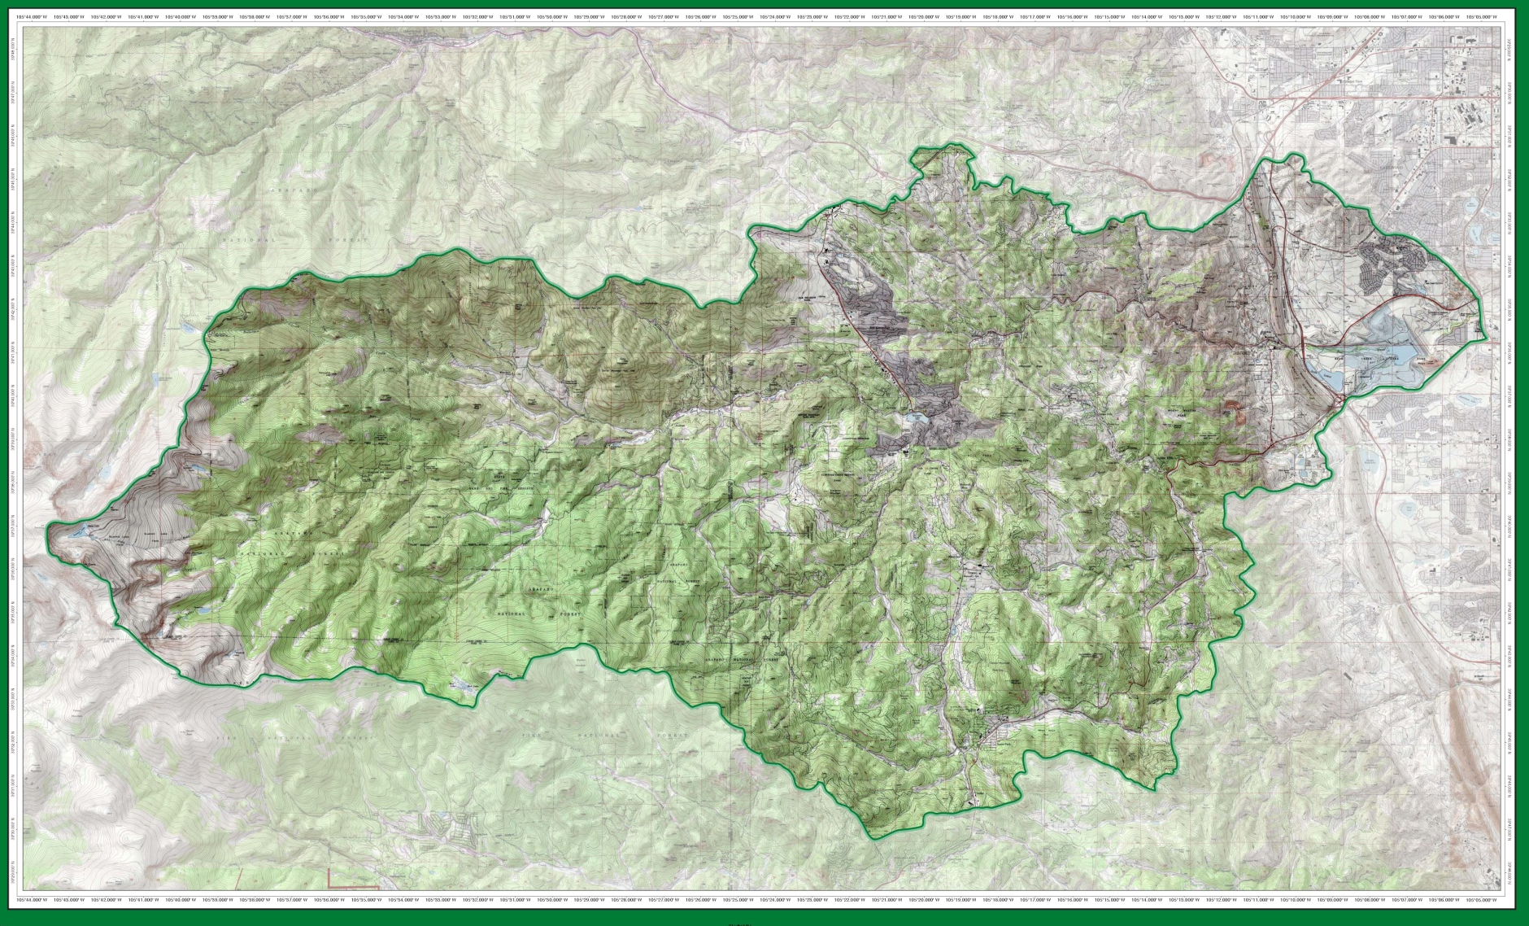
Operational Bear Creek Watershed 2019

Slide 3
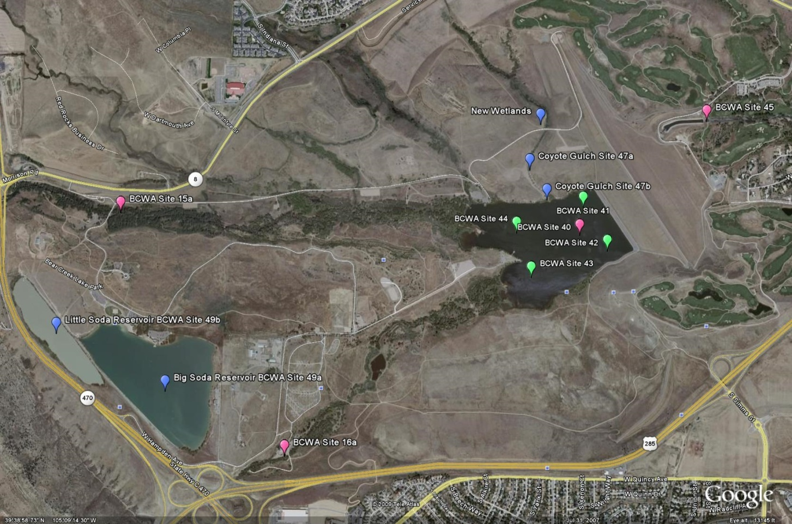

Slide 4
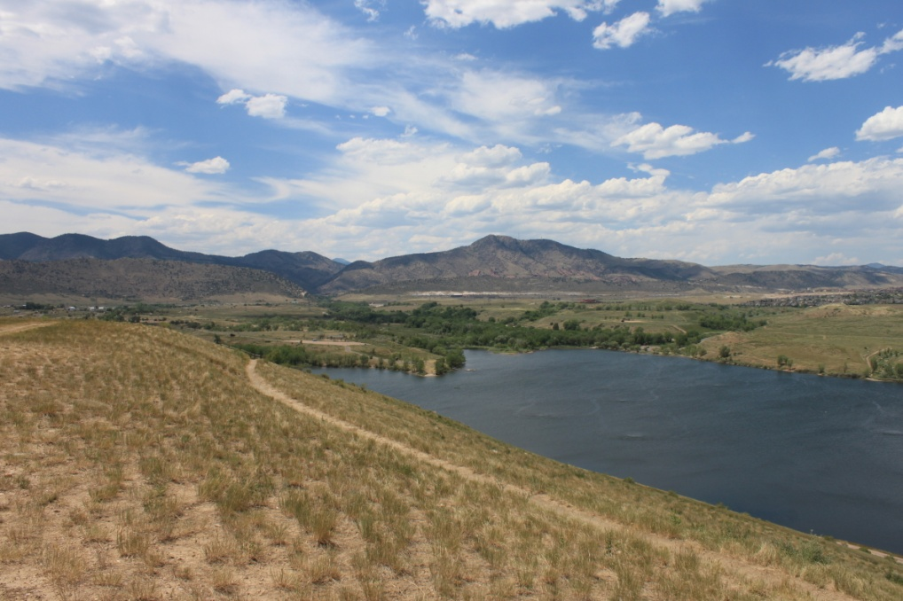
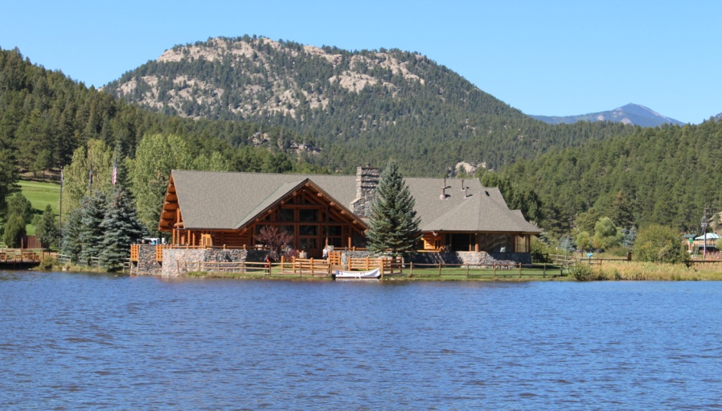
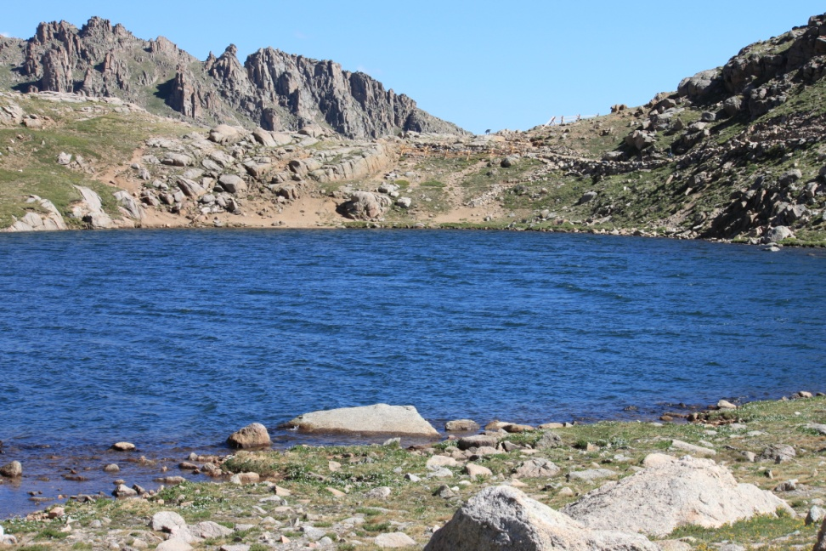
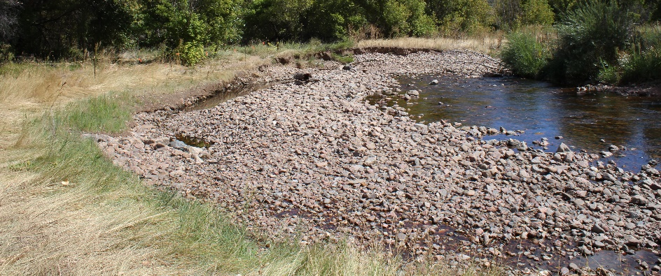
105 Stream Monitoring Sites
Bear Creek Reservoir
  Inflow Turkey Creek
  Inflow Bear Creek
  Outflow Site 45
  Wadsworth Site 90 input Barr/Milton
Evergreen Lake
Summit Lake (Mt Evans)
Other WQ Features

Slide 5
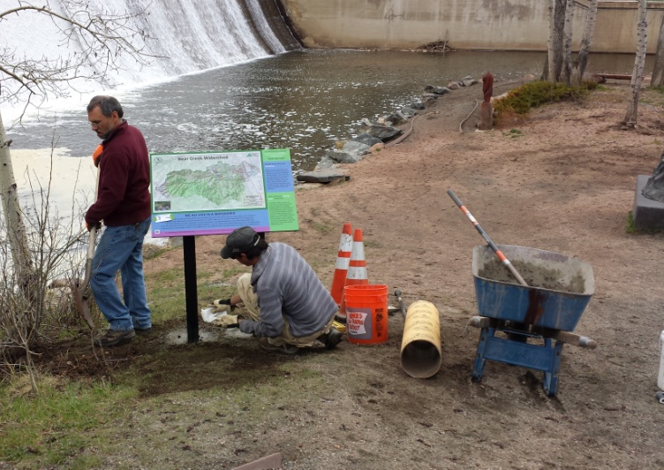
BCWA 2018 Watershed Plan
Online Decision Support Program
Electronic Online Watershed Plan
  37 Policies
  69 Fact Sheets
  27 Data Masters
  36 Informational Maps
  28-yrs of Rulemaking & Standards
  39 Program Documents
  >100 linked reports & documents
  18 Wastewater Management Summaries
  + Other Informational, Methods, Program Guidance, Technical Series, Special Studies, Annual Monitoring Plans
Photo Library
Quarterly Newsletter (>350)
NPS education
Membership special programs

Slide 6
Average seasonal total phosphorus of 61.8 µg/L in BCR exceeds the 22.2 µg/L goal-standard
Average seasonal chlorophyll-a of 16.4 µg/L was over the 12.2 µg/L standard
Trophic status of the reservoir remains at the Eutrophic-Hypertrophic boundary based on Carlson and Walker indices
Seasonal average reservoir temperature (-1/2-2m) = 21.4ºC with exceedances of the WAT (32) and DM (86)
Lake aeration maintained dissolved oxygen levels (-1/2-2m) at or above 6.0 mg/L throughout most of the growing season
Late season blue-green algal blooms
Recreational fishing remained active

Slide 7
 | 2018 Total Phosphorus Loading (Pounds)
 | Total TP Load | PS | %PS | NPS | %NPS
Turkey Creek Drainage | 75 | 39 | 52.2% | 36 | 48%
Bear Creek Drainage | 666 | 951 | 142.7% | -285 | -43%
Discharged into Reservoir | 741 | 990 | 133.6% | -249 | -34%
Site 45 Outflow BCR | 409
BCR Total Phosphorus Deposition | 332
Site 90 - Lower Bear Creek | 747
NPS load increase between 45 and 90 | 45% | 338

Slide 8
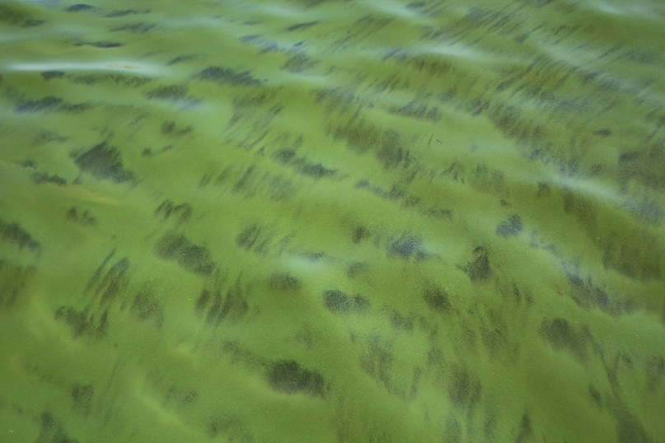
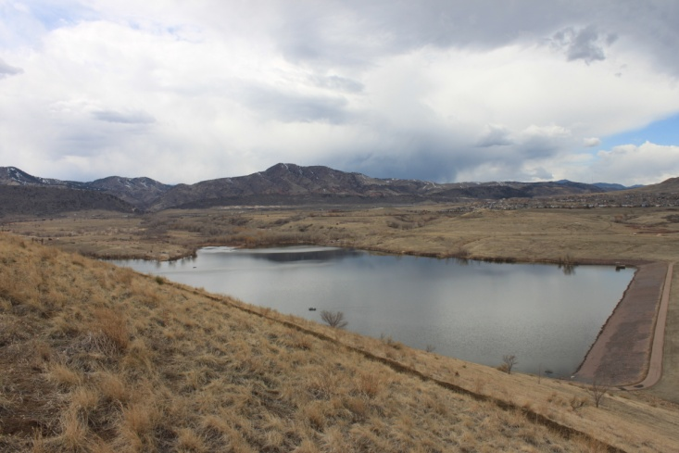

Slide 9
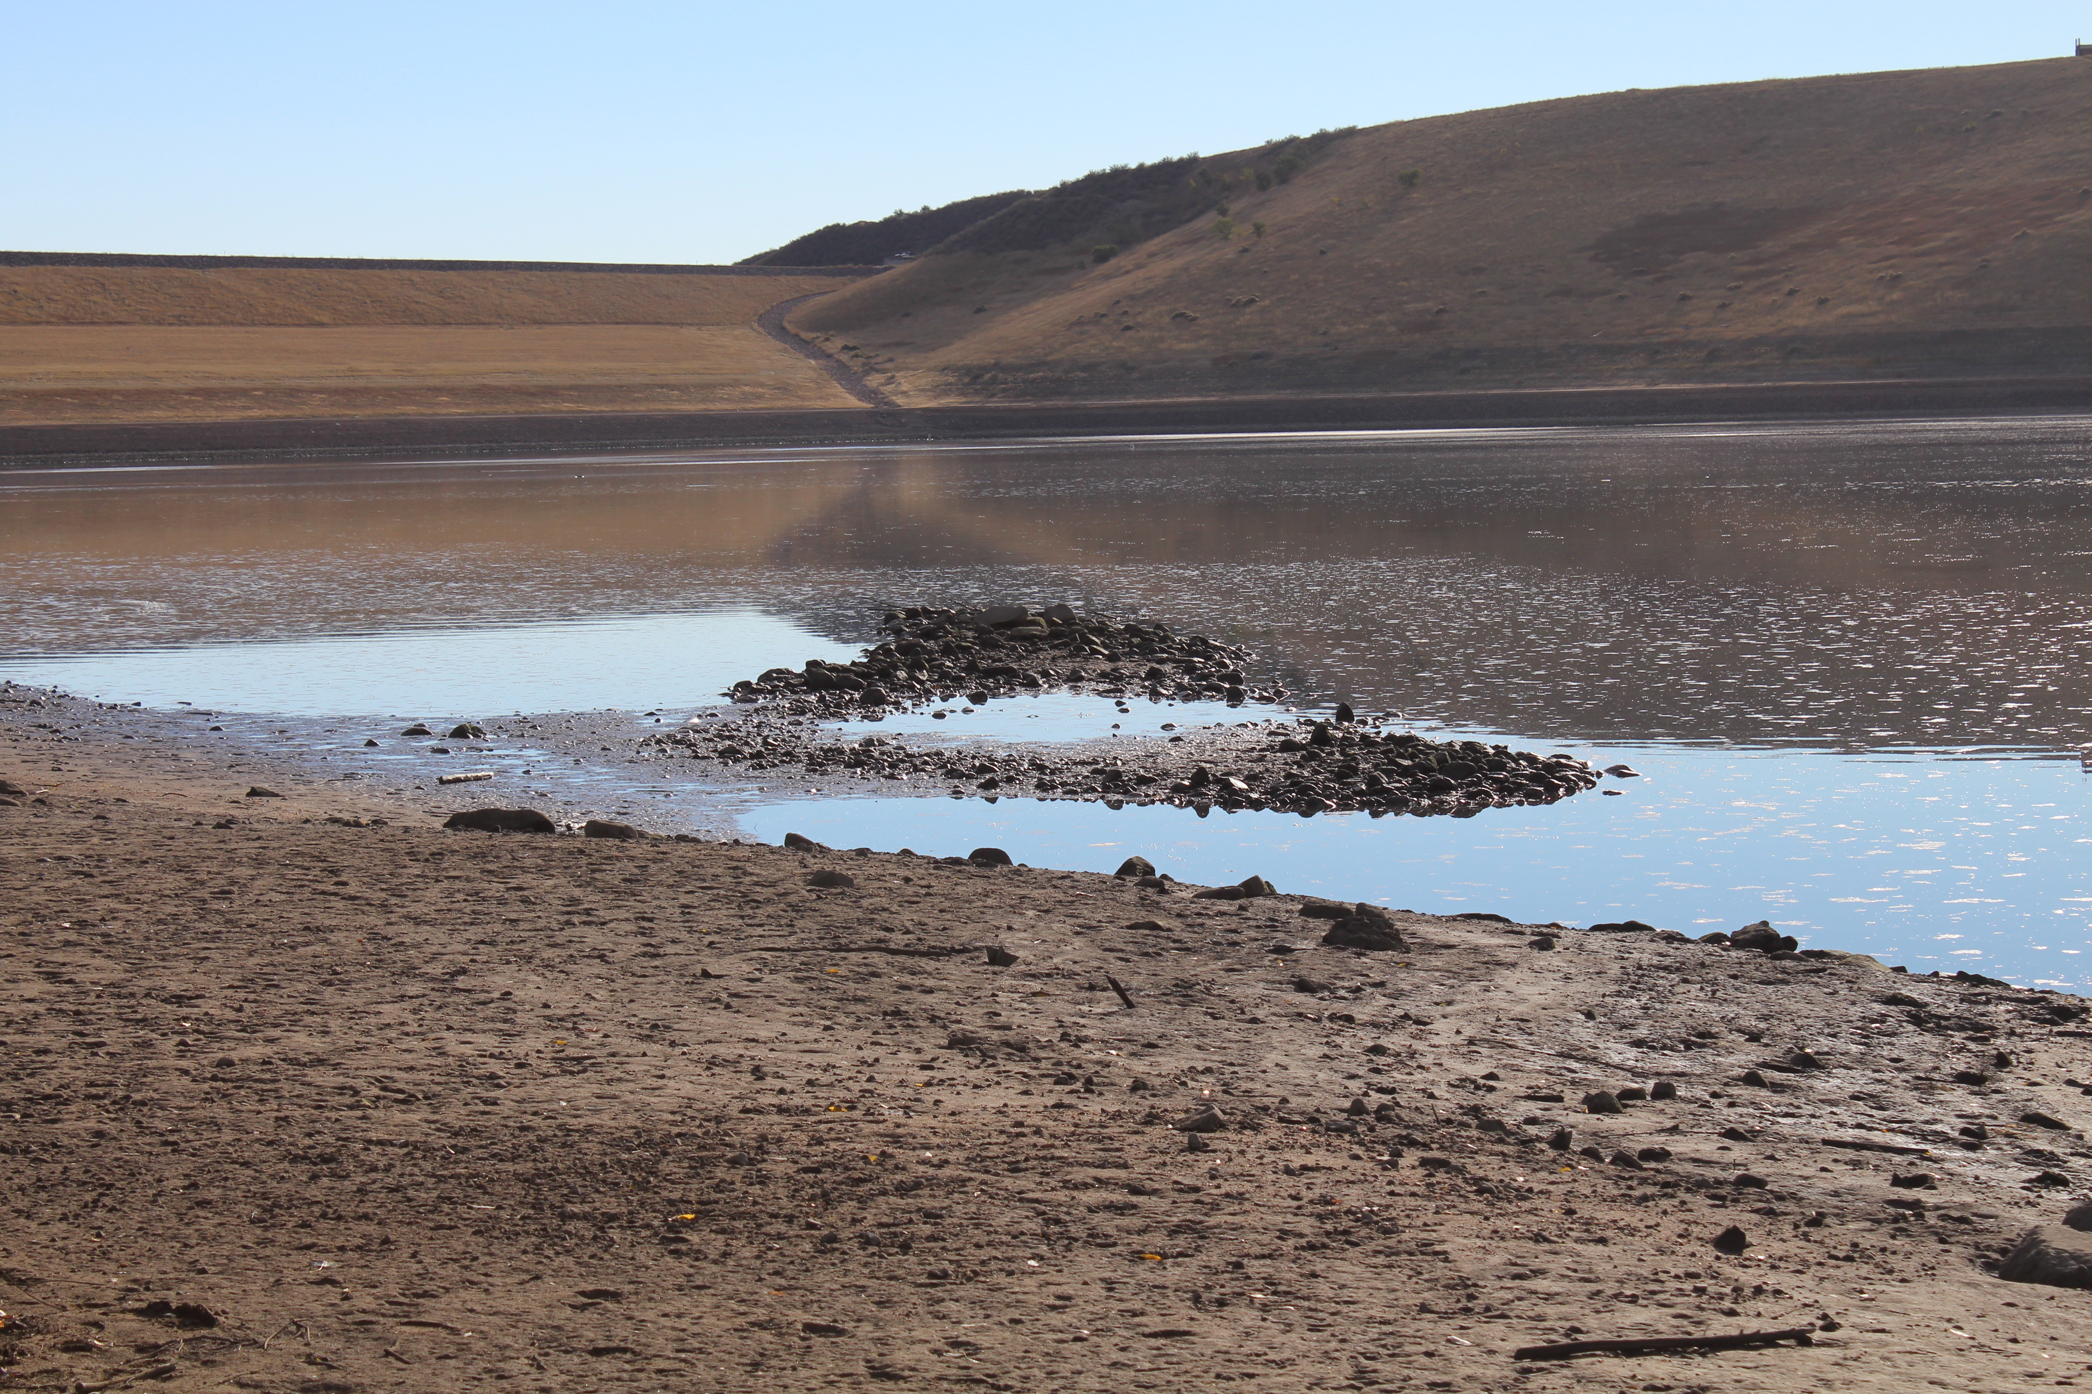
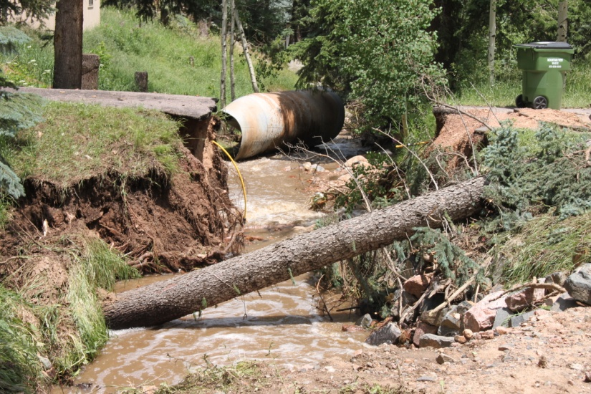
Adaptive Management Program
Nonpoint Source Loading & Tracking
Coyote Gulch - Trading
Septic Systems – Kerr & Cub
Tracking Management Practices
Zoning And Planning Reviews For BMPs
Local Presentations, Education Programs
Flood Restoration Practices
Assist Land-owners
Assist Invasive Species Programs
Green Infrastructure Projects
Wildfire Assessment
Source Water Protection
Tributary Loading Studies
Erosion Control Reviews
Online Adaptive Management
Climate Modeling

Slide 10
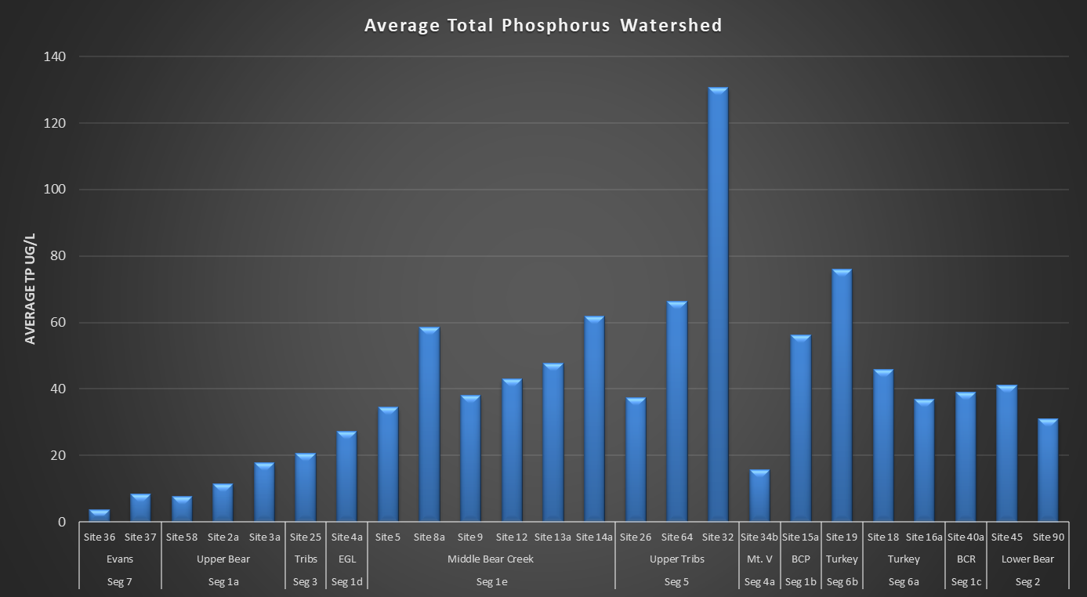

Slide 11
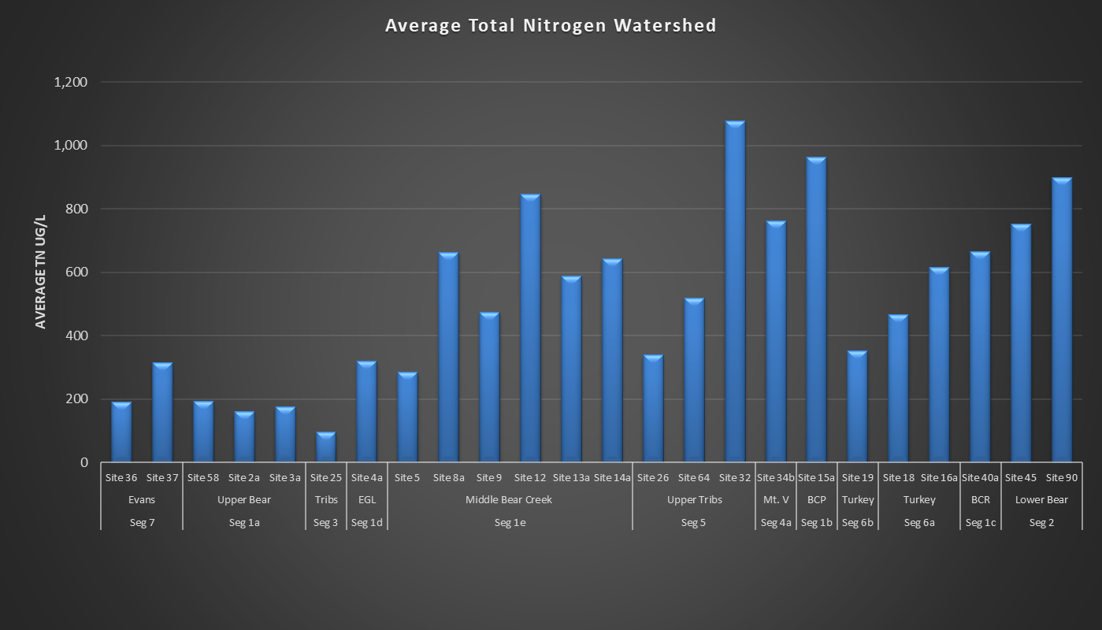

Slide 18
