Slide 1
Bear Creek Watershed Association
Bear Creek Watershed Hydrology - Expect the Unexpected
Russell Clayshulte - Manager

Slide 2
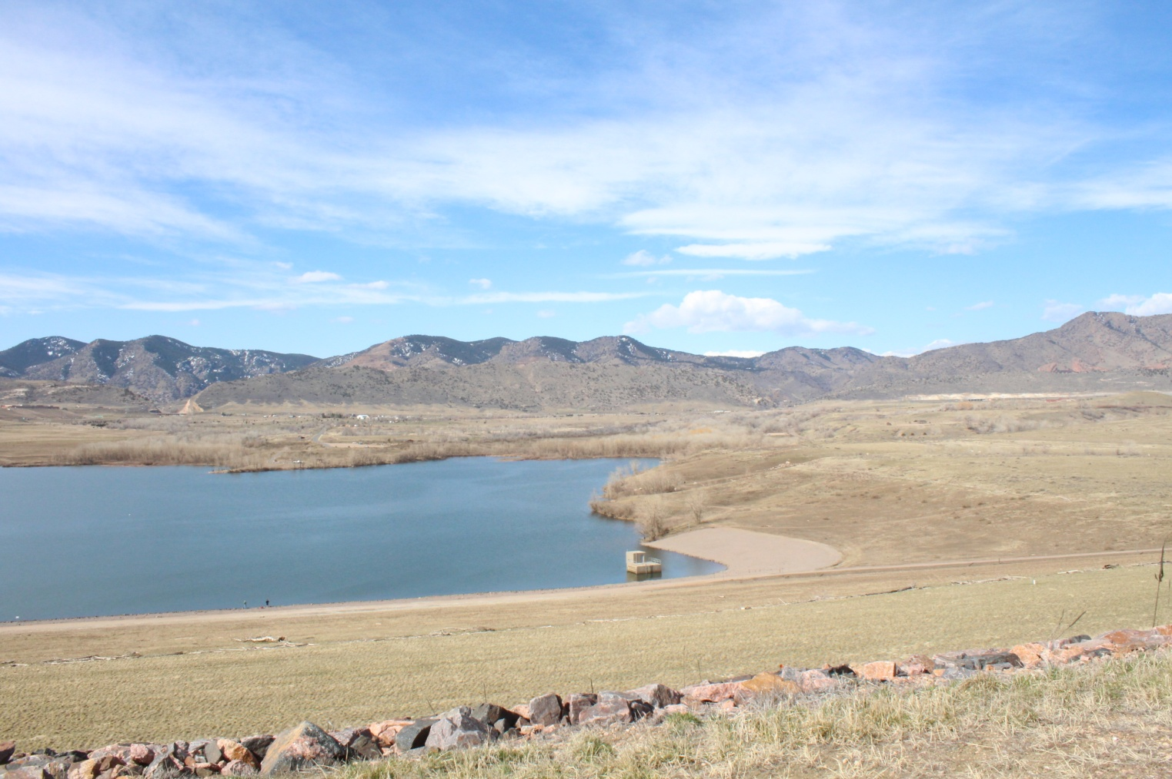
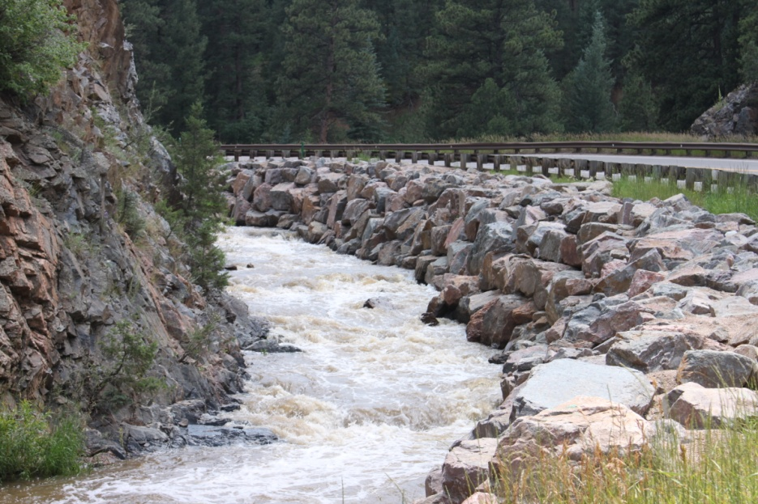
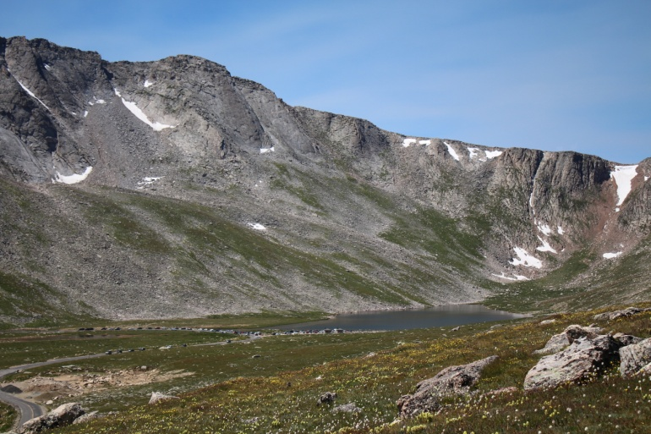
The Bear Creek Watershed Association protects & restores water & environmental quality within the Bear Creek Watershed from the effects of land use.

Slide 3
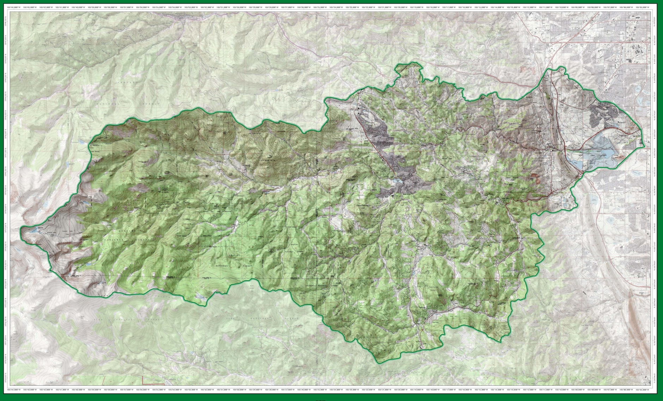
Bear Creek Watershed 2016

Slide 4
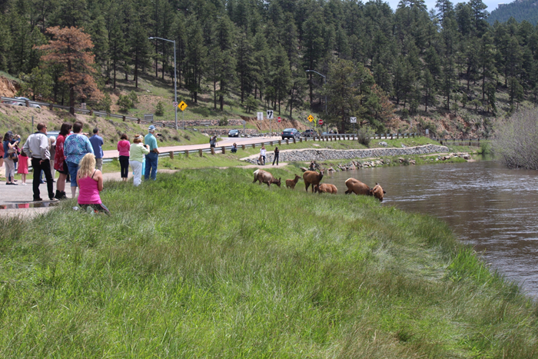
2015 Estimates of Recreation Use Bear Creek Watershed
Recreational Users Bear Creek Park > 580,000
People Traveling to Mt. Evans > 177,000
Mt. Evans Wilderness lower access > 25,000
Users Denver Mountain Parks > 225,000
Jefferson County Open Space > 80,000
Users Evergreen Lake > 275,000
Attendees & Visitors Red Rocks/Morrison >1.3 million
Bear Creek Park Swim Beach Use > 750 per weekend
Fishing > 65,000 people per year
BCWA Fact Sheet 43 BCW Audubon Breeding Bird Atlas
BCWA Fact Sheet 35 Recreational Uses in BCW >50
BCWA Fact Sheet 36 Larger Mammals
BCWA Fact Sheet 12 Fish Species
BCW Total Species
Common Sport Fish | Other Report Fish
16 | 14
BCWA Fact Sheet 37 Smaller Mammals

Slide 5
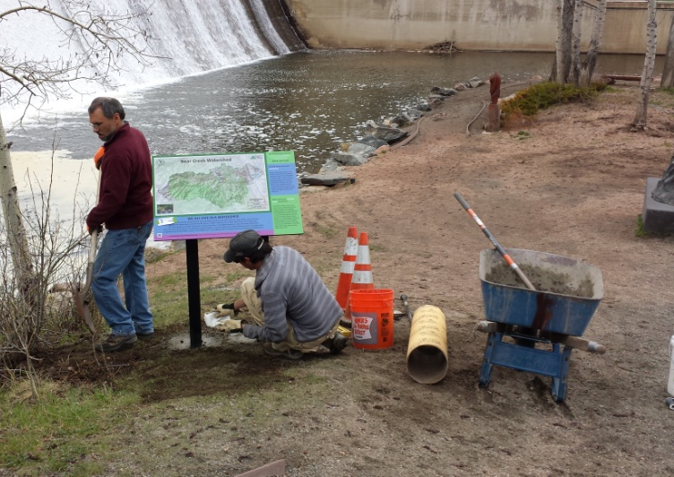
BCWA 2016 Watershed Plan
Online Decision Support Program
Electronic Watershed Plan (10.8 GB)
35 Policies
54 Fact Sheets
18 Data Masters
34 Informational Maps
20-yrs of Rulemaking & Standards
26 Program Documents
>90 linked reports & documents
18 Wastewater Management Summaries
+ Other Informational, Methods, Program Guidance, Technical Series, Special Studies, Annual Monitoring Plans
Photo Library (>18 GB)
Quarterly Newsletter (>300)
Increased NPS education
Membership special programs

Slide 6
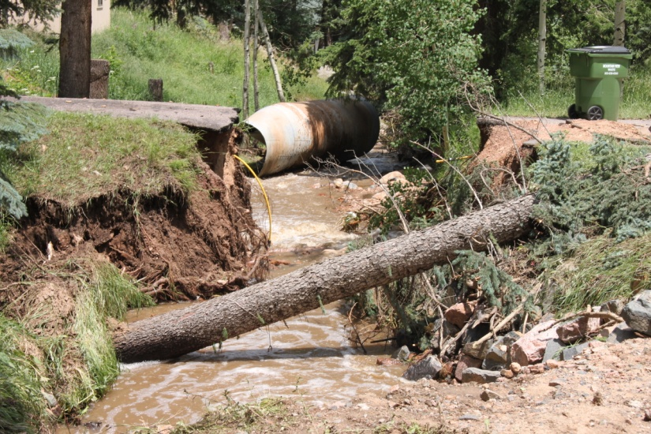
Adaptive Management Program
Nonpoint source loading & tracking
Coyote Gulch - Trading
Septic Systems – Kerr & Cub
Tracking management practices
Zoning and planning reviews for BMPs
Local presentations, education programs
Flood restoration practices
Assist land-owners
Assist invasive species programs
Green Infrastructure projects
Wildfire assessment
Source water protection
Tributary loading studies
Erosion Control Reviews
Online adaptive management
Climate Modeling

Slide 7
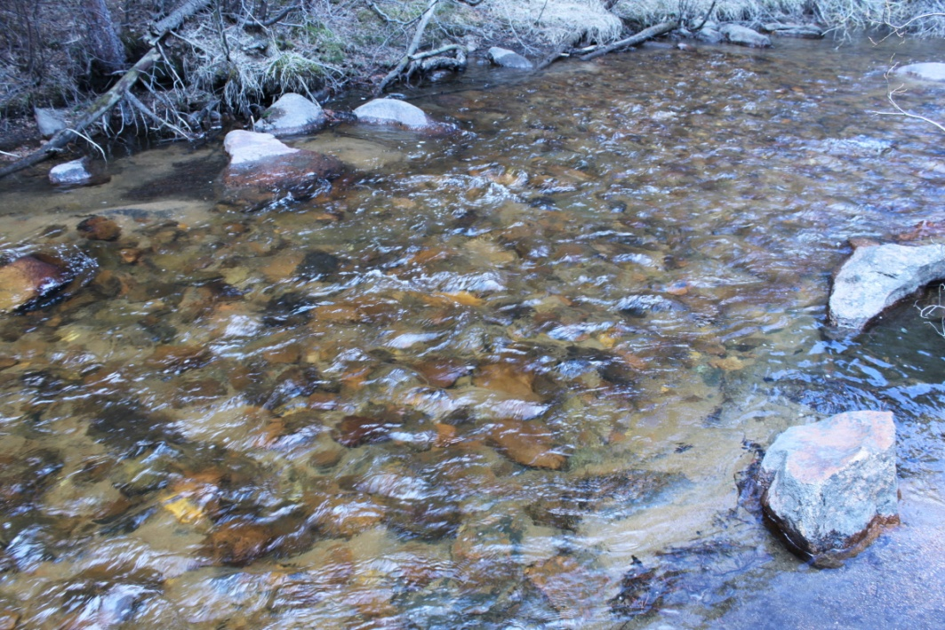
Monitoring Program Elements
Water quality monitoring program
94 Sites (some monitored since 1991)
5 Bear Creek Reservoir monitoring profiles
Evergreen Lake profiles
Physical, Chemistry & Biology
Year round temperature monitoring of Bear Creek and Turkey Creek
>3,500,000 measurements
Monitor total phosphorus, dissolved phosphorus, nitrate+nitrite, total ammonia, total nitrogen, TIN, oxygen, specific conductance, temp, carbon, pH, bacteria, phytoplankton, zooplankton, chlorophyll, Secchi, TSS
Special Studies
Fishery surveys at 12 sites
Macroinvertebrate collections
Habitat
Flow studies
BMP Effectiveness
Stormwater data collection
E. Coli
Septic Systems Contributions
Lake Sediments
Erosion Potential

Slide 8
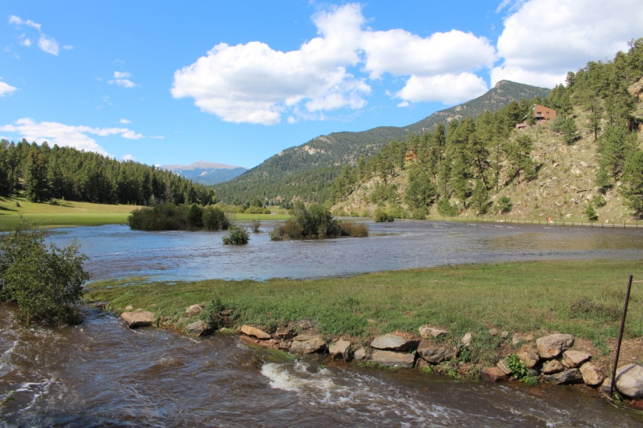
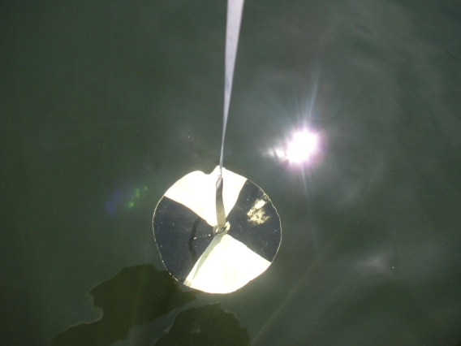
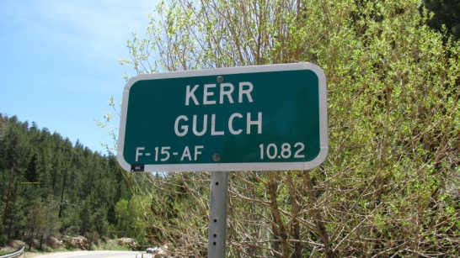
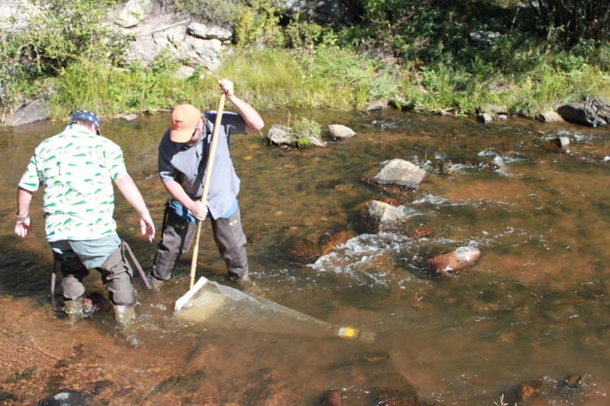
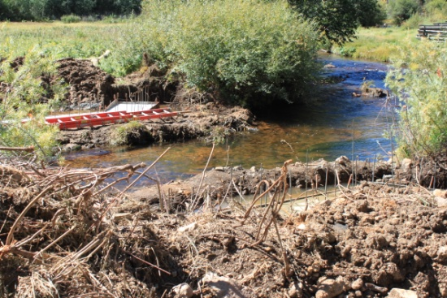
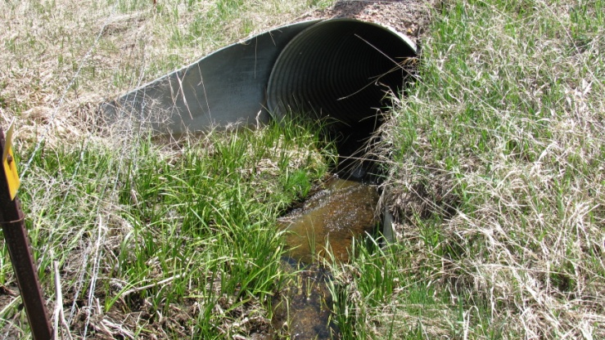
Bear Creek Watershed Association Surface Water Monitoring Program Version 2016.01
Annually reviewed and updated

Slide 9
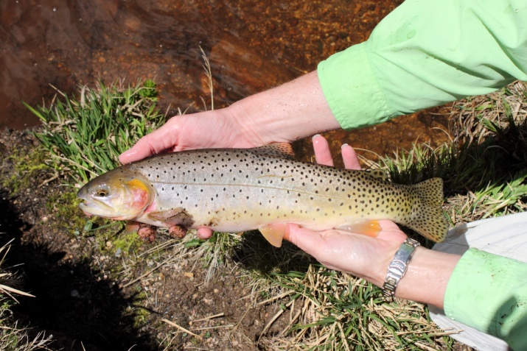
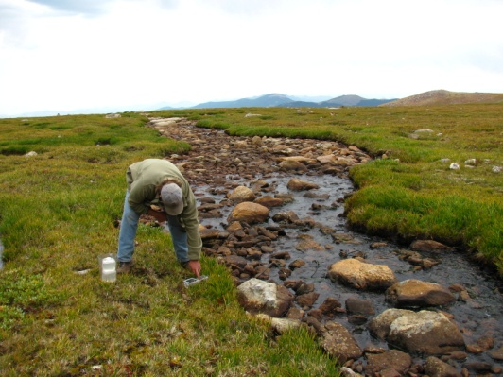
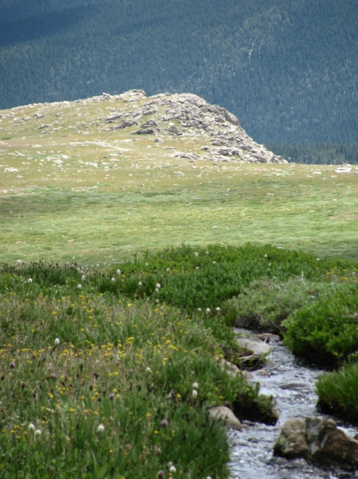
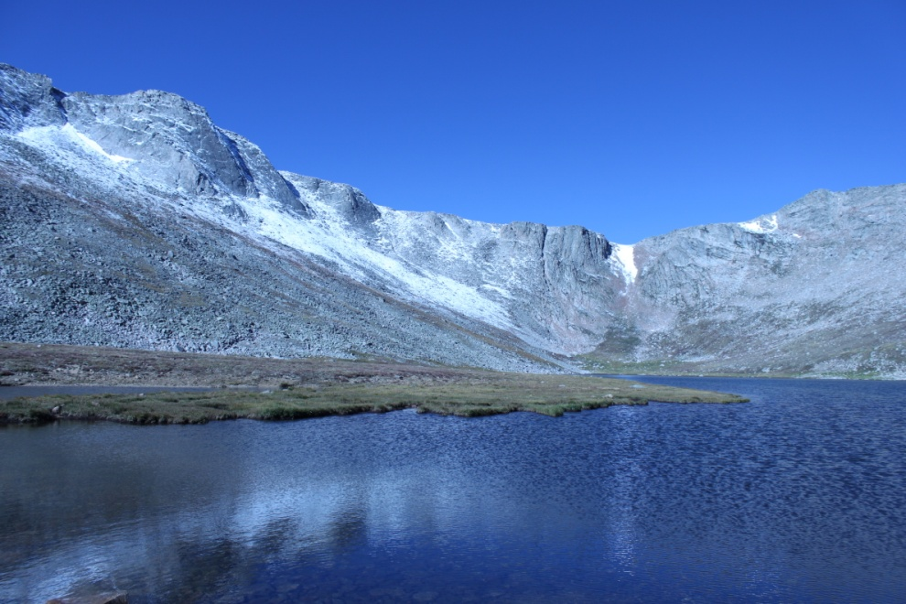
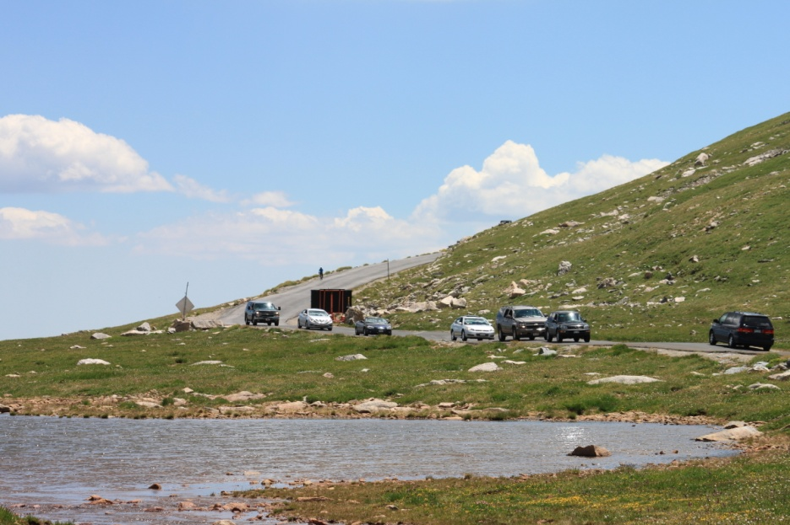
Stream Monitoring Begins at the Top

Slide 10
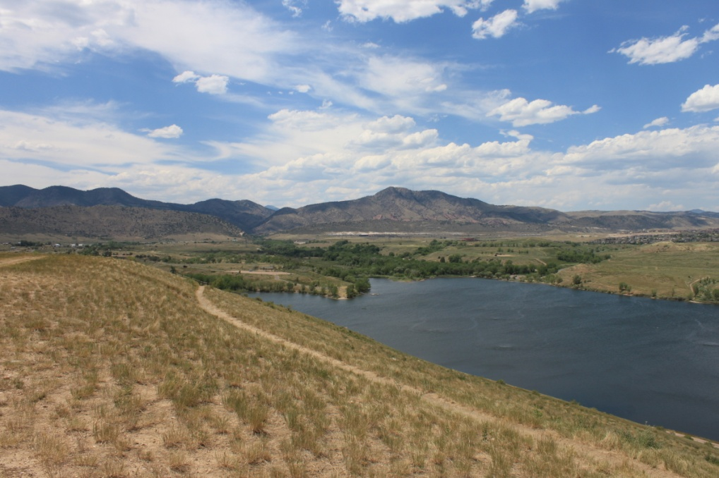
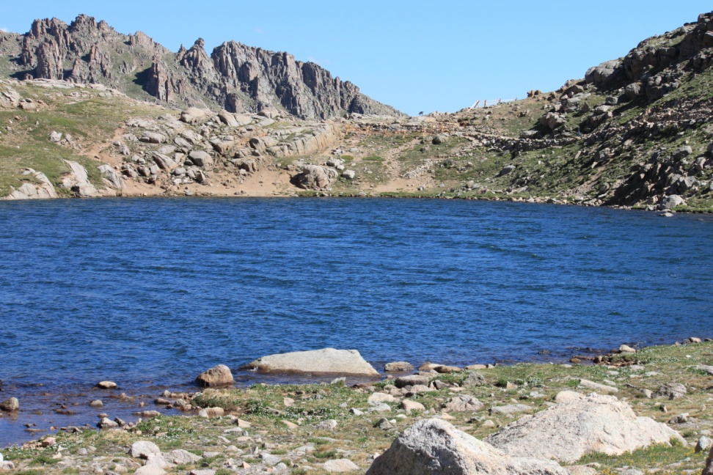
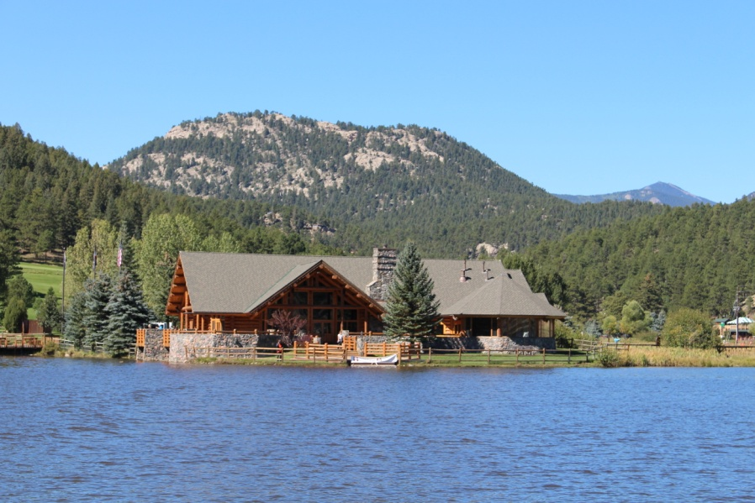
Reservoir/ Lake Studies
Bear Creek Reservoir
Inflow Turkey Creek
Inflow Bear Creek
Outflow site 45 (input Barr/Milton Watershed
Evergreen Lake
Summit Lake
Water Supply Reservoirs

Slide 11
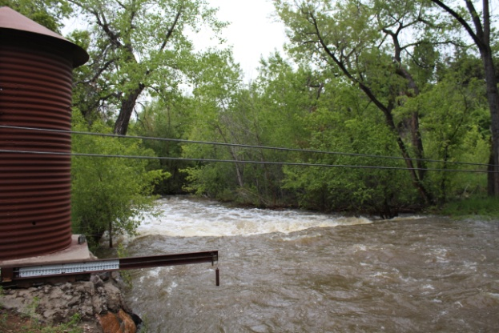
Watershed Hydrology
For 2015 - In the last 115 years, only 2 years with similar flow 1901 & 1944

Slide 12
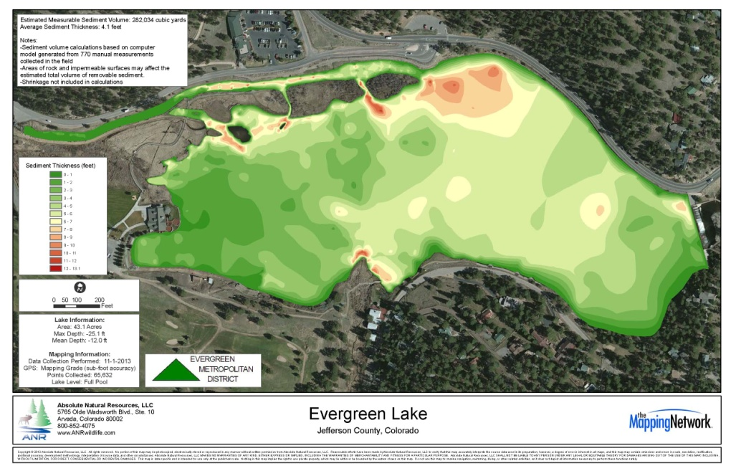
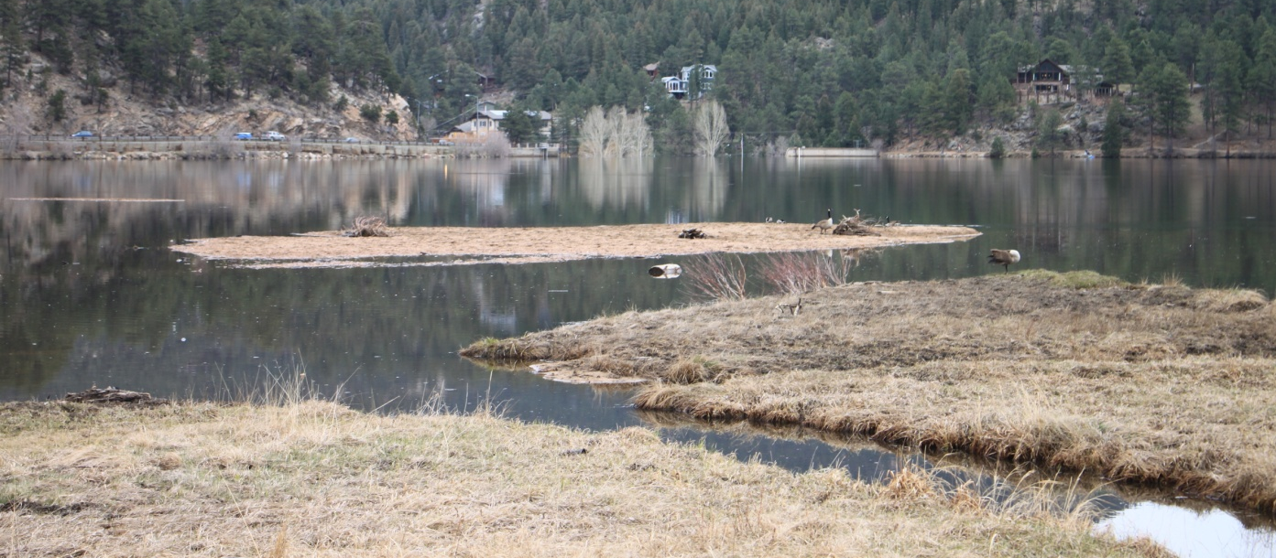
Evergreen Lake Dredging

Slide 13
Evergreen Station

Slide 14
Morrison Station

Slide 15
Morrison Long-Term

Slide 17
Bear Creek Lake Park Station

Slide 19
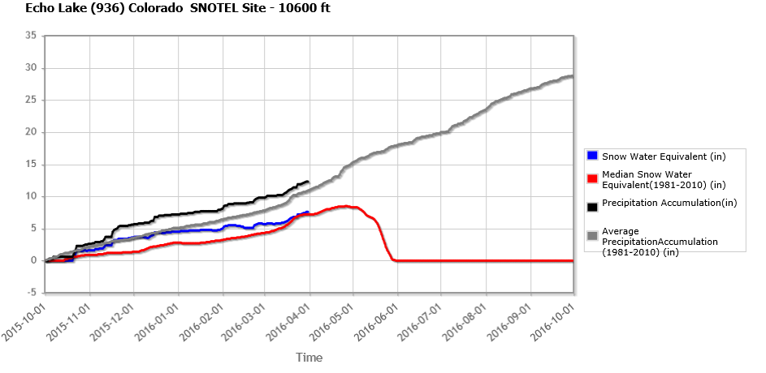

Slide 20
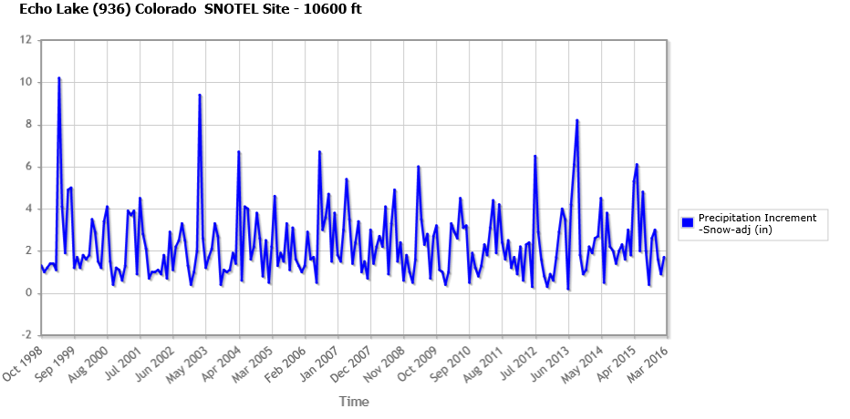

Slide 21
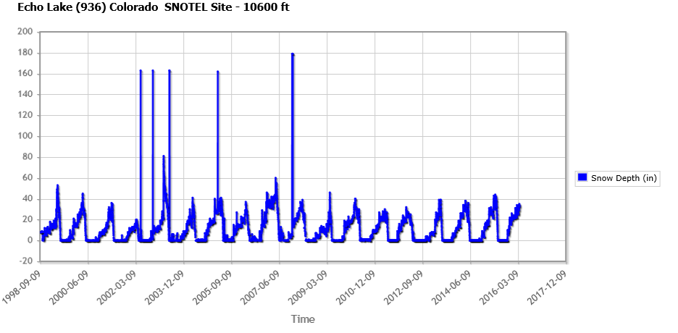

Slide 22
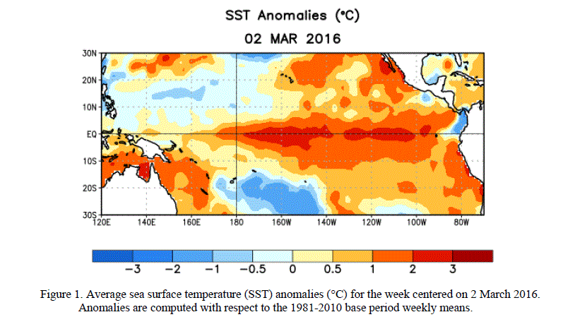
El Nino

Slide 23
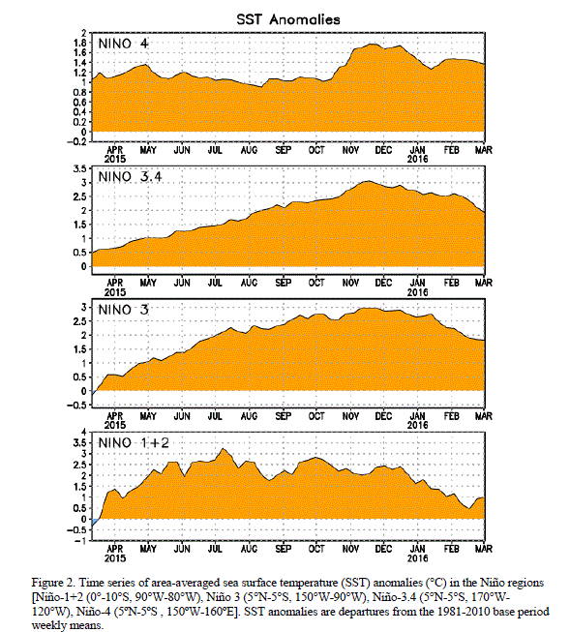

Slide 24
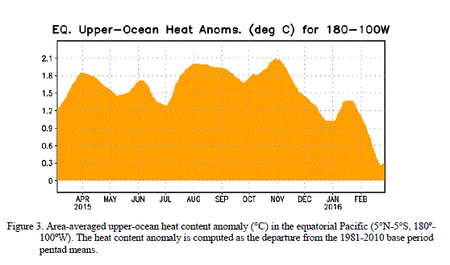

Slide 25
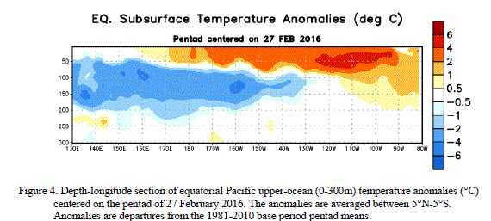

Slide 26
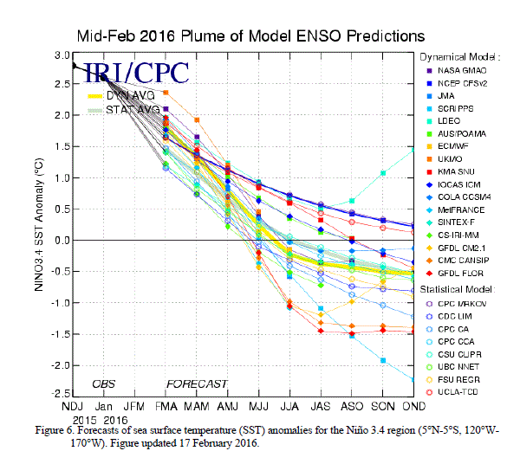

Slide 27
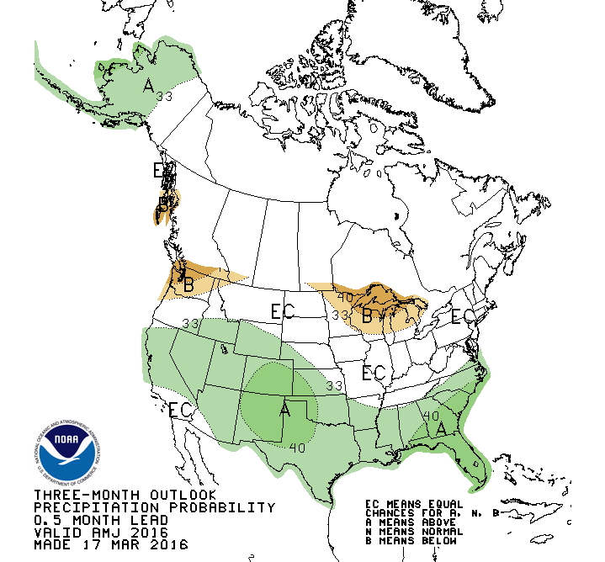

Slide 28
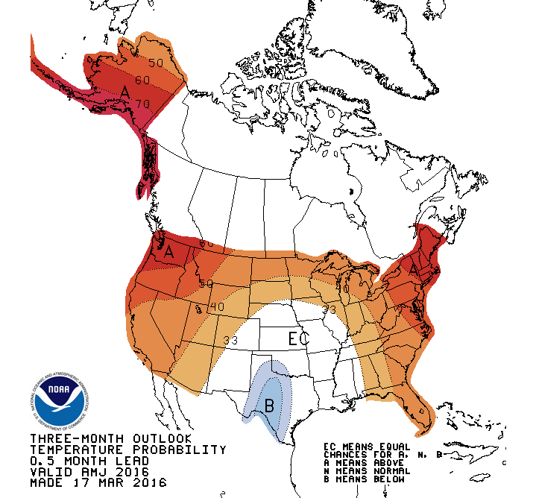

Slide 29
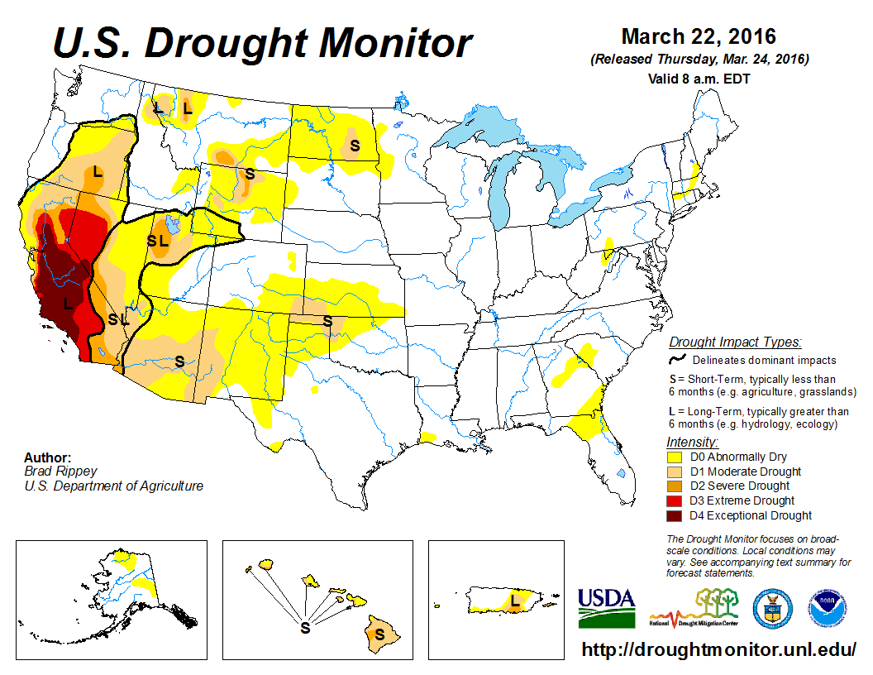

Slide 30
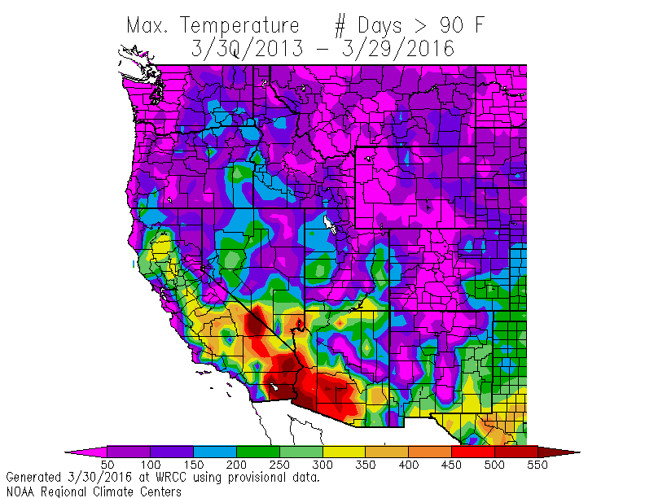

Slide 31
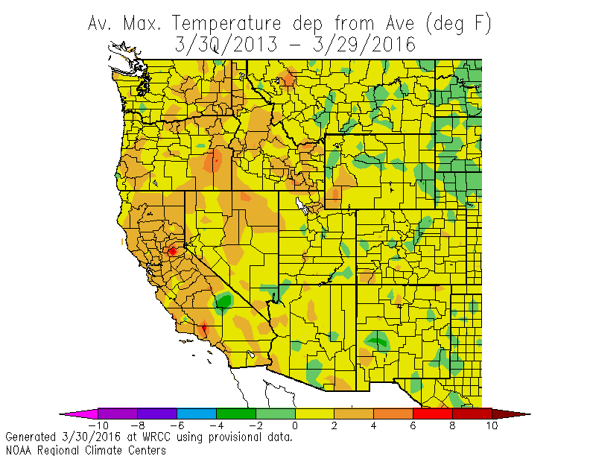

Slide 32
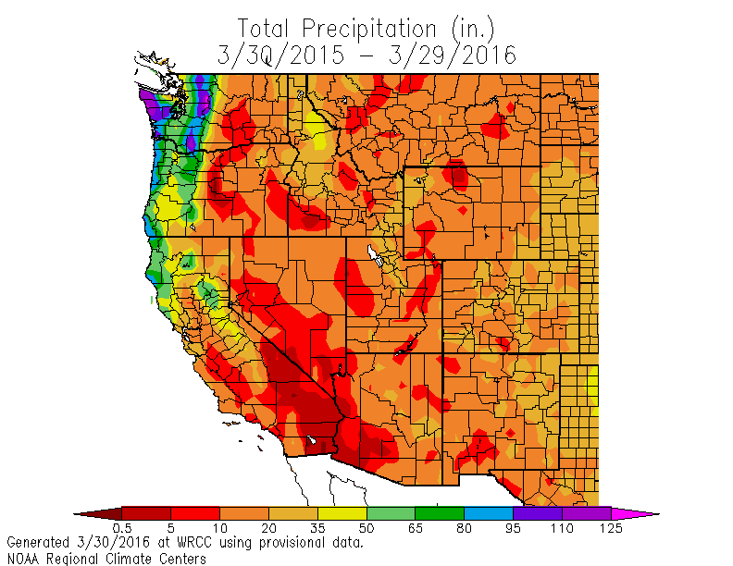

Slide 33
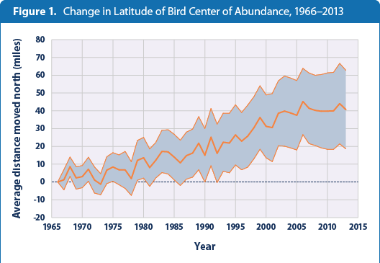

Slide 34
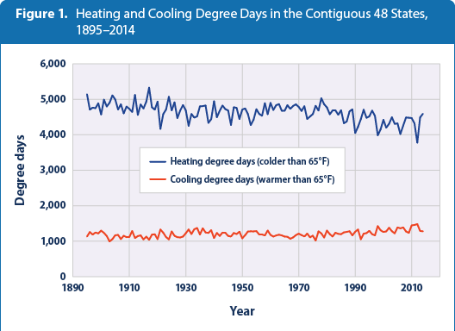

Slide 35
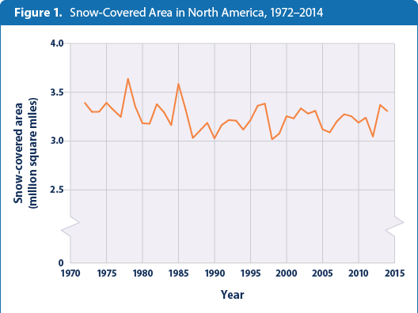

Slide 36
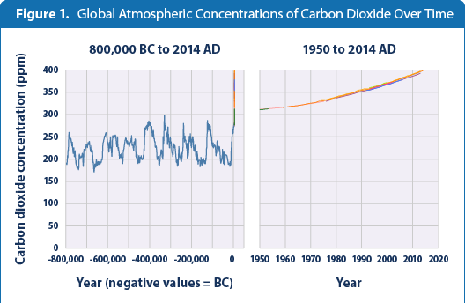

Slide 37
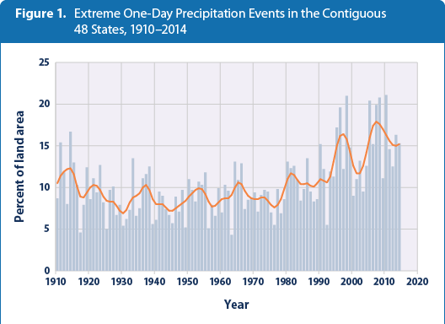

Slide 38
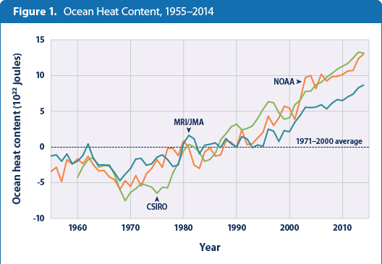

Slide 39
Use EPA Climate Resilience Evaluation and Awareness Tool (CREAT) to understand utility vulnerabilities to climate change impacts, particularly how current water quality and supply problems may worsen with increased periods of drought and more frequent extreme storm events, and how the information from the CREAT assessment can be applied at a watershed scale.
Historical climate observations
Temperature rises – water and air
Shifts in precipitation patterns and timing – Spring runoff period earlier
Drought and Flood
Future climate concerns
Increased frequency and severity of droughts
Increased precipitation and more frequent intense precipitation events
Changes in water quality and availability
Increasing water temperatures in cold water streams

Slide 40
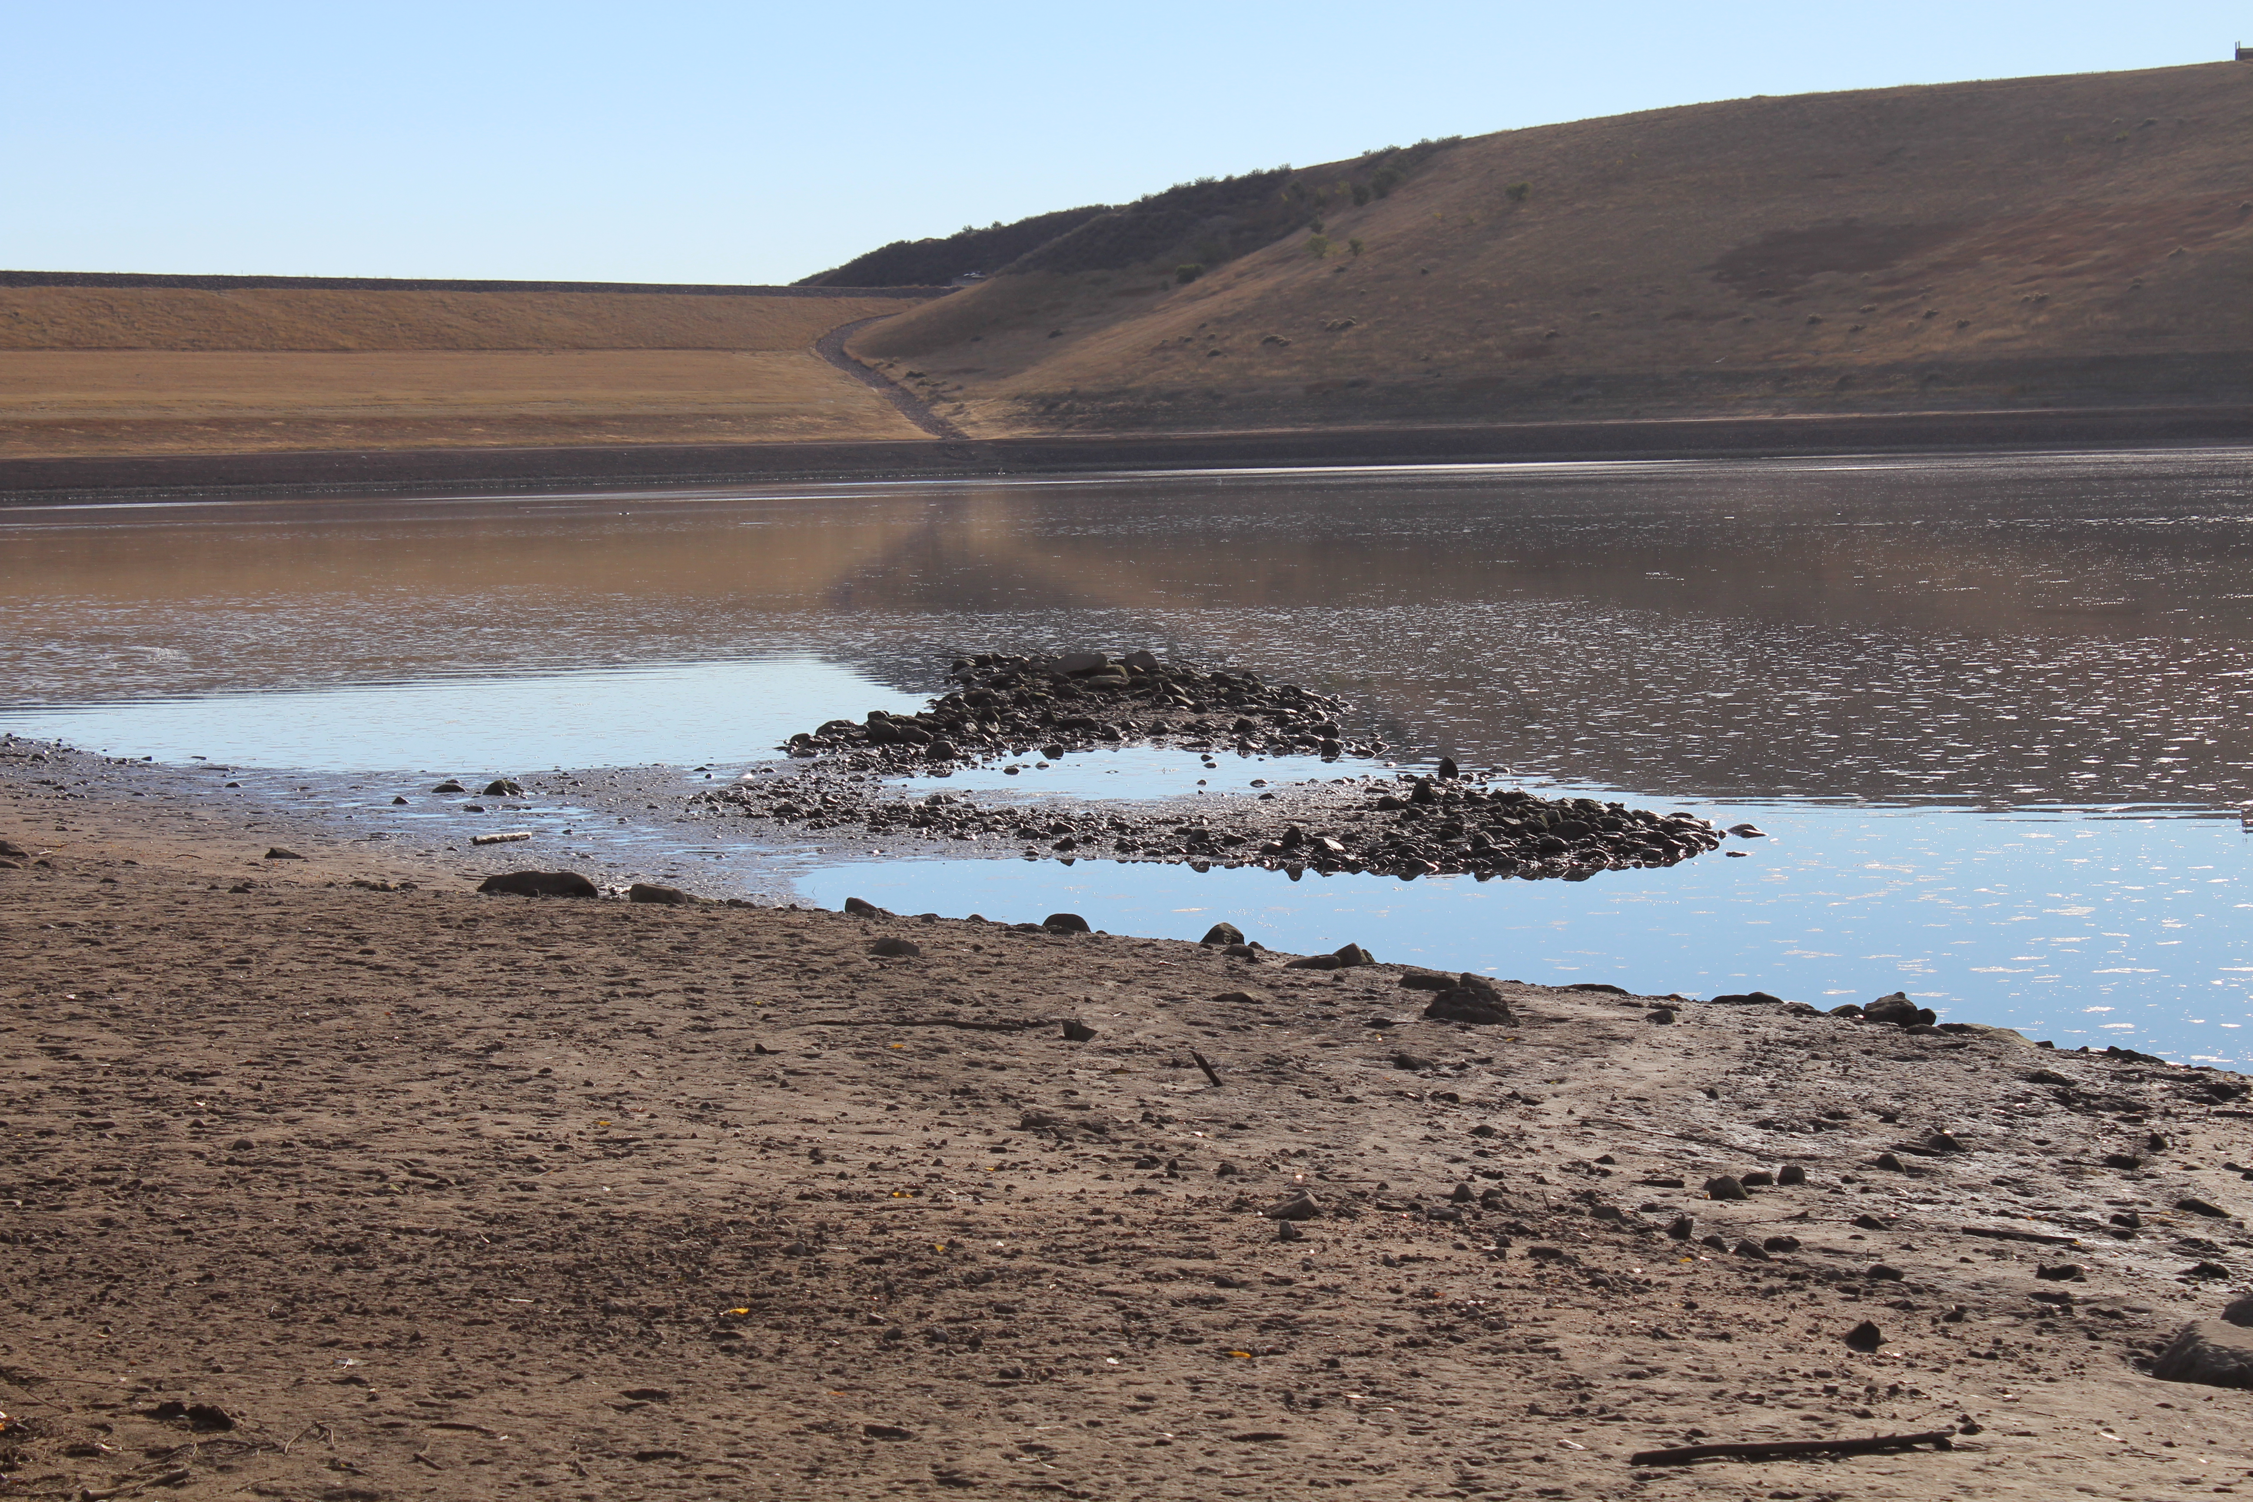

Slide 41
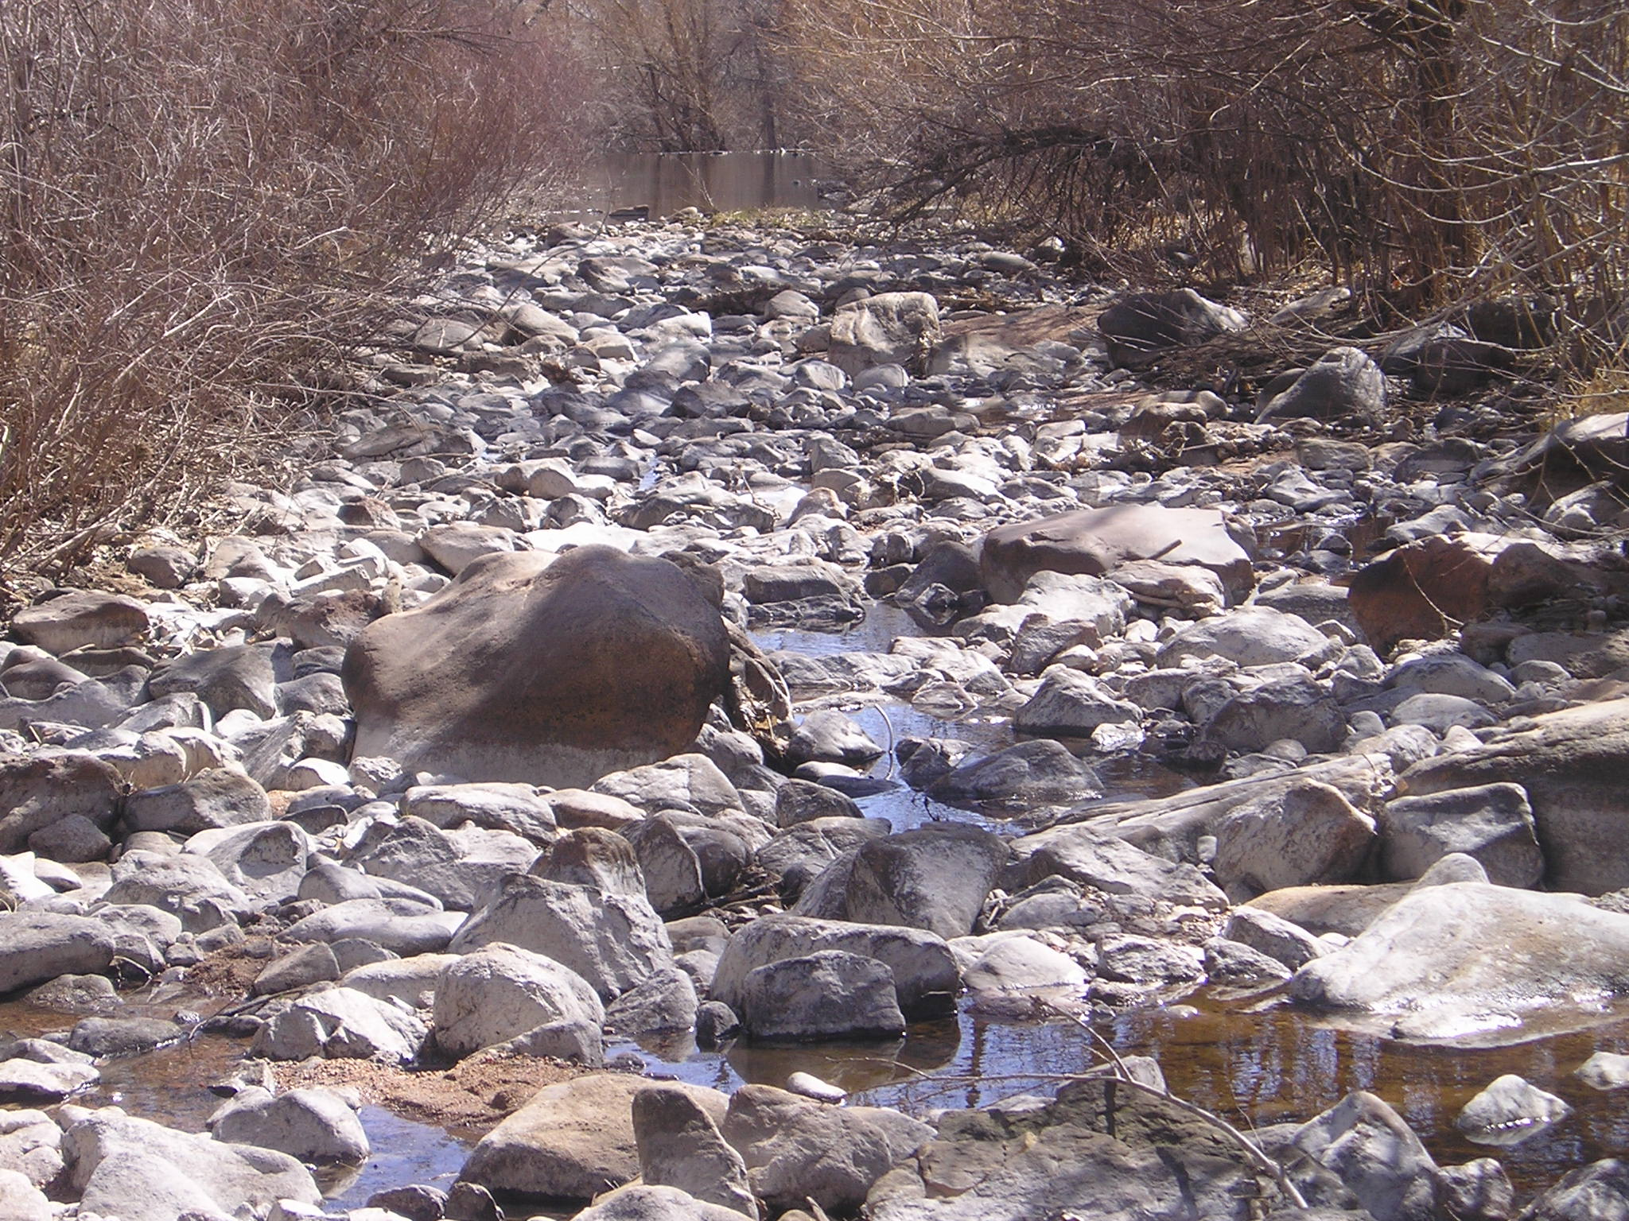

Slide 42
