Slide 1
Evergreen Middle School Nutrient Study
Supported by the BCWA
Tony Langowski
Russell Clayshulte

Slide 2
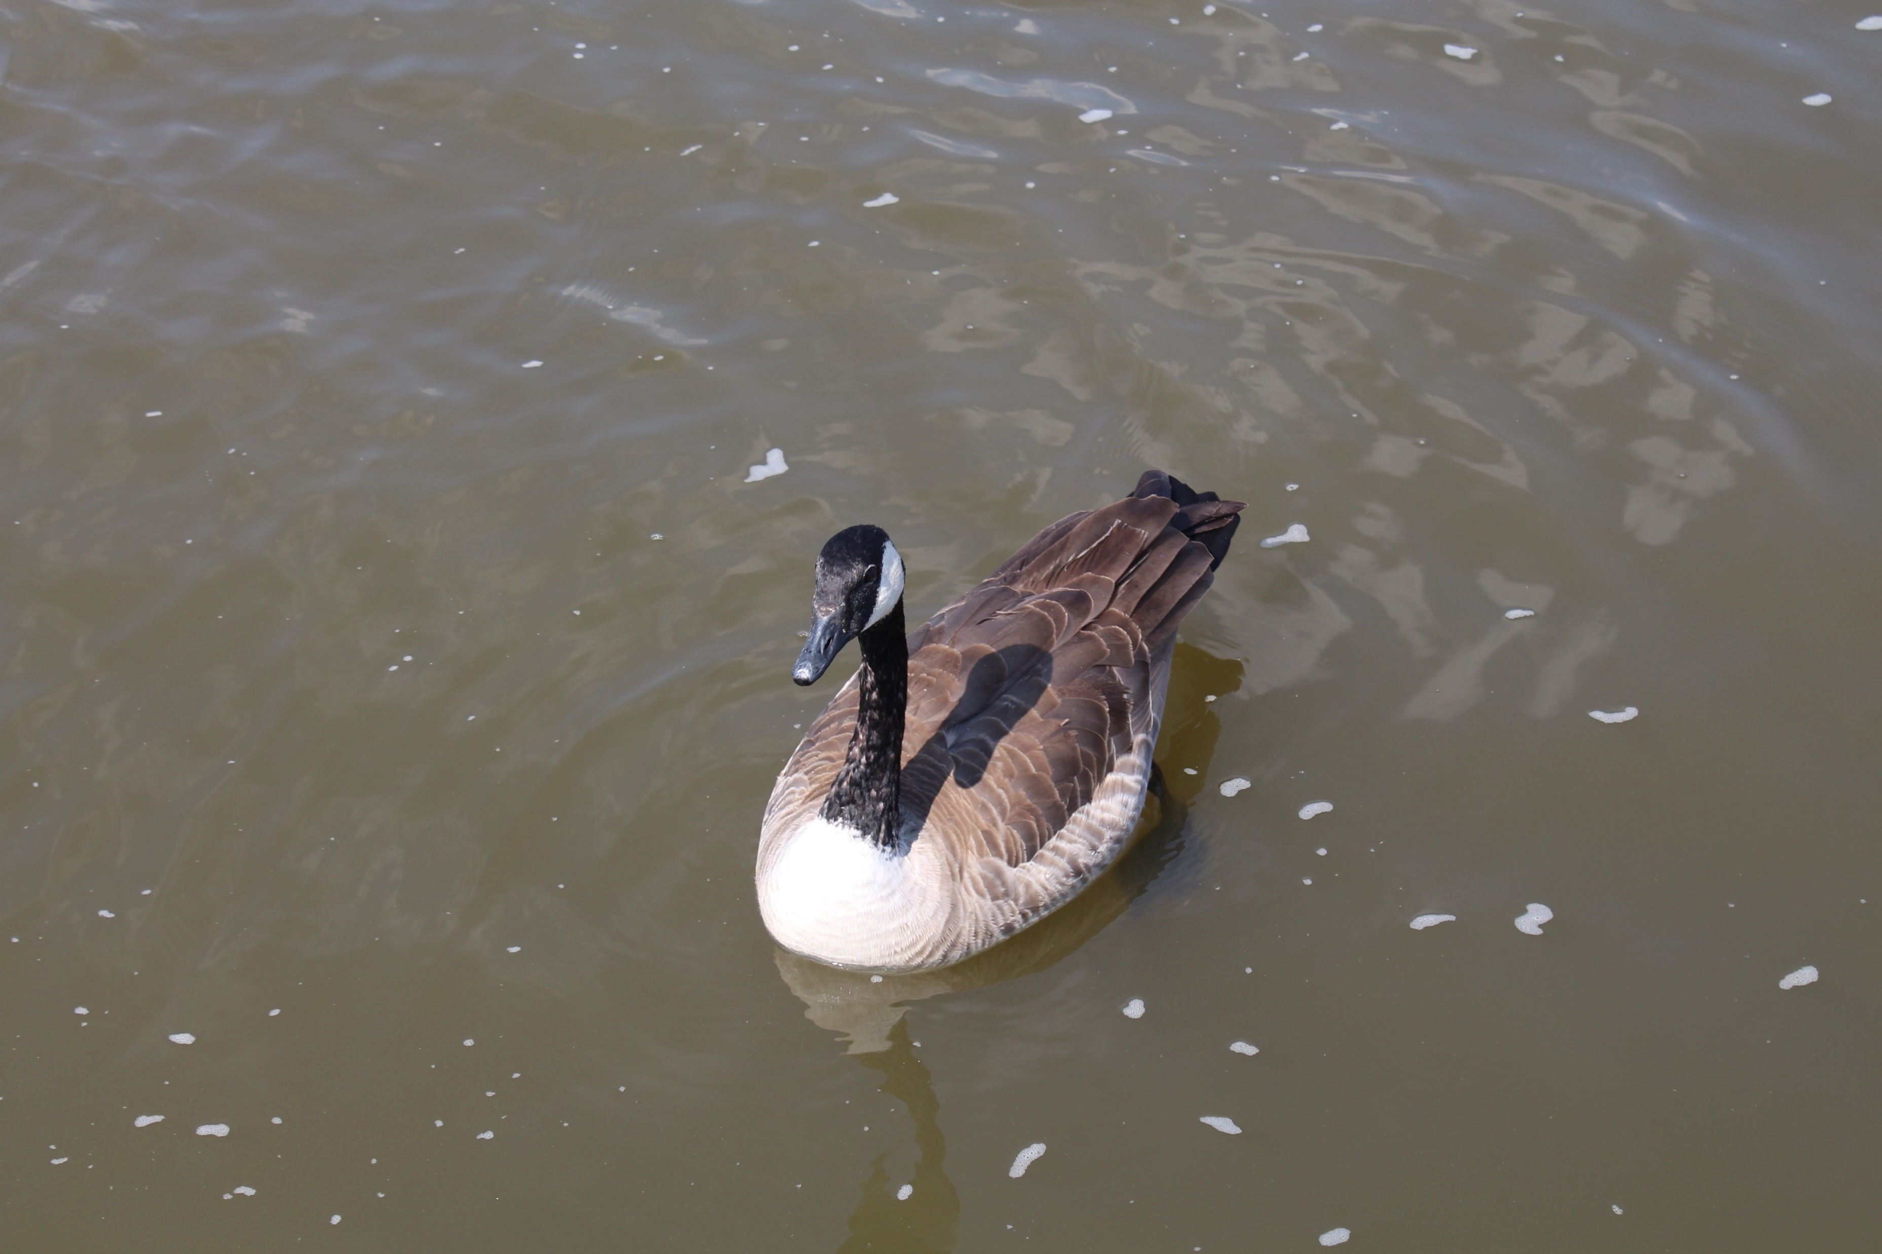
Nutrient Loading Upper Troublesome Gulch and Buchanan Ponds
Sample Plan
Select Stream Sites near Buchanan Ponds
Take Field probe measurements
Temperature, degrees Celsius
pH, standard unit
Dissolved Oxygen, mg/l
Specific Conductance or conductivity, us/cm
Stream flow, cubic feet per second
Collect Nutrient samples for total nitrogen and total phosphorus
Make observations on conditions of sites

Slide 3
Sites

Slide 4
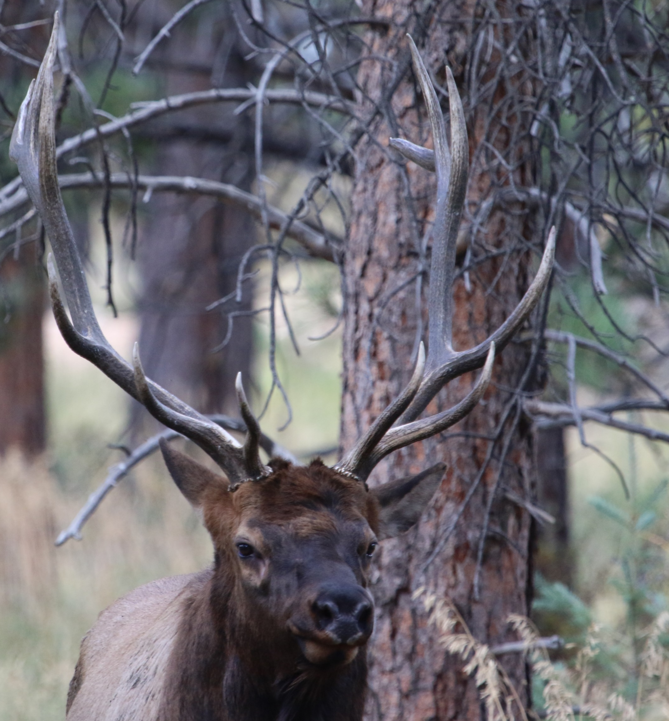
Assignment for each of you
Make a list :
Find a plant and an animal that you think should not be found at our sites
Thistle, Dandelion, pond algae, duck weed, crawfish, mosquito fish, grass carp, geese
Look closely at the water and see if you can find anything that might cause pollution
Oil, grease, trash, eroded sediment, foam from decayed plants, grass clippings
Look closely at the surrounding land and see if you can find anything that might cause pollution or is a problem.
chemical sprayed for weed control, eroded areas, parking lots, storm drains, sewer pipes, roadway sand/salt or chemicals, roads, cars, houses and yards, pet waste, large animal waste, geese
Find something that makes the stream or pond Healthy.
Grass buffers, stormwater ponds, runoff controls, litter pickup and trashcans, aerators, duckweed, grass carp
Look at one of the ponds and tell us how it looks and smells, what might live in the water.
Lots of organics and decayed plants and fish, no funny smells, healthy Rainbow Trout

Slide 5
Samplers | T Langowski, RNC, L Moody, C King, C Major, Meagan, E Mason, M Robinson, S Orsund, K Kunr, Ethan E, S Orsund, Logan L, M Robinson
Weather | Sunny, 40-50 degrees F, slight breeze
Date | 5/4/2016
Site | 96a
Sample Point | Overflow | Pond, Upper | Pond, Lower | Overflow | Pond, Upper
Time | 8:25:00 AM | 8:30:00 AM | 8:35:00 AM | 10:10:00 AM | 10:15:00 AM
Water Clarity, visual | SM | SM | SM | SM | SM
Periphyton, % cover | 100% | 25% | 100% | 100% | 50%
pH | 8.49 | 8.46 | 8.43 | 8.03 | 8.08
Temp, Degrees C | 7.6 | 7.7 | 7.8 | 8.0 | 7.9
Dissolved Oxygen, mg/l | 10.64 | 10.10 | 9.37 | 10.99 | 9.65
Conductivity, us/cm | 287.0 | 286.7 | 289.1 | 288.0 | 288.0
Flow (cfs)
Width, inches |  | 36 |  | 36
Depth, inches |  | 0.11 |  | 0.09
Velocity, cf |  | 1.81 |  | 1.68
Cubic-Feet/ Second |  | 0.597 |  | 0.454
Gallons/minute |  | 268 |  | 204
Million gallons/day |  | 0.385 |  | 0.293

Slide 6
Site | 96c
Sample Point | Inflow
Time | 9:58:00 AM
Water Clarity, visual | C
Periphyton, % cover | 5%
pH | 8.13
Temp, Degrees C | 9.8
Dissolved Oxygen, mg/l | 8.95
Conductivity, us/cm | 177.6
Flow (cfs)
Width, inches | 24.0
Depth, inches | 0.18
Velocity, cf | 2.91
Cubic-Feet/ Second | 1.048
Gallons/minute | 471
Million gallons/day | 0.676

Slide 7
Site | 96b
Sample Point | Stream
Time | 11:48:00 AM | 11:55:00 AM | 1:00:00 AM | 1:05:00 AM
Water Clarity, visual | SM | SM | SM | SM
Periphyton, % cover | 5% | 5% | 5% | 10%
pH | 8.03 | 8.00 | 7.93 | 7.94
Temp, Degrees C | 10.7 | 10.9 | 11.2 | 11.2
Dissolved Oxygen, mg/l | 9.40 | 9.16 | 9.09 | 9.18
Conductivity, us/cm | 444.1 | 445.4 | 443.4 | 443.0
Flow (cfs)
Width, inches | 26 |  | 26
Depth, inches | 0.22 |  | 0.24
Velocity, cf | 1.91 |  | 1.85
Cubic-Feet/ Second | 0.924 |  | 0.98
Gallons/minute | 415 |  | 439
Million gallons/day | 0.596 |  | 0.630

Slide 8
Measure Nutrients in micro-grams/liter or parts per billion
Think of this number in steps
Most days you walk between 6,000 to 7,000 steps, okay a few more for some
Imagine walking one billion steps
Take a big breath
That journey would take you to the moon
So one part per billion or one micro-gram is one step to the moon

Slide 9
LABID | CLIENTID | COLLECTDATE | RECEIVEDATE | ANALYTE | MATRIX | RESULT
BC516-1 | 96a | 5/4/2016 | 5/4/2016 | Total Nitrogen | SW | 620
BC516-1 | 96a | 5/4/2016 | 5/4/2016 | Phosphorus, total | SW | 17
BC516-2 | 95b | 5/4/2016 | 5/4/2016 | Total Nitrogen | SW | 602
BC516-2 | 95b | 5/4/2016 | 5/4/2016 | Phosphorus, total | SW | 26
BC516-3 | 96c | 5/4/2016 | 5/4/2016 | Total Nitrogen | SW | 818
BC516-3 | 96c | 5/4/2016 | 5/4/2016 | Phosphorus, total | SW | 44

Slide 10
Cubic feet/ second*1.983 = acre-feet/day * days = acre-feet/month flow* concentration * conversion number = pounds per month
Site | Flow (May 2016) |  |  | Total Nitrogen | Total Phosphorus | Total Nitrogen | Total Phosphorus | Total Phosphorus
5/1/2016 | cfs | acre-feet/day | Acre-feet/month | Concentration ug/l |  | Pounds/Month |  | pounds/year
96c | 1.048 | 2.08 | 64.4 | 818 | 44 | 143.5 | 7.7 | 92.6
96a | 0.966 | 1.92 | 59.4 | 620 | 17 | 100.3 | 2.7 | 33.0
96b | 0.951 | 1.89 | 58.5 | 602 | 26 | 95.8 | 4.1 | 49.7

Slide 11
Flow Acre-feet per month (May 2016)

Slide 12
Total Nitrogen and Total Phosphorus

Slide 13
Other Parameters
 | 96c | 96a | 96b
pH | 8.13 | 8.30 | 7.98
Temperature, Degrees C | 9.80 | 7.80 | 11.00
Dissolved Oxygen, mg/l | 8.95 | 10.15 | 9.21
Conductivity, us/cm | 177.60 | 287.76 | 443.98

Slide 18
Phosphorus
One pound of phosphorus Grows 500 pounds of algae
A 55 pound of fertilizer (10-10-10) has 10% nitrogen, 10% phosphorus, 10% Potassium
10% Phosphorus = 5.5 pounds of phosphorus
May 2016 had 7.7 pounds of introduced phosphorus or a 77 pound bag of fertilizer
In a year that would be about a 924 pound bag of fertilizer
Goose poop is 1.3% phosphorus = 1.2 grams per dropping
A goose poops 92 times a day = 0.85 pounds per goose per year
Horse = 23 pounds phosphorus per year
Cow = 16 pounds phosphorus per year
Chicken = 154 pounds per year

Slide 19
How Clean is the Water
If phosphorus is less than 10 ug/l, then the water is clean
If phosphorus is more than 10 ug/l but less than 50 ug/l, then water is good for a fishery
Buchanan Pond #1 had about 17 ug/l, so good for fishery
If phosphorus is more than 50 ug/l but less than 100 ug/l, then water is polluted
Bear Creek Reservoir near Morrison is in this range
If phosphorus is great 100 ug/l, fish die

Slide 20
Nitrogen and Phosphorus have limits
Colorado is managing nutrients
Streams have different limits depending on if they are warm or cold
Cold streams can’t exceed 110 ug/l phosphorus
Cold streams can’t exceed 1,250 ug/l nitrogen
Reservoirs and ponds will have even lower limits
Buchanan Ponds may need to be below 10 ug/l

Slide 21
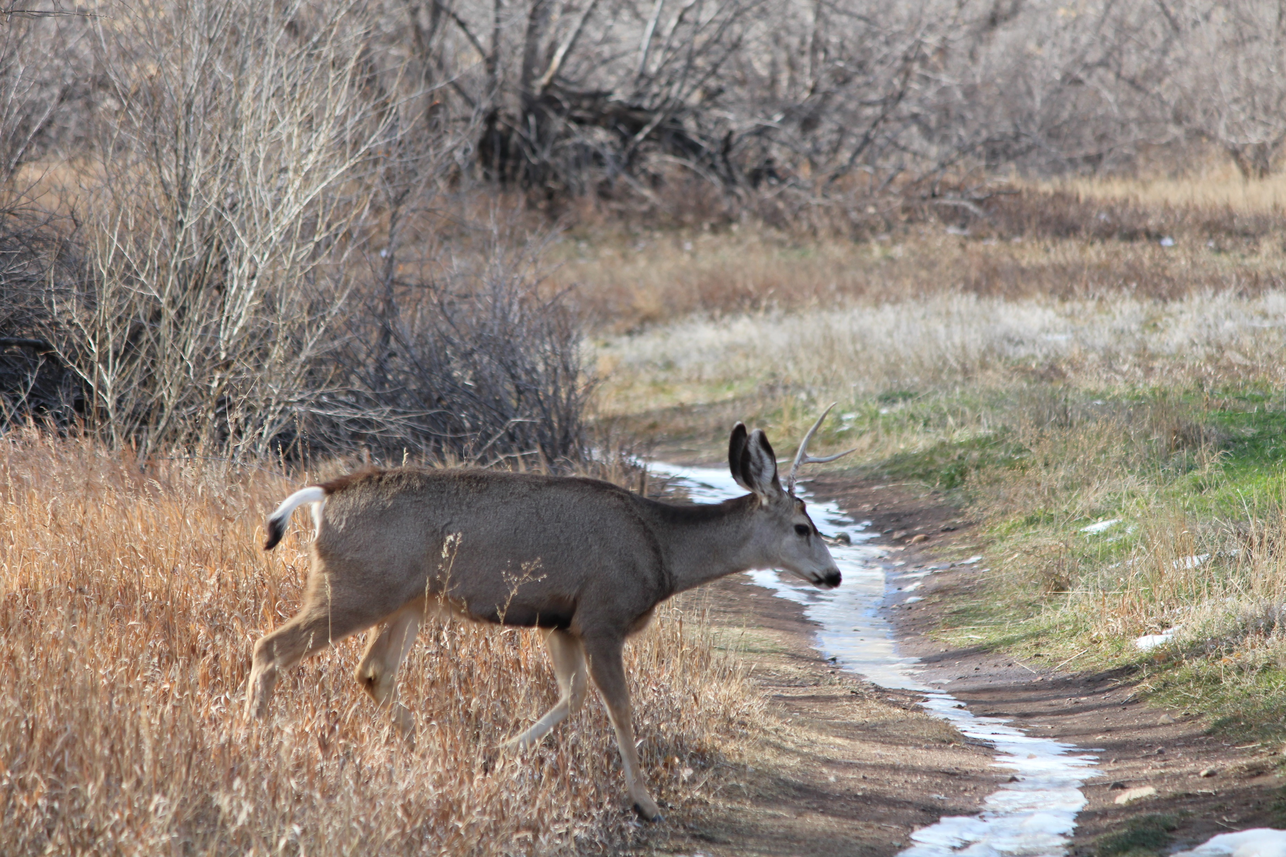
What Next?

