Slide 1
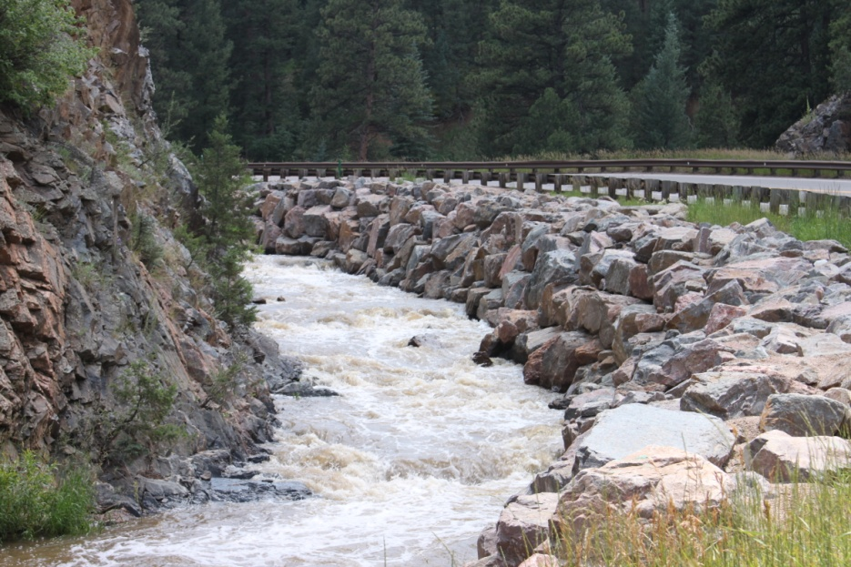
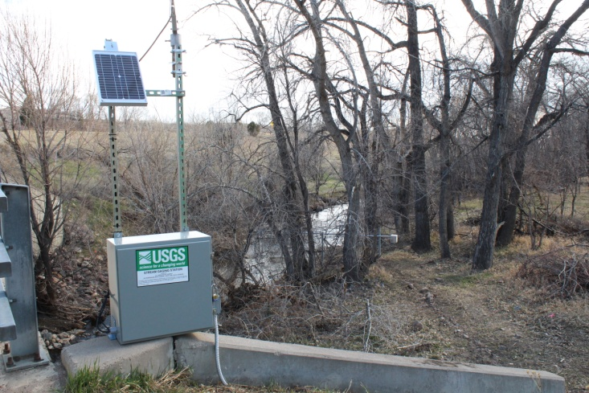
Bear Creek Watershed Association
The Bear Creek Watershed Association protects & restores water & environmental quality within the Bear Creek Watershed from the effects of land use.
Bear Creek Association Newsletter
Flood Recovery
BCWA PINNACLE

Slide 2
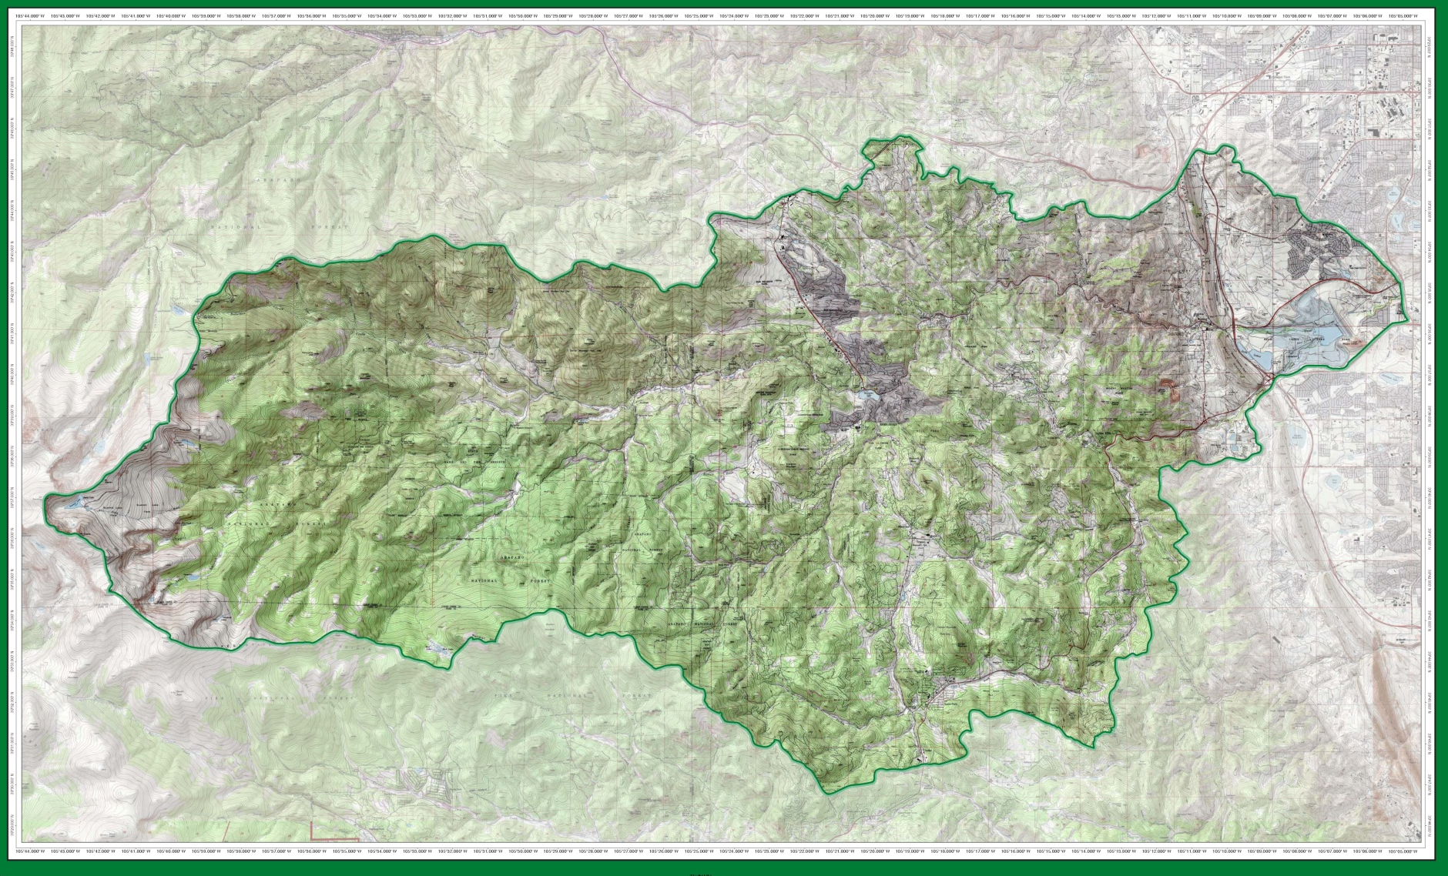
Bear Creek Watershed 2014

Slide 3
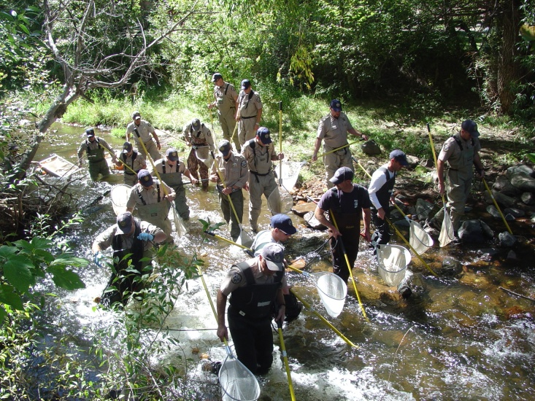
2014 Estimates of Recreation Use Bear Creek Watershed
Recreational Users Bear Creek Park > 580,000
People Traveling to Mt. Evans > 177,000
Users Denver Mountain Parks > 225,000
Users Evergreen Lake > 275,000
Attendees & Visitors Red Rocks/Morrison >1.3 million
Bear Creek Park Swim Beach Use > 750 per weekend
Fishing > 65,000 people per year
BCWA Fact Sheet 35 Recreational Uses in BCW

Slide 4
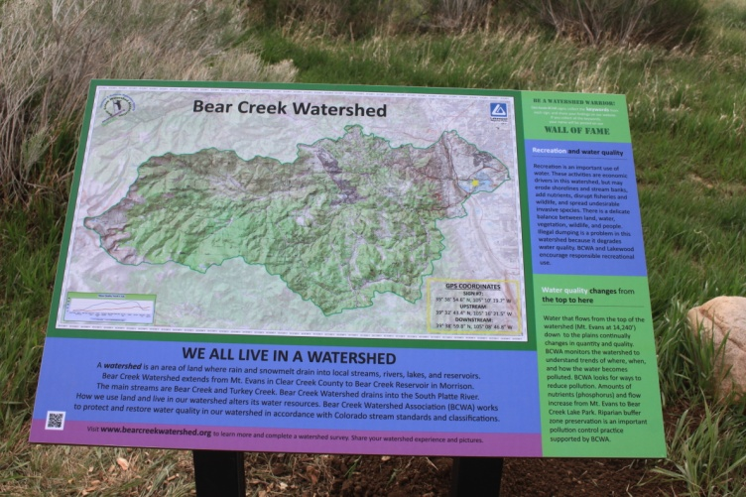
Members & Participants | Wastewater Discharger | 2014 Participation
Counties
Jefferson County |  | Active
Clear Creek County |  | Active
City and Towns
City of Lakewood |  | Active
Town of Morrison | Yes | Active
Water & Sanitation Districts
Aspen Park Metropolitan District | Yes | Active
Bear Creek Cabins | Yes | Active
Brook Forest Inn | Yes | Active
Conifer Sanitation Association | Yes | Dues Paid, Not Active
Conifer Metropolitan District | Yes | Dues Paid, Not Active
Evergreen Metropolitan District | Yes | Active
Forrest Hills Metropolitan District | Yes | Active
Genesee Water & Sanitation District | Yes | Active
Geneva Glen | Yes | Dues Paid, Not Active
Jefferson County School District | Yes | Active
Kittredge Water & Sanitation District | Yes | Active
Singing River Ranch | Yes | Dues Not Paid, Not Active
The Fort Restaurant | Yes | Active
Tiny Town Foundation, Inc. | Yes | Dues Paid, Not Active
West Jefferson County Metropolitan District | Yes | Active
Other Member
Denver Water Department |  | Active
Participant Agencies
Denver Health/ Parks & Recreation |  | Attended
Evergreen Trout Unlimited |  | Active
U.S. Army Corps of Engineers |  | Attended
WQCD |  | Attended

Slide 5
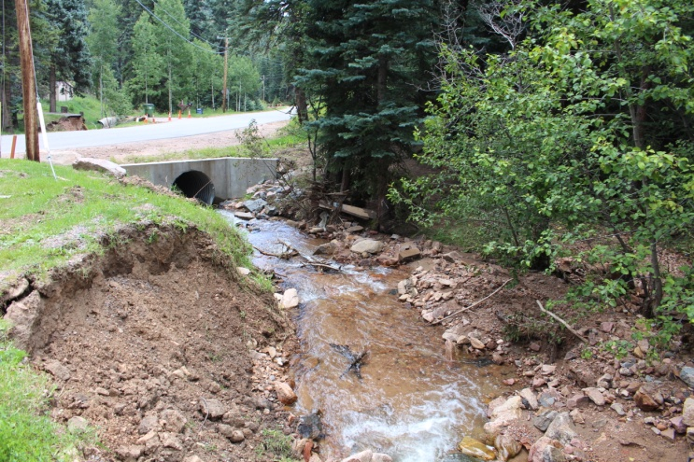
2014 Annual Report
WQCC Summary
Status of Water Quality (Flood Recovery)
Status of WQ Goals & Standards (Temperature)
Phosphorus Trading Program (3 trade policies)
Bear Creek Watershed Association Program

Slide 6
TN Data

Slide 7
2014 BCR Internal Load Problem

Slide 8
Reservoir Hydrology

Slide 9
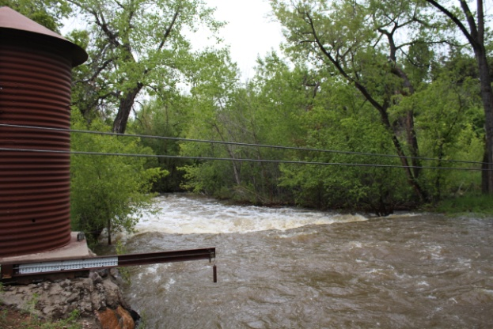
Watershed Hydrology

Slide 10
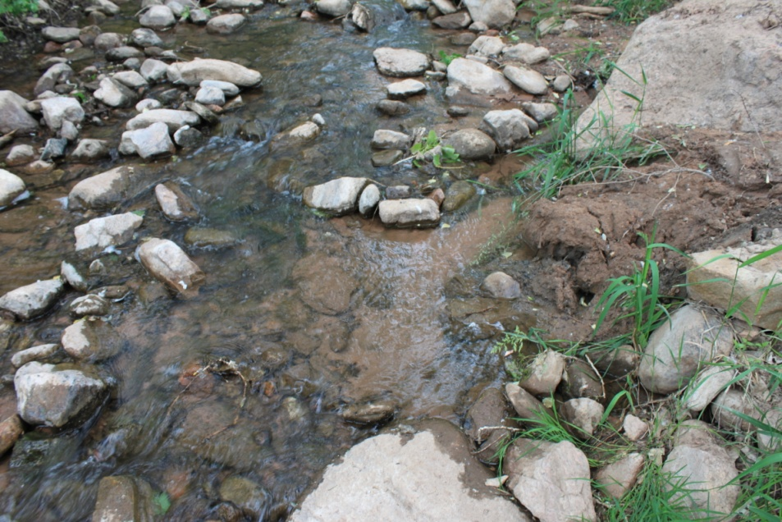
Total Phosphorus Loading
2014 Total Phosphorus Loading (Pounds)
 | Total TP Load | PS | NPS | %NPS
Turkey Creek Drainage | 489 | 7 | 482 | 99%
Bear Creek Drainage | 3,521 | 1,069 | 2,452 | 56%
Discharged into Reservoir | 4,010 | 1,076 | 2,934 | 63%
Site 45 Outflow BCR | 1,980
BCR Total Phosphorus Deposition | 2,031

Slide 11
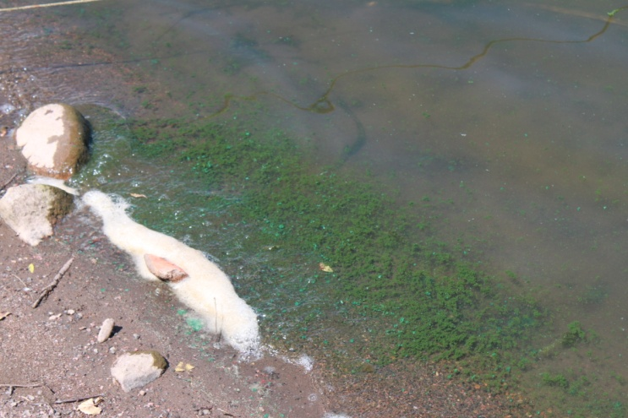
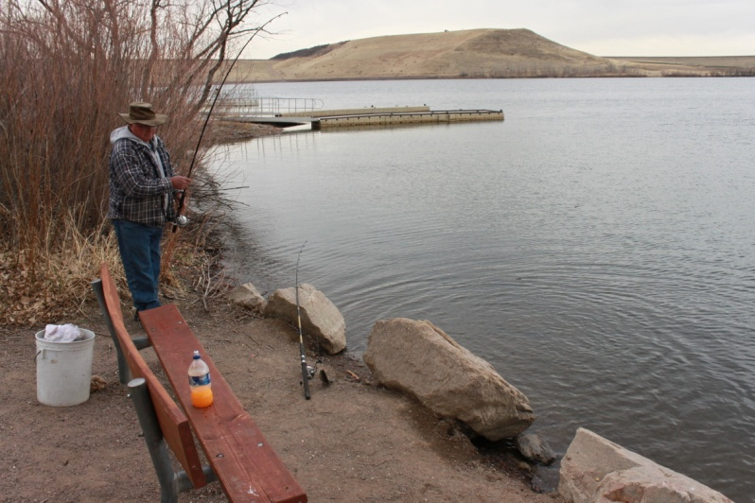
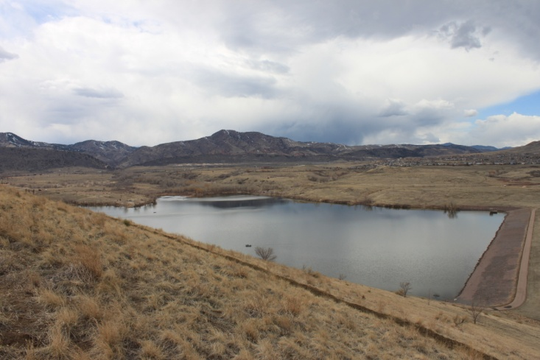
Chlorophyll Trends

Slide 12
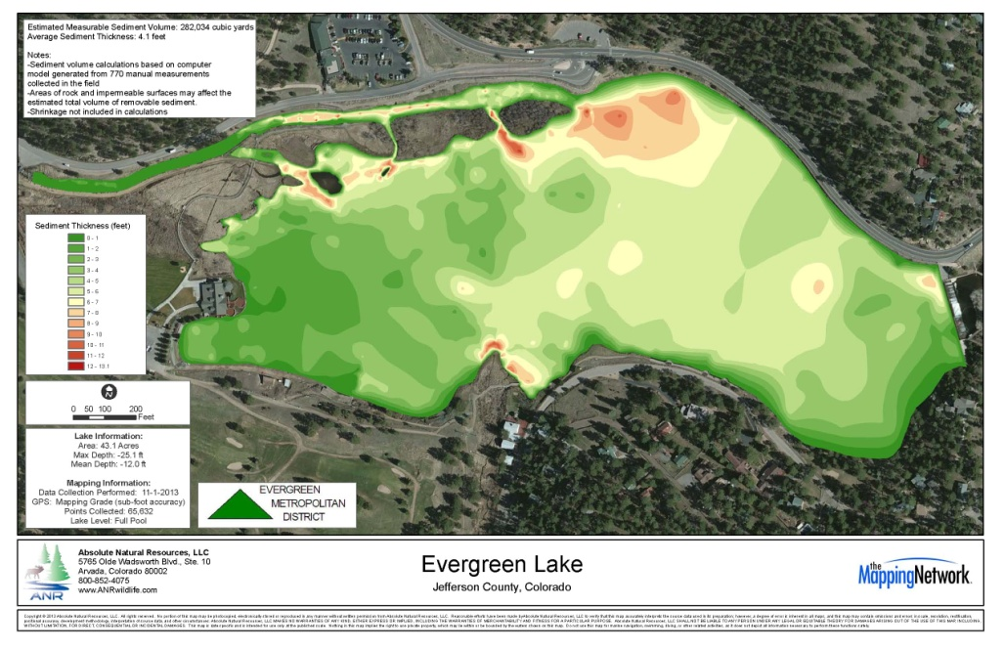
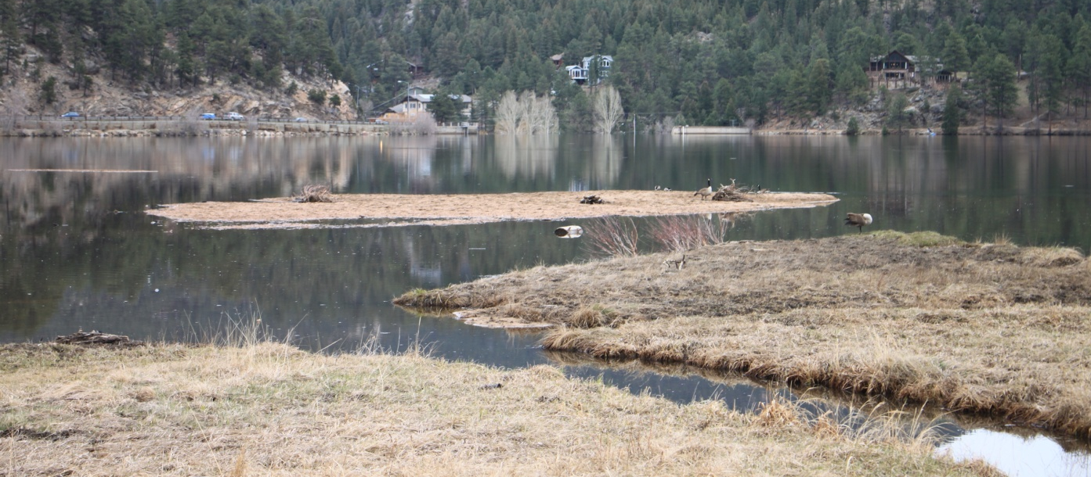
Evergreen Lake Dredging

Slide 13
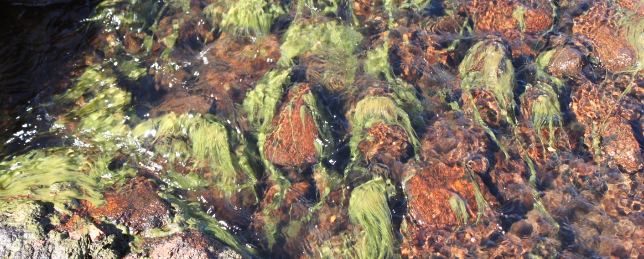
Summit Lake and upper Bear Creek
Data demonstrates pollution source(s) causing elevated nutrient loads, low pH conditions and reduced dissolved oxygen
Repaired new toilet vaults
Plume diminishing
Reduced Total Phosphorus average 216 ug/l
Reduced Total Nitrogen average 377 ug/l

Slide 14
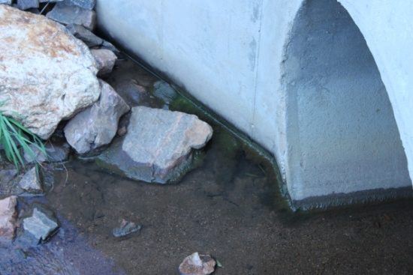
Wastewater Management
Bear Creek Watershed Wastewater Treatment Plants by Drainage Basin | WQCC Adopted Phosphorus WLA Pounds/ year | 2014 Discharged Phosphorus Pounds/year | % Allocation Used by WWTF
Bear Creek Drainage
Jefferson County Schools – Mt. Evans Outdoor Lab | 20 | 6.36 | 32%
Brook Forest Inn | 5 | 1.4 | 28%
Evergreen Metropolitan District | 1,500 | 286.52 | 19%
West Jefferson County Metro District | 1,500 | 384.56 | 26%
Kittredge Sanitation and Water District | 240 | 71.31 | 30%
Genesee Water and Sanitation District | 1,015 | 251.98 | 25%
Forest Hills Metropolitan District | 80 | 23.55 | 29%
Town of Morrison | 600 | 40.9 | 7%
Bear Creek Total | 4,960 | 1,066.6 | 22%
Turkey Creek Drainage
Conifer Metropolitan District | 40 | Land Applied | 0%
Conifer Sanitation Association | 40 | 1.7 | 4%
Aspen Park Metropolitan District | 40 | 4.4 | 11%
Jefferson County Schools - Conifer High School | 110 | 1.05 | 1%
Geneva Glen¹ | 5 | Land Applied | 0%
Bear Creek Development Corp. - Tiny Town² | 5 | Hauling Columbia | 0%
The Fort³ | 18 | No Monitoring | 0%
Turkey Creek Total | 258 | 7.2 | 3%
Total Operational Facilities Lbs/year | 5,218 | 1,073.73 | 21%
Reserve Pool | 37 | 0 | 0%
Total Phosphorus Wasteload lbs/year | 5,255
1-Geneva Glen treatment system land applies, no Reported Pounds
2-Records from Columbia Sanitary show they hauled 72,400 gallons in the 2014 operation season
3-Permit; No established monitoring

Slide 15
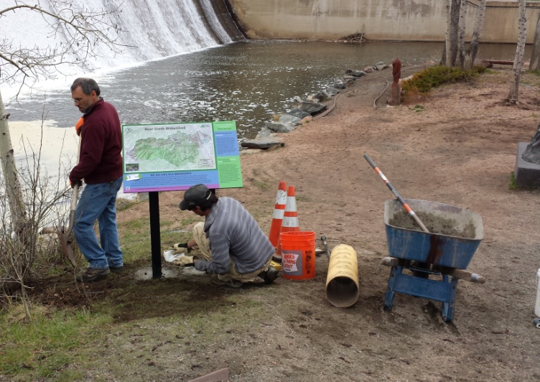
BCWA 2014 Watershed Plan
Online Decision Support Program
Electronic Watershed Plan (10.8 GB)
35 Policies
51 Fact Sheets
18 Data Masters
34 Informational Maps
+ Informational, Methods, Program Guidance, Technical Series, Reports
Photo Library (>18 GB)
Quarterly Newsletter (>300)
Increased NPS education
Membership special programs

Slide 16
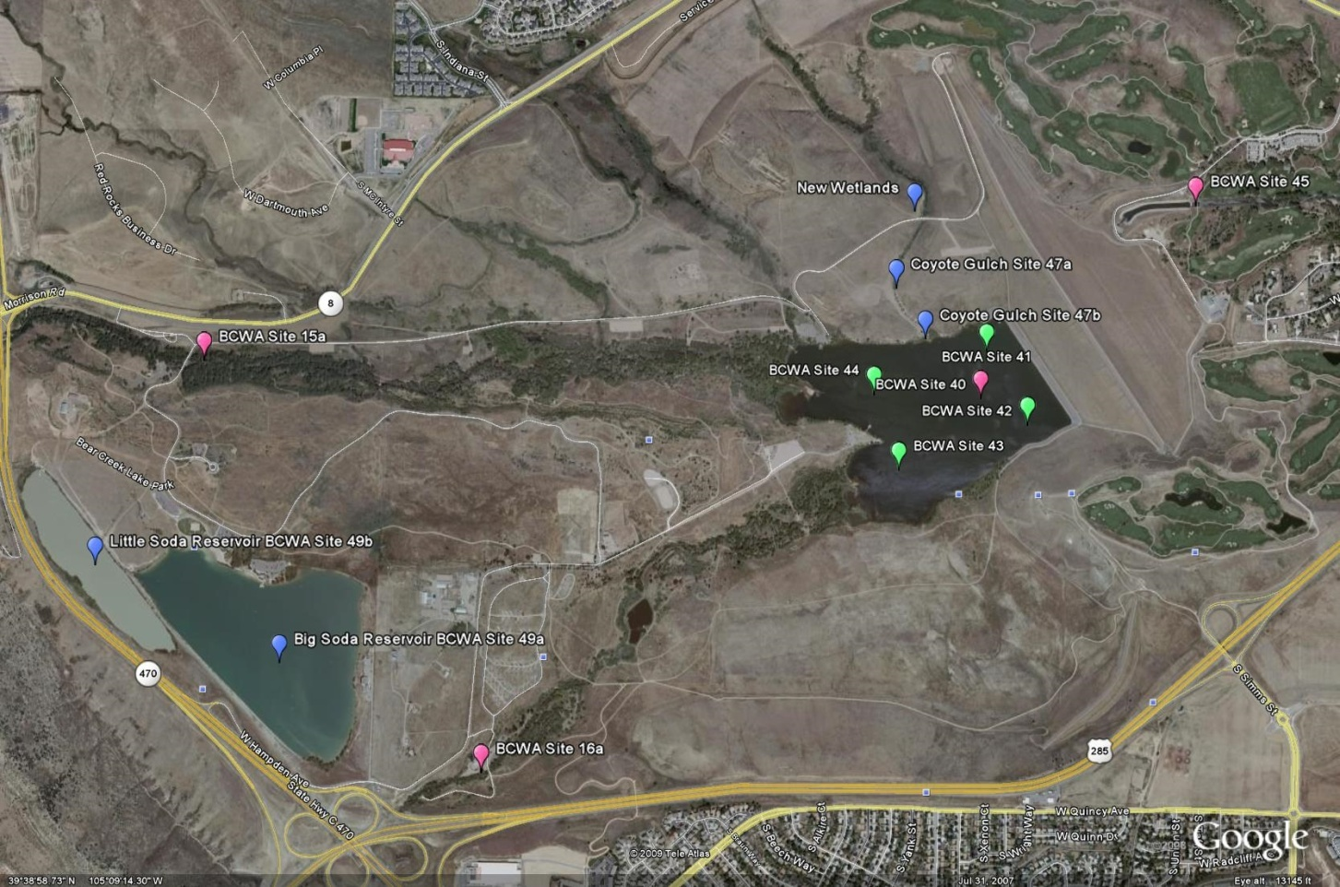
Bear Creek Reservoir & Park

Slide 17
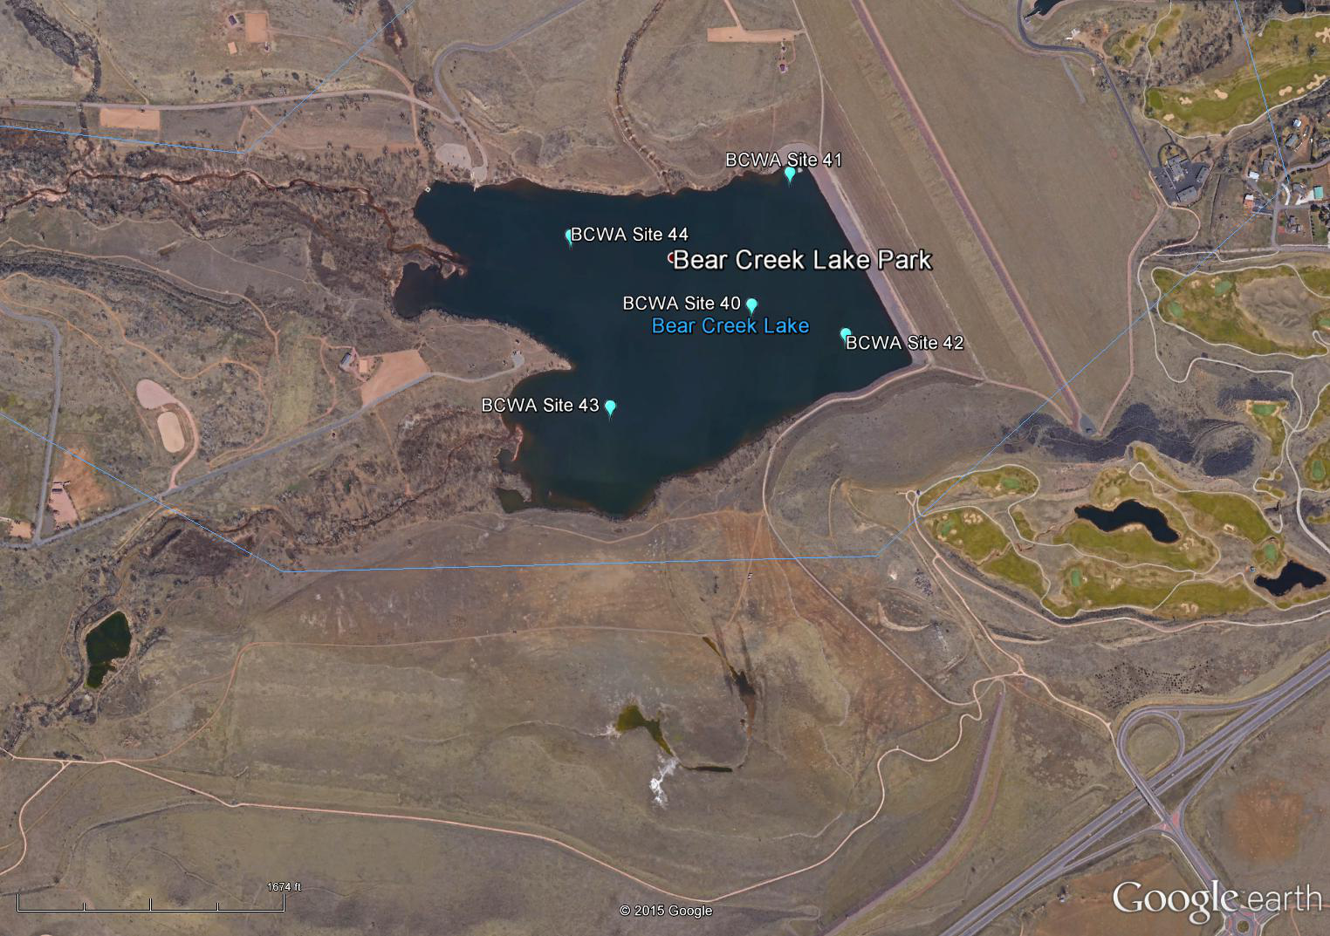

Slide 18
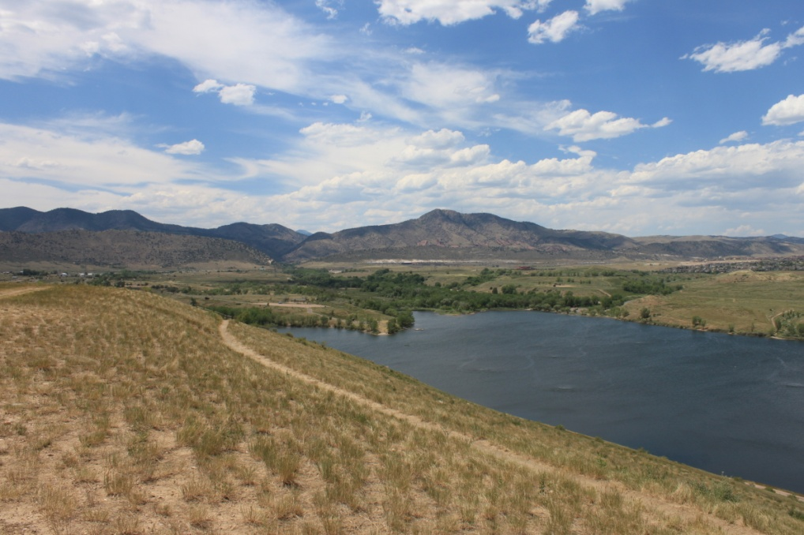
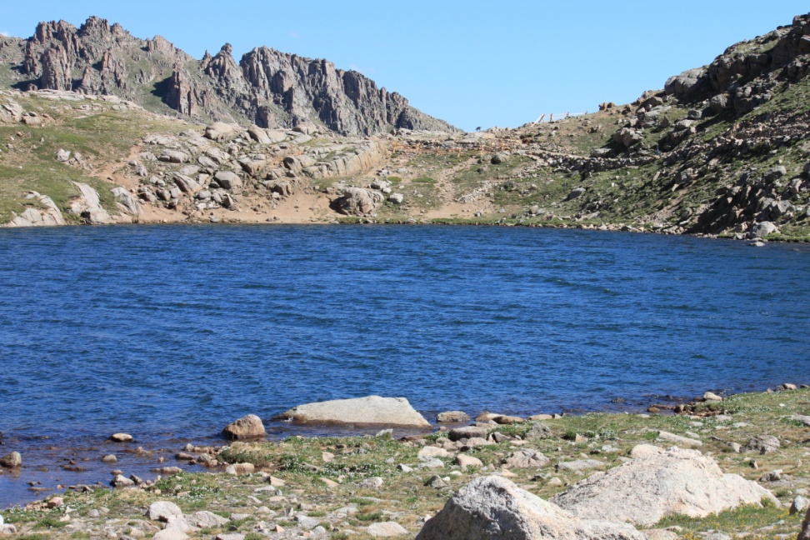
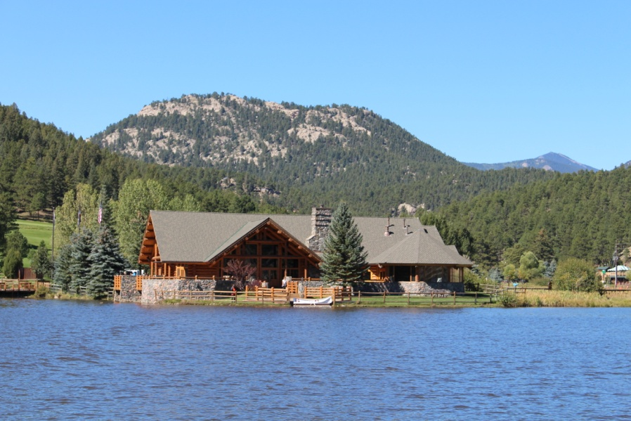
Reservoir/ Lake Studies
Bear Creek Reservoir
Inflow Turkey Creek
Inflow Bear Creek
Outflow site 45 (input Barr/Milton Watershed
Evergreen Lake
Summit Lake

Slide 19
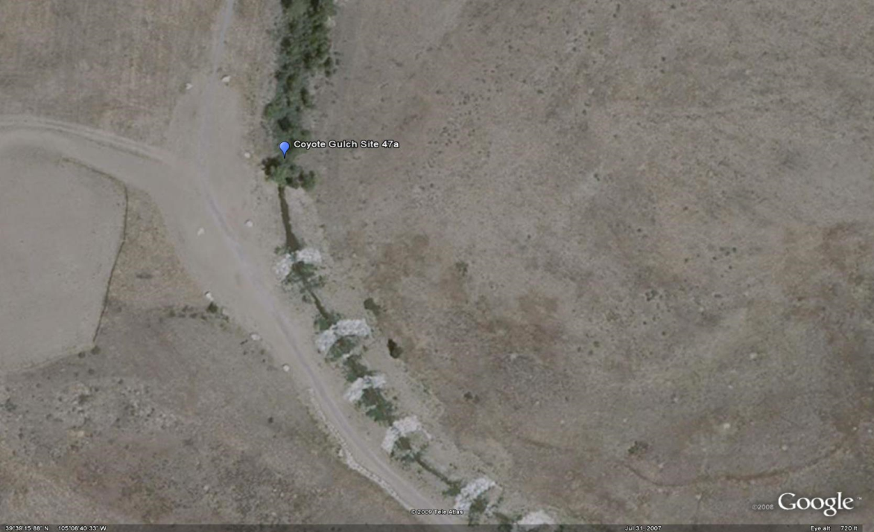
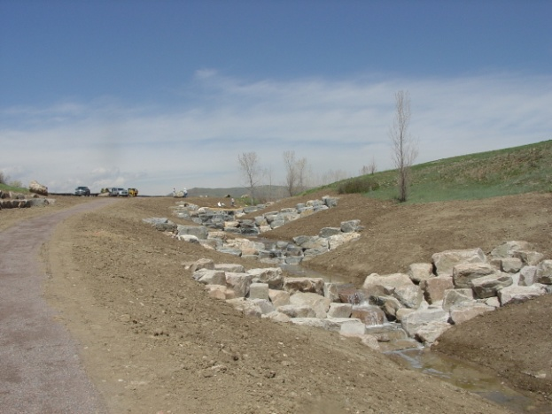
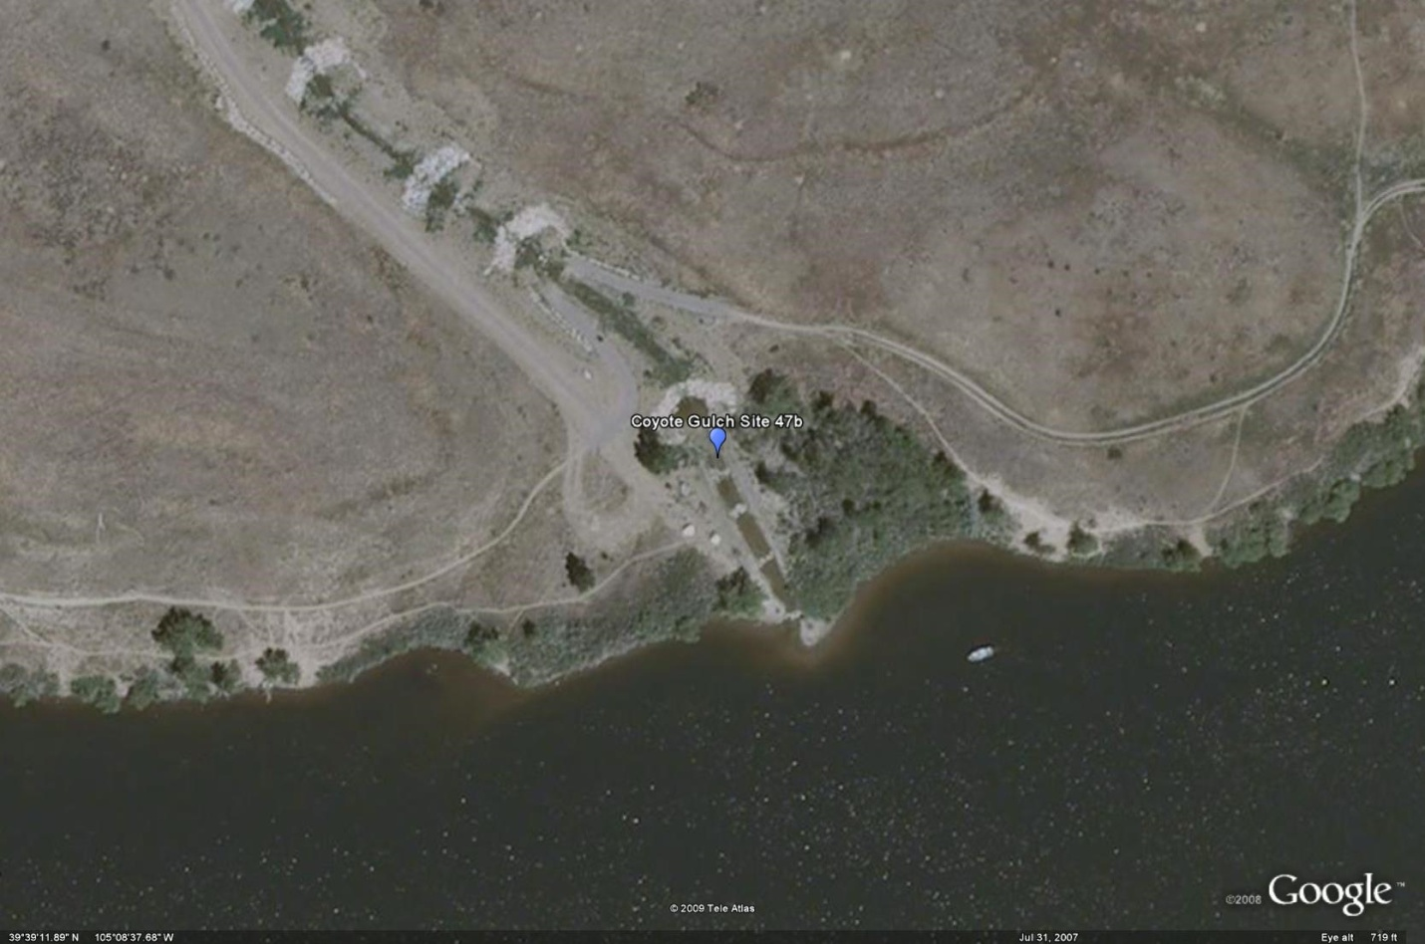
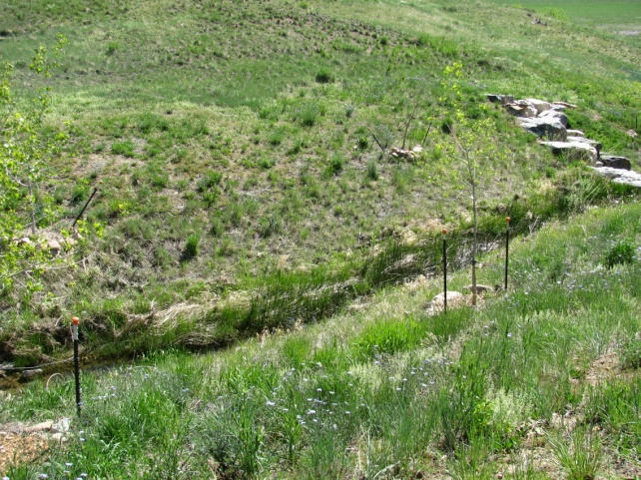
Coyote Gulch
2006-2014
Trade Pounds = 92.2

Slide 20
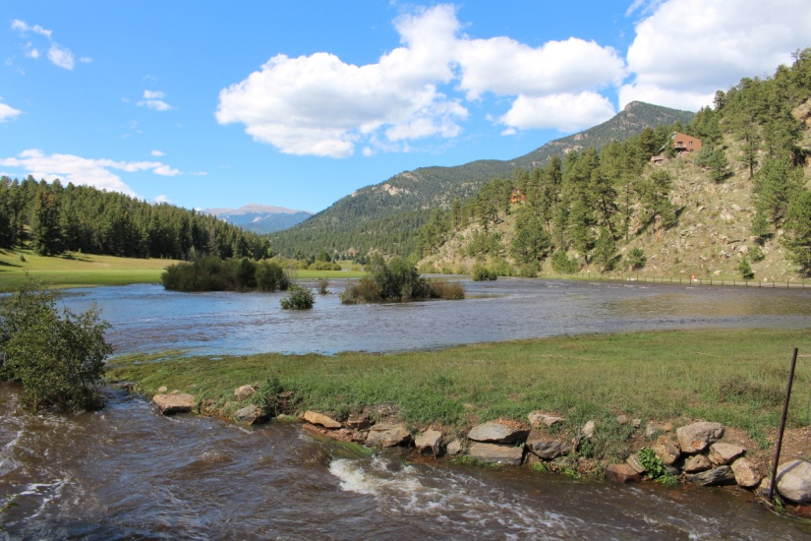
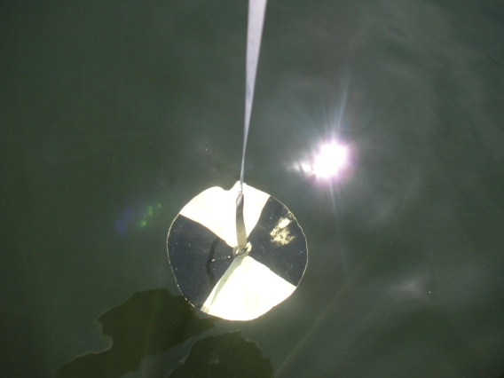
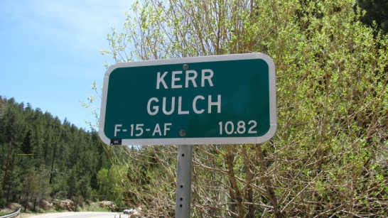
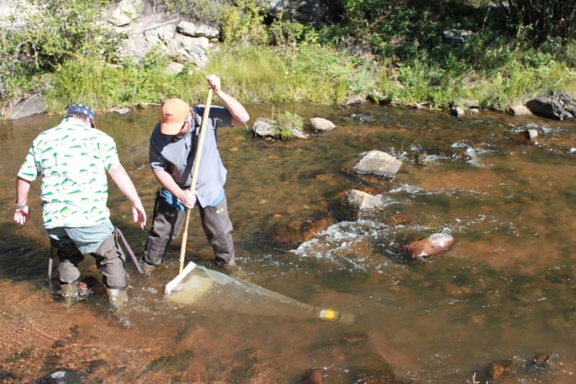
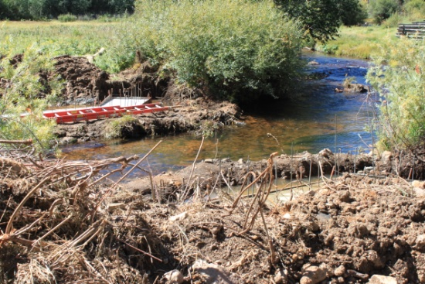
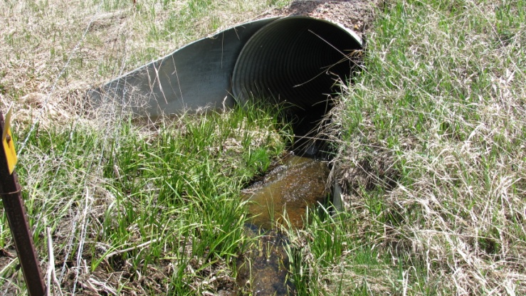
Bear Creek Watershed Association Surface Water Monitoring Program Version 2014.01
Annually reviewed and updated

Slide 21
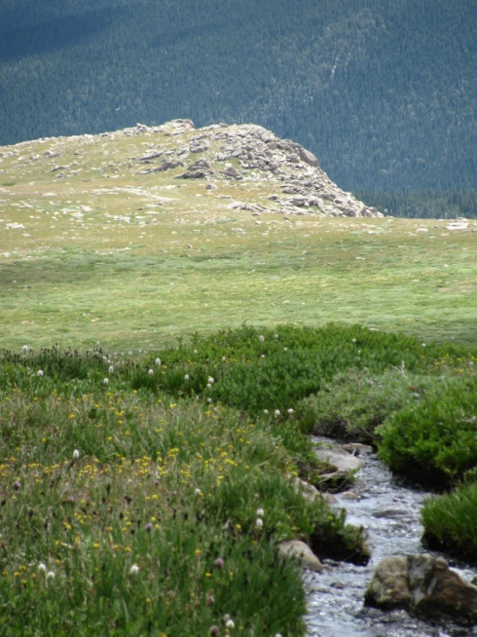
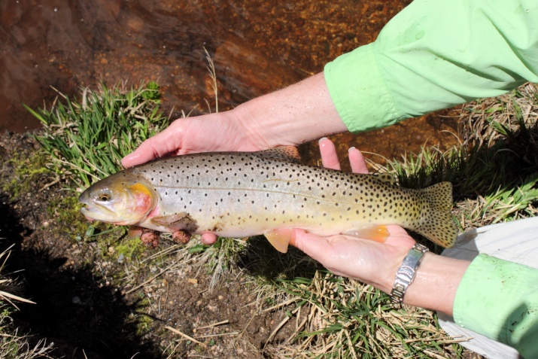
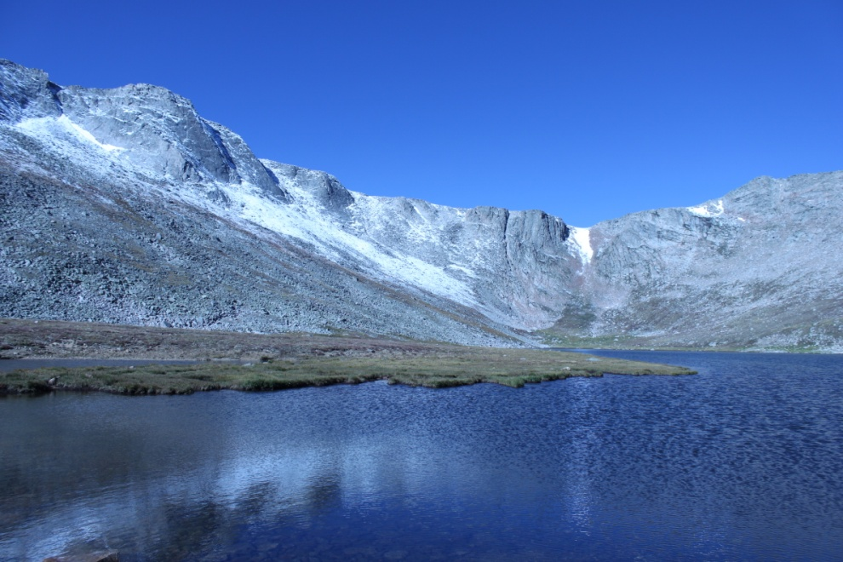
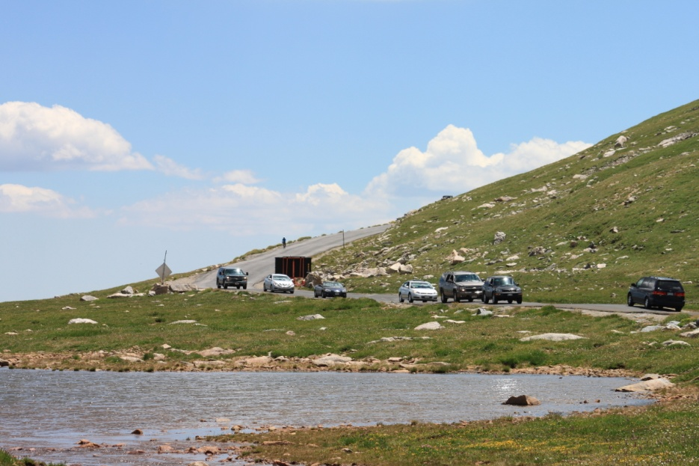
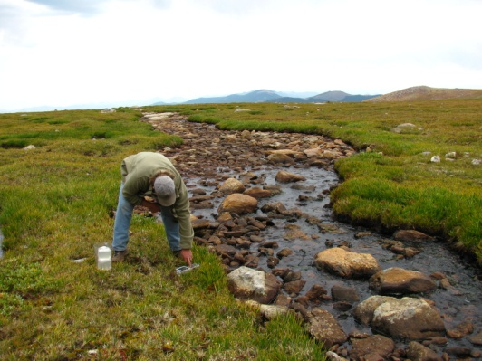
Sampling Begins at the Top

Slide 22
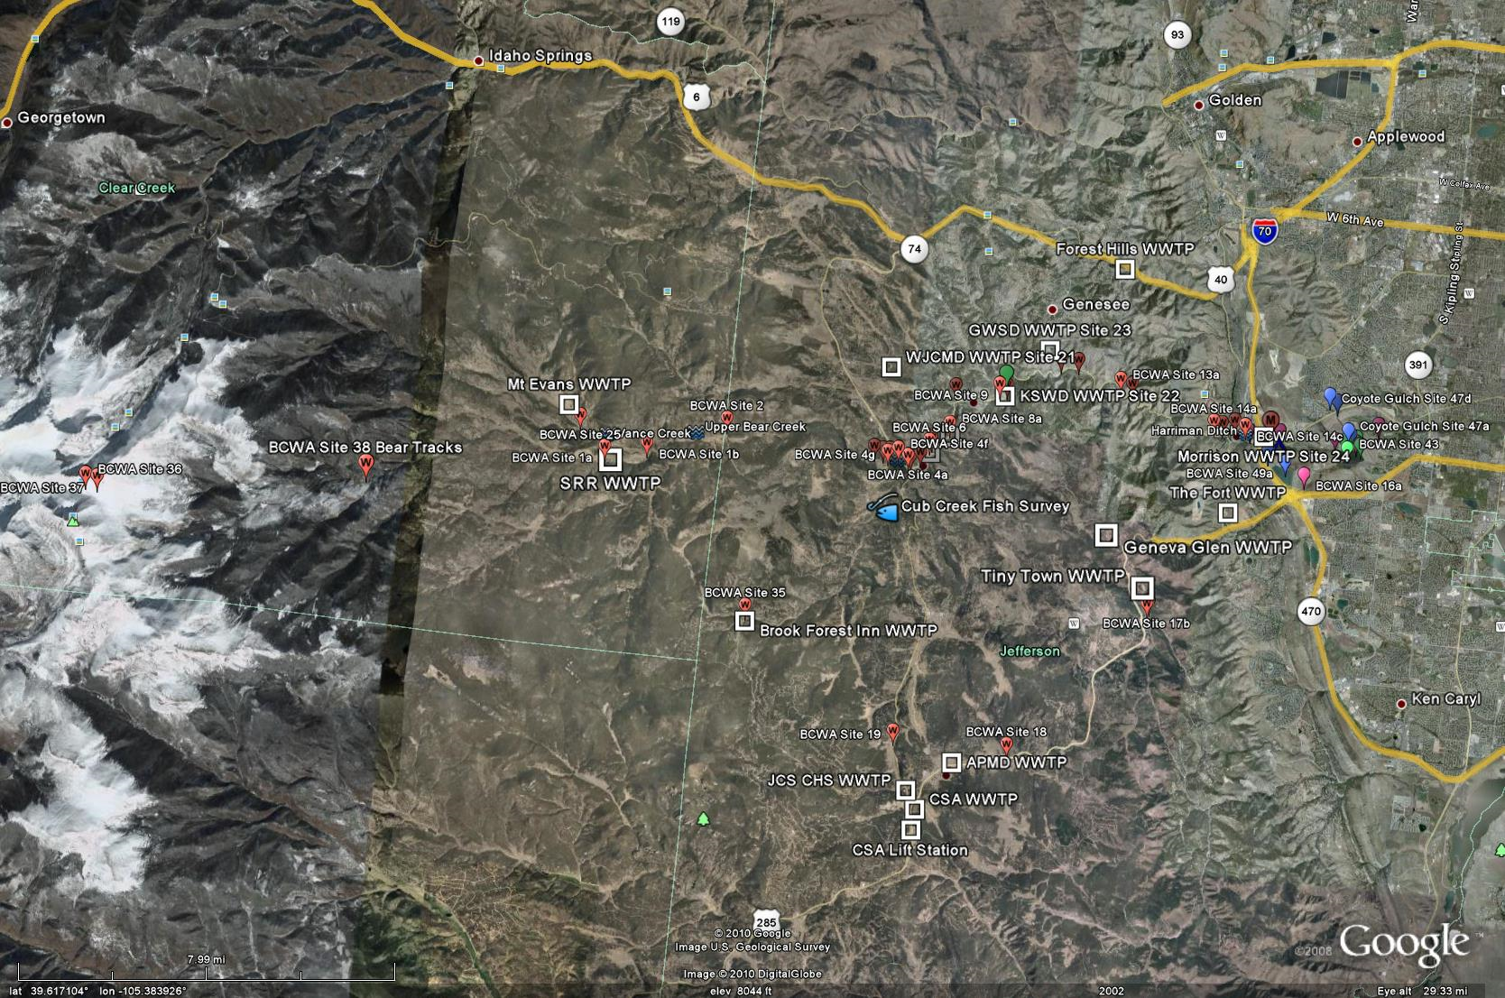
Watershed Monitoring
82 Monitoring Sites

Slide 23
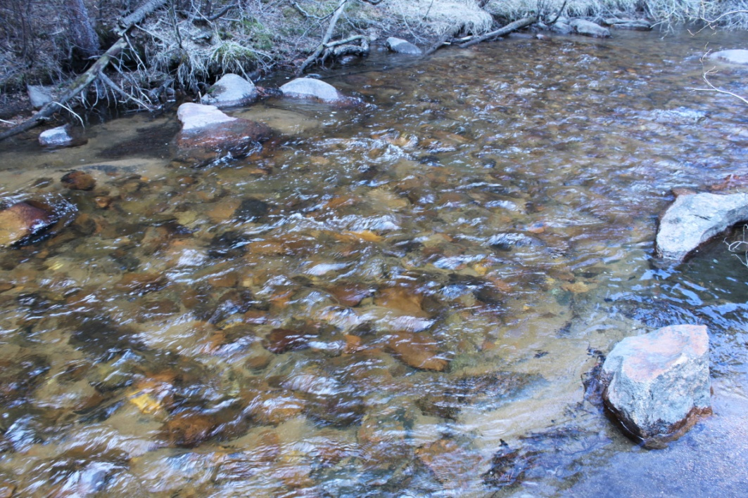
Monitoring Program Elements
Water quality monitoring program
82 Sites (some monitored since 1991)
5 Bear Creek Reservoir monitoring profiles
Evergreen Lake profiles
Physical, Chemistry & Biology
Year round temperature monitoring of Bear Creek and Turkey Creek
>2,750,000 measurements
Monitor total phosphorus, dissolved phosphorus, nitrate+nitrite, total ammonia, total nitrogen, TIN, oxygen, specific conductance, temp, carbon, pH, bacteria, phytoplankton, zooplankton, chlorophyll, Secchi, TSS
Special Studies
Fishery surveys at 12 sites
Macroinvertebrate collections
Habitat
Flow studies
BMP Effectiveness
Stormwater data collection
E. Coli
Septic Systems Contributions
Lake Sediments

Slide 24
BCR Temperature Compliance
Segment 1c Datalogger Temperature Summary 2014
All Temperatures in °C | 30-Min Temp. COLD/WARM SEASON |  | Nov 1-Mar 31 Stream Std. WAT (9°C) | Nov 1-Mar 31 2-Hr Avg. Temp. | Nov 1-Mar 31 Stream Std. DM (13°C) | Apr 1-Oct 31 Stream Std. WAT (19.3°C) | Apr 1-Oct 31 2-HR Avg. Temp. | Apr 1-Oct 31 Stream DM (23.8°C)
Min | 6.36 | 2.53 |  | 6.42 | 6.94 | 6.01 | 2.84 | 3.88
Max | 8.22 | 21.72 |  | 8.10 | 8.10 | 20.75 | 21.49 | 21.49
Avg | 7.12 | 15.00 |  | 7.12 | 7.51 | 15.03 | 15.00 | 15.40
Measurements | 480 | 22222 |  | 120 | 10 | 66 | 5554 | 462
# 9°C WAT exceeded
% Compliance WAT
# 13°C DM exceeded |  |  |  | 0
% Compliance DM |  |  |  | 100%
# 23.3°C WAT exceeded |  |  |  |  |  | 0
% Compliance WAT |  |  |  |  |  | 100%
# 23.8°C DM exceeded |  |  |  |  |  |  |  | 0
% Compliance DM |  |  |  |  |  |  |  | 100%

Slide 25
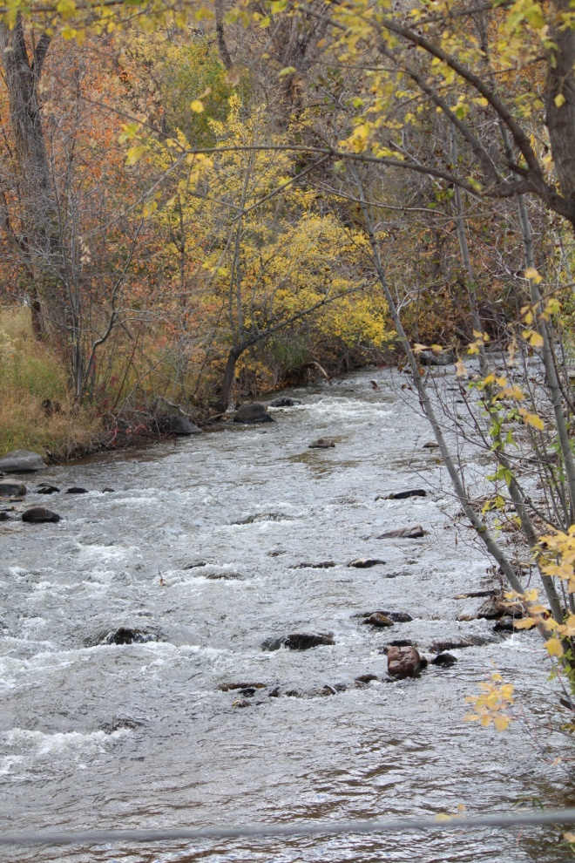
Watershed Temperature Compliant
 | Cold-season |  | Warm Season
Segment 3 | 9°C WAT | 13°C DM | 17°C WAT | 21.2°C DM
# Exceedances | 0 | 0 | 0 | 0
% Compliance | 100% | 100% | 100% | 100%
Segment 1a | 9°C WAT | 13°C DM | 17°C WAT | 21.2°C DM
# Exceedances | 0 | 1 | 0 | 0
% Compliance | 100% | 99% | 100% | 100%
Segment 1d | 9.0°C WAT | 13.0°C DM | 18.2°C WAT | 23.8°C DM
# Exceedances |  |  | 0 | 0
% Compliance |  |  | 100% | 100%
Segment 1e | 9°C WAT | 13°C DM | 19.3°C WAT | 23.8°C DM
# Exceedances | 0 | 0 | 0 | 0
% Compliance | 100% | 100% | 100% | 100%
Segment 1b | 9°C WAT | 13°C DM | 19.3°C WAT | 23.8°C DM
# Exceedances | 6 | 14 | 0 | 0
% Compliance | 67% | 90% | 100% | 100%
Segment 5 | 9°C WAT | 13°C DM | 18.2°C WAT | 23.8°C DM
# Exceedances | 4 | 17 | 0 | 0
% Compliance | 88% | 79% | 100% | 100%
Segment 6a | 9°C WAT | 13°C DM | 18.2°C WAT | 23.8°C DM
# Exceedances | 0 | 0 | 0 | 0
% Compliance | 100% | 100% | 100% | 100%
Segment 6b | 9°C WAT | 13°C DM | 17°C WAT | 21.2°C DM
# Exceedances | 0 | 1 | 0 | 0
% Compliance | 100% | 99% | 100% | 100%
Segment 2 | 13.7°C WAT | 14.3°C DM | 27.5°C WAT | 28.6°C DM
# Exceedances | 0 | 0 | 0 | 0
% Compliance | 100% | 100% | 100% | 100%
Segment 1c | 9°C WAT | 13°C DM | 24.0°C WAT | 26.0°C DM
# Exceedances |  | 0 | 0 | 0
% Compliance |  | 100% | 100% | 100%

Slide 26
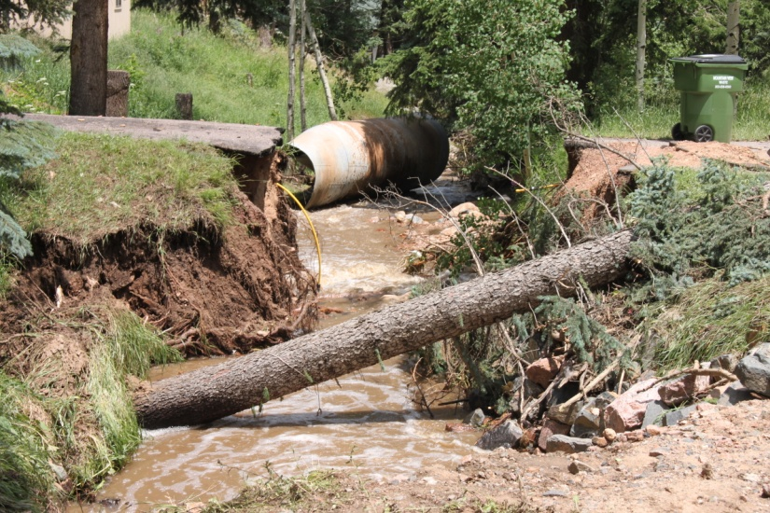
Active Nonpoint Source Management
Coyote Gulch - Trade Poundage Allocation
Septic Systems – Kerr & Cub
Tracking management practices
Fourteen zoning and planning reviews for BMPs
>22 local presentations, education programs
Assist invasive species programs
Green Infrastructure projects
Wildfire assessment & source water protection
Erosion Control Reviews

Slide 27
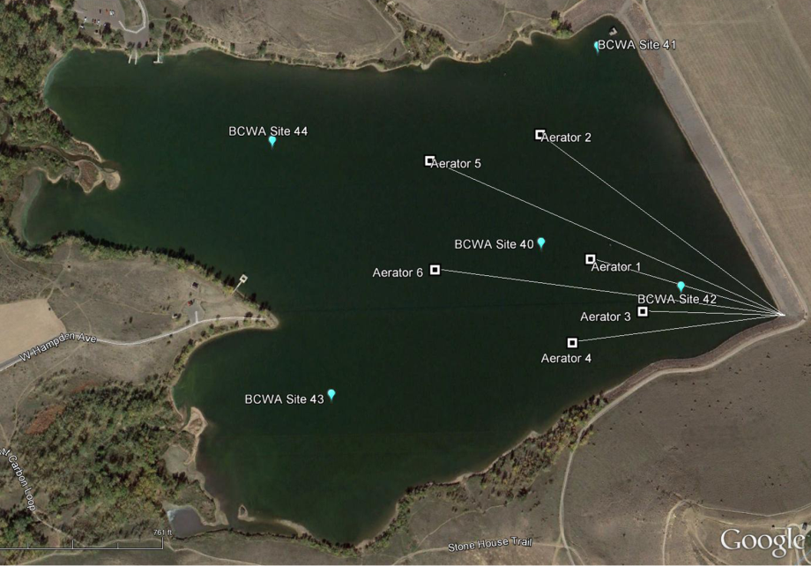
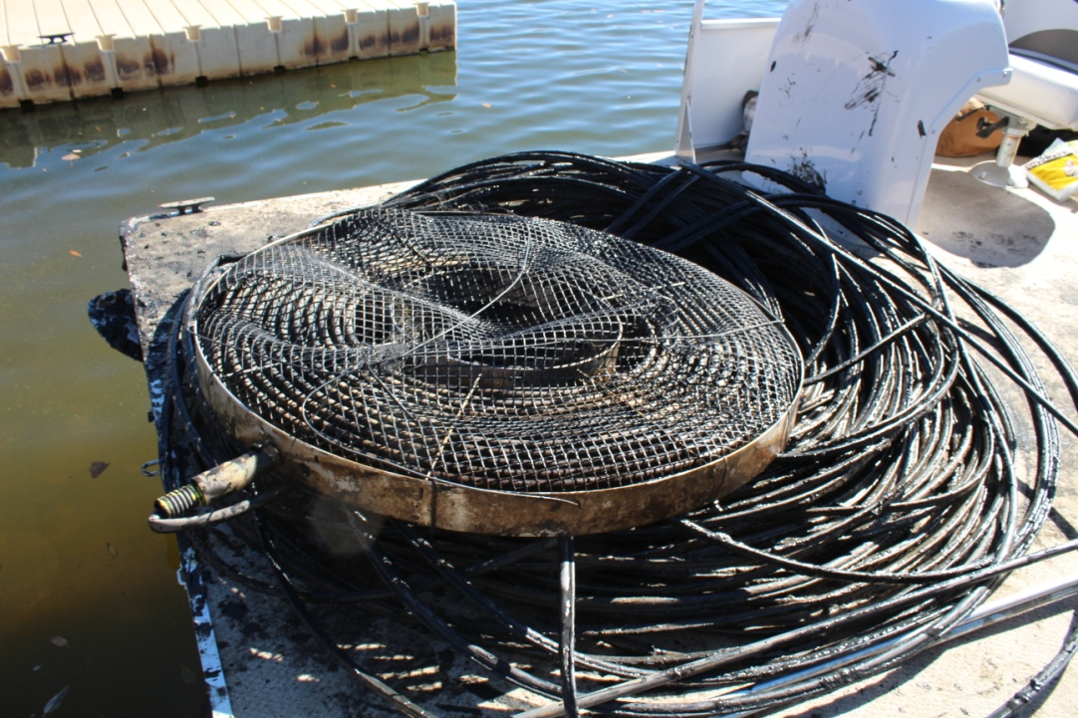
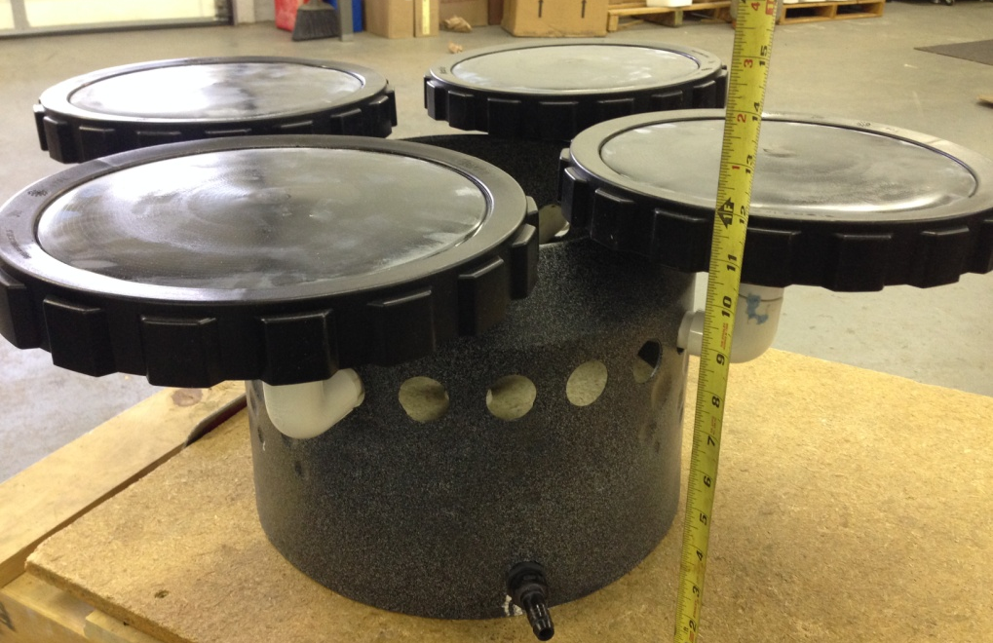
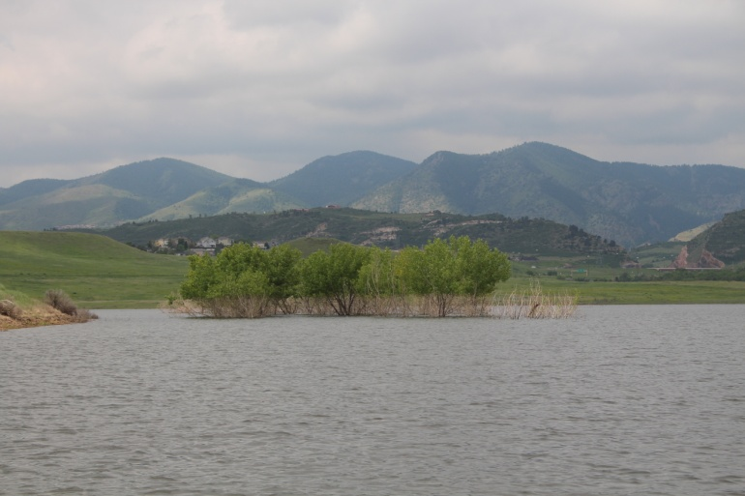
Replaced BCR Aeration System

Slide 28
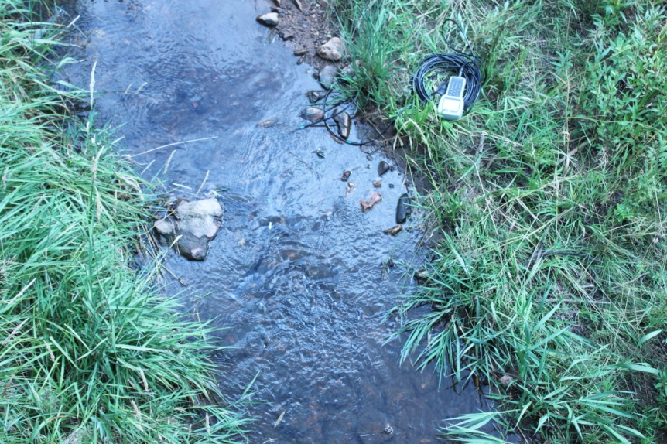
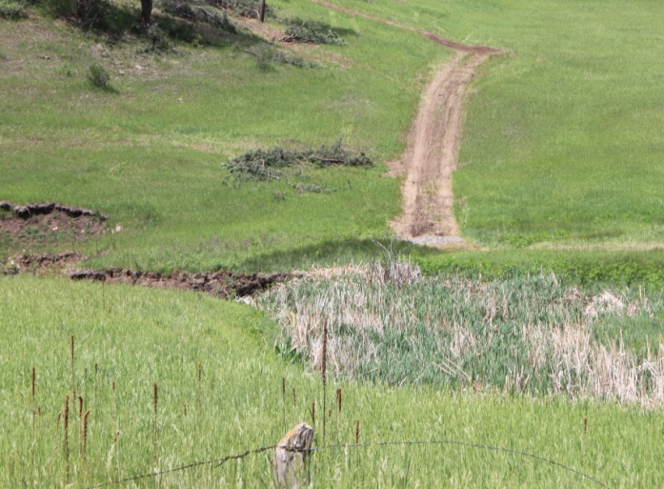
Kerr/ Swede Gulch
E. coli Summary, Geometric Mean
BCWA Site | 2010 | 2011
 | May-Dec | J-D (Annual) | Jan-Feb | Mar-Apr | May-Jun | Jul-Aug | Sep-Oct | Nov-Dec | May-Oct
 | n=36 | n=48 | n=8 | n=8 | n=8 | n=8 | n=8 | n=8 | n=24/6
Sites 52-53 |  |  | 14 | 2 | 6 | 5 | 6 | 2 | 6
Site 52 - Confluence | 10 | 6 |  |  |  |  |  |  | 15
Site 53 - Riefenberg | 13 | 4 |  |  |  |  |  |  | 9
Site 54 - Kerr | 16 | 5 |  |  |  |  |  |  | 3
Site 55 - Swede | 11 | 3 |  |  |  |  |  |  | 2
 |  | 2012
Sites 52-53 |  | 5 | 3 | 1 | 11 | 26 | 10 | 3 | 13
Site 52 - Confluence |  | 3 |  |  |  |  |  |  | 6
Site 53 - Riefenberg |  | 4 |  |  |  |  |  |  | 9
Site 54 - Kerr |  | 10 |  |  |  |  |  |  | 32
Site 55 - Swede |  | 3 |  |  |  |  |  |  | 13
 |  | 2013
Sites 52-53 |  | 3 | 2 | 1 | 9 | 14 | 1 | 3 | 5
Site 52 - Confluence |  | 2 |  |  |  |  |  |  | 4
Site 53 - Riefenberg |  | 2 |  |  |  |  |  |  | 5
Site 54 - Kerr |  | 6 |  |  |  |  |  |  | 14
Site 55 - Swede |  | 3 |  |  |  |  |  |  | 3
 |  | 2014
Sites 52-53 |  | 4 | 3 | 2 | 5 | 11 | 5 | 4 | 6
Site 52 - Confluence |  | 3 |  |  |  |  |  |  | 6
Site 53 - Riefenberg |  | 2 |  |  |  |  |  |  | 3
Site 54 - Kerr |  | 8 |  |  |  |  |  |  | 11
Site 55 - Swede |  | 6 |  |  |  |  |  |  | 7

Slide 30
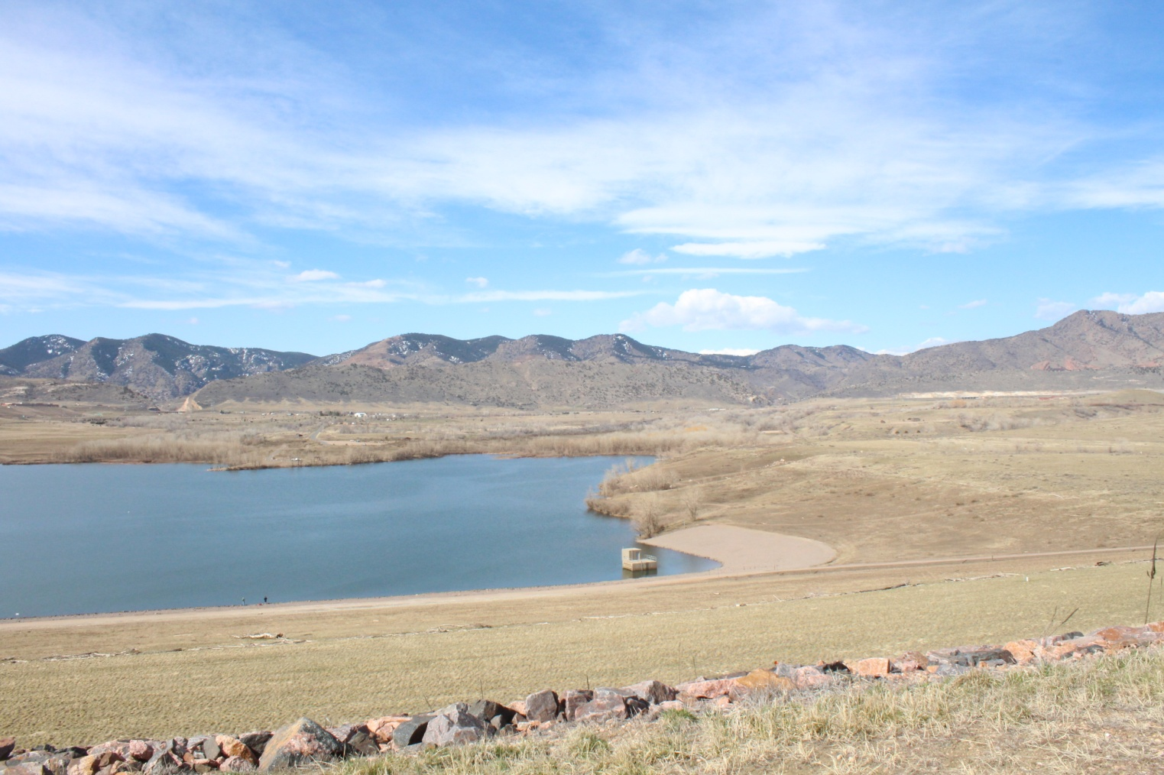

Slide 31
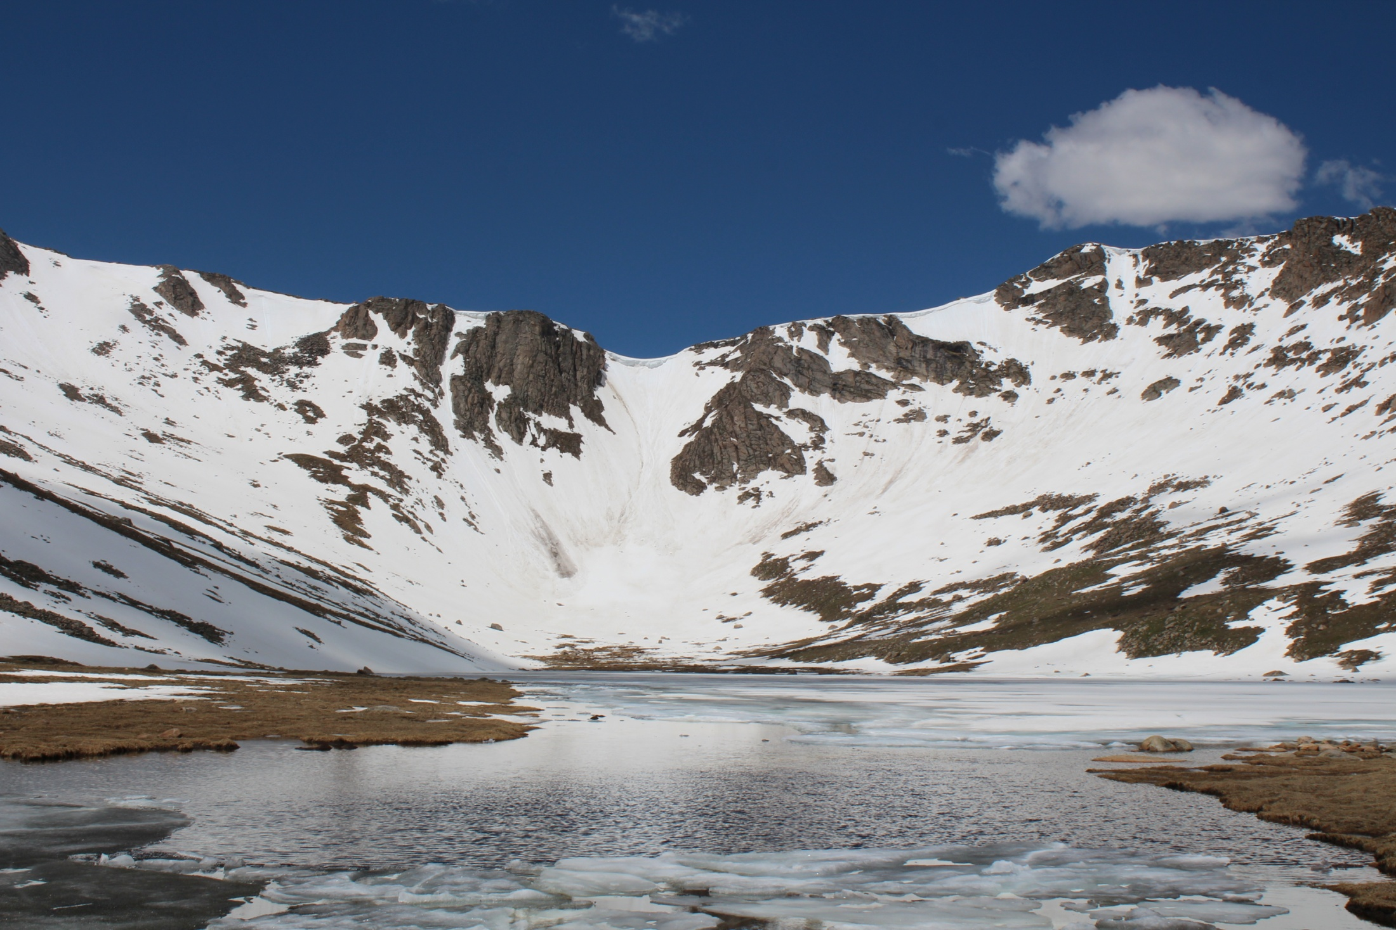

Slide 32
